Slide 1
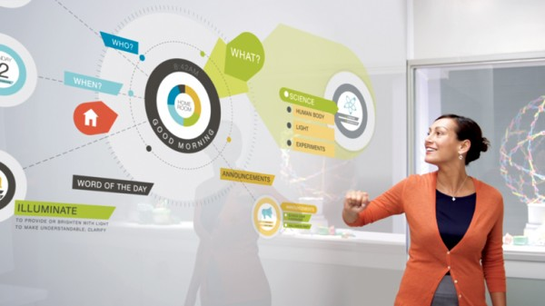
Teachers and Technology
Sandra Sembel

Slide 2
Introduction
3 TRUE
1 FALSE
I have one son
I like chocolate ice cream
I have a black belt in Karate
I drive to work every day

Slide 3
A glimpse to the future!
https://www.youtube.com/watch?v=jZkHpNnXLB0&list=PL363989F7BCF53A36
A Day Made of Glass 2

Slide 4
What are the words that come to mind? Title? Words?
Wordclouds
http://www.wordclouds.com/

Slide 5
Word Clouds

Slide 6
Learning Objectives
Peserta dapat menyebutkan alasan menggunakan teknologi dalam pengajaran
Peserta dapat menjelaskan berbagai manfaat pembelajaran dengan menggunakan teknologi.
Peserta dapat menjabarkan perubahan yang diperlukan dalam pengajaran dengan menggunakan teknologi.
Peserta dapat menyebutkan berbagai strategi pengajaran menggunakan teknologi.
Peserta dapat membuat contoh RPP yang menggunakan teknologi.
1. Alasan
2. Manfaat
3. Perubahan
4. Strategi pengajaran
5. RPP

Slide 7
K-W-H CHART

Slide 8
Alasan (reasons)
1. Alasan
Learning Objective 1

Slide 9
Video 1: Reasons!
https://www.youtube.com/watch?v=ulb4jl3xqs8

Slide 10
Think-Pair-Share

Slide 12
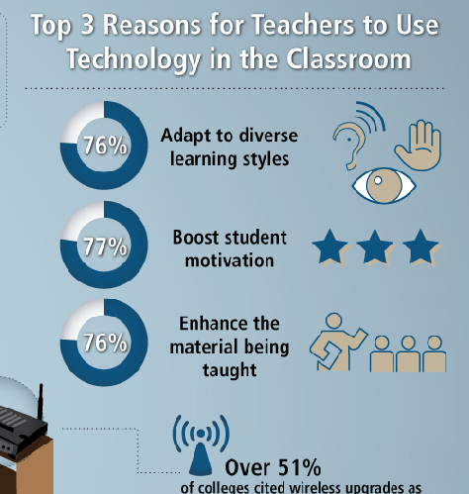

Slide 13
Revisit! K-W-H CHART 1: ALASAN

Slide 14
manfaat
2. Manfaat
Learning Objective 2

Slide 15
Benefits
Think-Pair-Share
1
Before
2
During
3
After

Slide 16
Benefits
1
Before
2
During
3
After
Researching
Immersing
Interacting
Pre-assignment
Reviewing
Engaging
Application
Exploring further

Slide 17
Manfaat
Engage
1
Resources
2
Beyond classroom
3
5
Multimedia
4
Collaborate
Real time
6

Slide 18
Revisit! K-W-H CHART 2: Manfaat

Slide 19
Perubahan
Learning Objective 3

Slide 20
Agree or Disagree
Knowledge is power
It is important for student to learn the subject matter
We help students understand the lesson

Slide 21
New Normal 1
Knowledge is Power
Learning Skill is Power

Slide 22
New Normal 2
You go to the Learning Centers
The Learning goes with You

Slide 23
New Normal 3
Learning Subject Matter
Researching Subject Matter

Slide 24
New Normal 4
Learning from the Teacher
Learning from other sources

Slide 25
New Normal 5
Single Focus
Holistic

Slide 26
New Normal 6
Submit Class Assignments
Publish Assignments

Slide 27
New Normal 7: Compete or collaborate?
Compete in the global market
Collaborate to make a better world

Slide 28
3rd Millennium-Ready Teachers
http://www.educatorstechnology.com/2012/08/the-21-signs-you-are-21st-century.html

Slide 29
Revisit! K-W-H CHART 3: Perubahan

Slide 30
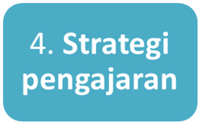
Strategi pengajaran
Learning Objective 4

Slide 31
Simple ways to

Slide 32
Strategies
Posters
Teachers?
Students?

Slide 33
Revisit! K-W-H CHART 4: Strategi

Slide 34
RFP
5. RPP
Learning Objective 5

Slide 35
Learning Phases
Pre
During
Post
Beyond

Slide 36
Elements of Lesson Plans
Lesson Description
Topic
Goal:
What is the primary purpose, main point of this class?
Objectives: Enabling objectives
Lesson Content and Instructional Procedures
Timing
Content
References
Evaluation Procedures
Materials and Aids

Slide 37
Revisit! K-W-H CHART 5: RFP

Slide 38
Reflection: Lessons Learned and Action Plan?
Hal penting yang saya pelajari hari ini?
Hal yang akan saya coba di kelas?

Slide 39
So, Remember ...
We prepare students for their FUTURE, not our PRESENT.
1

Slide 40
So, Remember ...
2
Use technology to support LEARNING (Don’t just simply fit learning for the sake of technology)

Slide 41
So, Remember ...
3

Slide 42
ssembel@gmail.com
Sandra Sembel (facebook)
sandrasembel (instagram)
Ssembel (twitter)

