Slide 1
Adopting and Adapting Materials

Slide 2
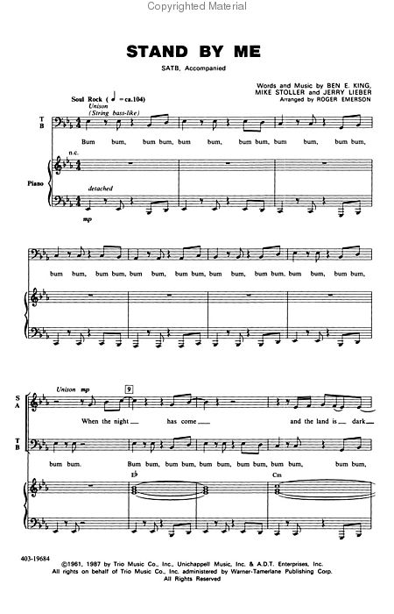
What is this?
Does it produce music on its own?
What or who makes this musical notes ‘alive’?

Slide 3
Just like musical notes that don’t make music,
Learning resources (textbooks) also don’t teach students.
They are just INSTRUMENTS that stimulate learning

Slide 4
Students are different
Here are five jumbled words to show how students are different from one another
City
Learning: 3 years
Song lyrics
Learning: 1 year
Movies
Small town
otiamotinv
urackrbondg
nopcetecem

Slide 5
Students are different
Here are five jumbled words to show how students are different from one another
City
Learning: 3 years
Song lyrics
Learning: 1 year
Movies
Small town
Motivation
Background
Competence

Slide 7
Adapt?
Adopt?

Slide 8
Learning Materials?
Adapt?
Adopt?

Slide 9
Adopt?
Adapt?
Learning Objectives
Content
Language
Culture
Activities
Available materials
Motivation
Background
Confidence
Competence
Interest
Complementary
Adopt?
Adapt?

Slide 10
Learning Materials

Slide 11
Principles
Strategies

Slide 12
Principles of Adopting and ADAPTING Learning Materials
Contextualize
Futurize
Personalize
Touch the heart
Touch the mind

Slide 13
Strategies
imslifpying
ediletng
Rearrange the jumbled letters
derorering
adding
fomdiy
cerapling

Slide 14
Strategies
Simplifying
Deleting
Reordering
Adding
Modifying
Replacing

Slide 15
Examples?

Slide 16
References
Cunningsworth, A. (1984). Evaluating and selecting EFL teaching materials. London: Heinemann Educational Books.
Islam, C., & Mares, C. (2003). Adapting classroom materials. In Tomlinson, B. (Ed.). Developing materials for language teaching. (PP. 86-107). London: Continuum
Tomlinson, B. (Ed.) 2003 . Developing materials for language teaching. (PP. 107-129). London: Continuum.

