Slide 1
Demo Teaching 1
Topic:
A ‘Thank You’ email

Slide 2
Name?
Time of day?
Where?
Activity?

Slide 3
Why do people write a ‘thank you’ email?

Slide 4
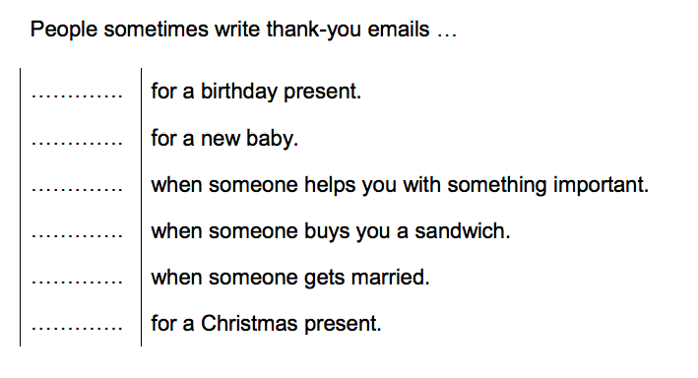
Why do people write ‘thank-you’ emails?

Slide 5
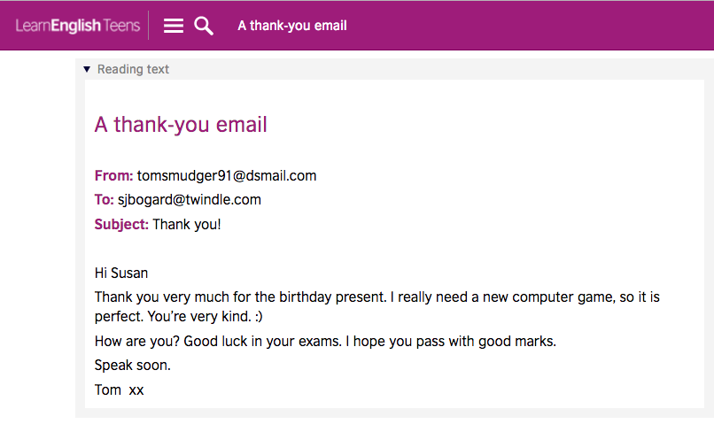
Sender?
Receiver?
Subject?
Salutation?
Message?
Closing?

Slide 6
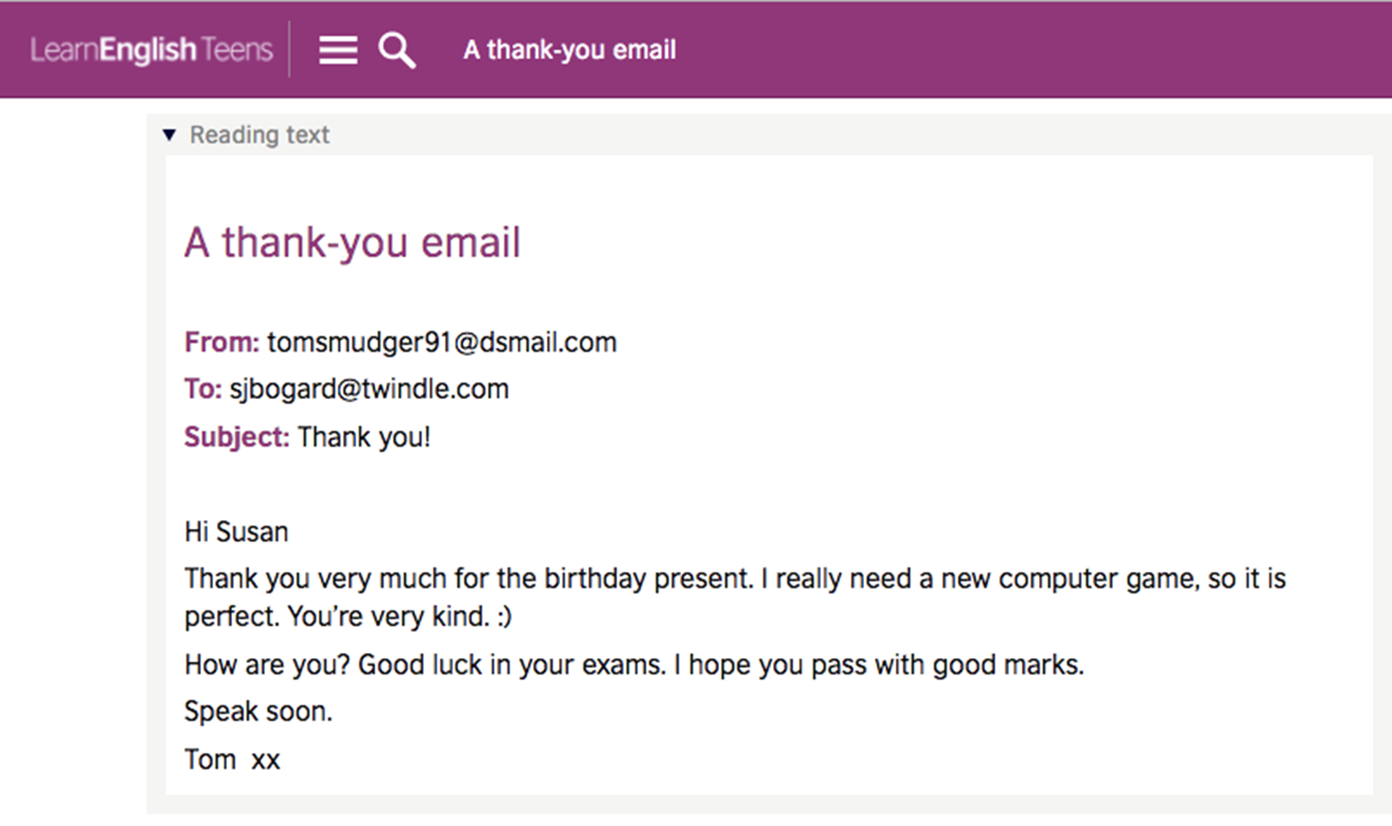
Do you remember?
Who is the writer of the email?
Who is the receiver?
Who has just celebrated birthday?
Who has exam to take?
What is the birthday gift?

Slide 7
Email
Email address
Receiver
Sender
Subject
Salutation
Message
Closing

Slide 8
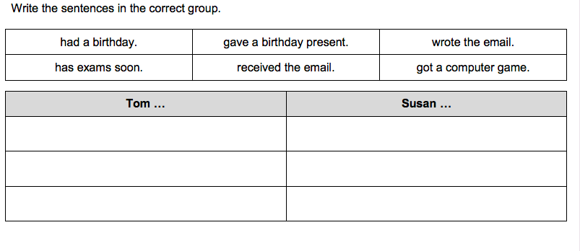
Checking your understanding

Slide 9
Checking your understanding
Had a birthday
Gave a birthday present
Write the email
Had exams soon
Got a computer game
Received the email

Slide 10
Rearrange the following strips.
A | How are you? Good luck in your exams.
B | Speak soon, Tom.
C | Thank you very much for the birthday present.
D | Hi Susan,
E | I hope you pass with good marks.
F | I really need a computer game, so it is just a perfect gift. You are very kind.

Slide 11
Rearrange the following strips.
D | Hi Susan,
C | Thank you very much for the birthday present.
F | I really need a computer game, so it is just a perfect gift. You are very kind.
A | How are you? Good luck in your exams.
E | I hope you pass with good marks.
B | Speak soon, Tom.

Slide 12
Group writing
Write the salutation.
Say thank you for the _______.
Say it is what you need and you’ve been wanting to buy it.
Tell the person that he/she is very kind.
Wish the person all the best for his/her _____.
Tell the person you will talk to him/her soon.
End with a complimentary closing.

Slide 13
Individual writing
Who is the receiver?
Why are you thanking him/her for?
Say something nice about the gift.
Wish the person something good.
End the message with a hope to meet the person soon.
Close with a complimentary closing.

Slide 14
Reflective Learning
I like _____________ from this session.
From this session, I learned _____.
I think I can try (name of an activity) in my class.

