Slide 1
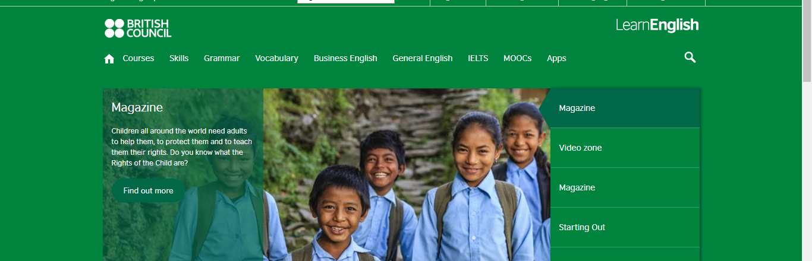
Learnenglish.britishcouncil
https://learnenglish.britishcouncil.org/en

Slide 2
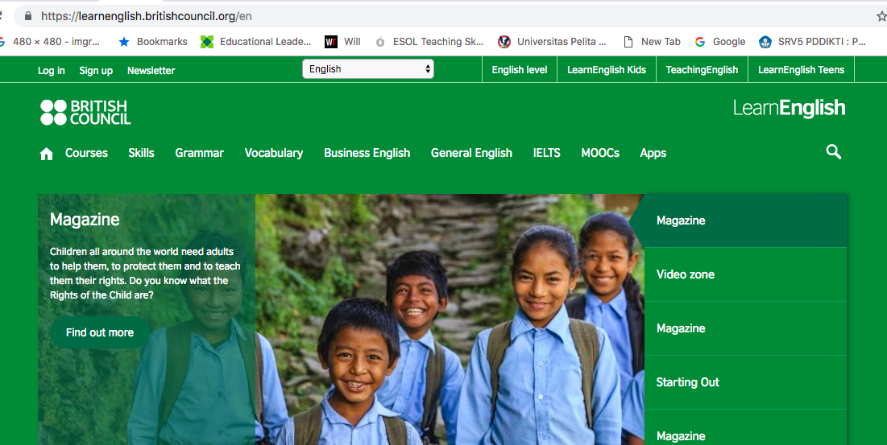
Click and see at least different sections.

Slide 3
Task 1 Explore
Explore learnenglish website
1
Which different sections did you CLICK and SEE?
2
Which one struck you most? Why?
3
Which one is most likely be used in your class? Ideas?
4
https://learnenglish.britishcouncil.org/en

Slide 4
Think, Pair, Share
Questions | You | Friend 1 | Friend 2
1. Which sections did you click and see?
2. Which section struck you most?
3. Which section do you think you will try to integrate in your class.

Slide 5
Share and Grow
From the sharing session, is there anything you would add to your list of interesting findings?

Slide 6
Report it to the class
Now, report your interesting findings to the class.

