Slide 2
Sandra Sembel
1. How do I teach big classes?
2. Should I integrate technology in the classroom?

Slide 4
Topic 1
Topic 2
Topic 4
Topic 3
Profile of Students
School library
Classroom management
Fellow teachers
Lesson planning
Digital technology
Further education
Handling difficult students
Using books from the library
…. Etc.

Slide 5
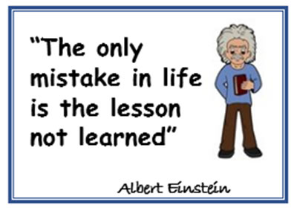
So, what’s the lesson learned from the introduction session?

