Slide 1


KOMUNIKASI PEMASARAN BERDAYA SAING BAGI LEMBAGA KURSUS BAHASA INGGRIS LBPP-LIA DALAM DISRUPTIVE ERA
Dr. MARGARETHA PINK BERLIANTO* (KETUA)
DR. INNOCENTIUS BERNARTO
DR. MOSES L. HUTABARAT
J. SANDRA SEMBEL, M.M
YOHANA F. CAHYA PALUPI MEILANI, M.Si
FEB-Universitas Pelita Harapan

Slide 2
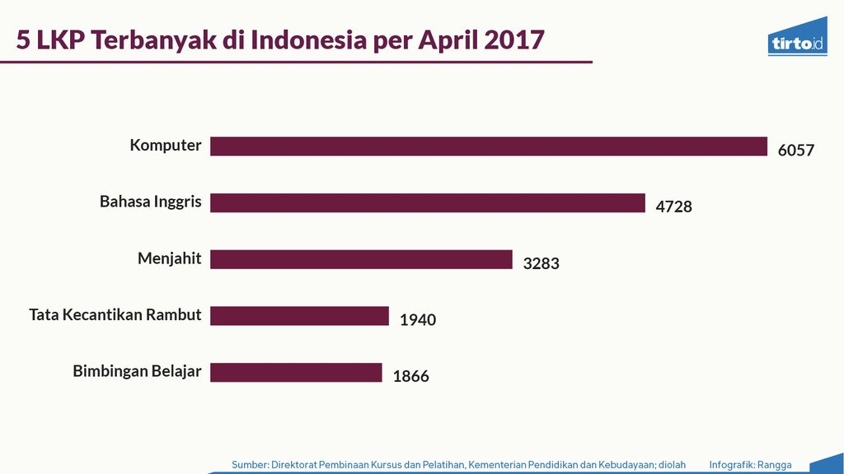

Slide 3
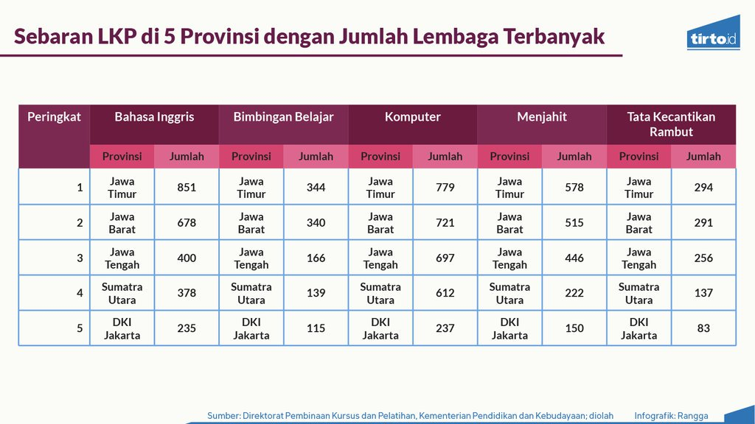

Slide 4

Inovasi baru masuk ke pasar & menciptakan efek disrupsi cukup kuat mengubah struktur pasar sebelumnya.
Fenomena efek disrupsi saat ini. Contoh, RUANG GURU PEMBELAJARAN SECARA daring, dan berbagai marketplace online yang cukup mengubah tren jual beli termasuk pada industri jasa kursus bahasa Inggris
Era disrupsi ini tidak dapat disepelekan karena bisa saja perusahaan Anda yang na.nti akan terkena DAMPAKNYA.
DISRUPTIVE ERA

Slide 5
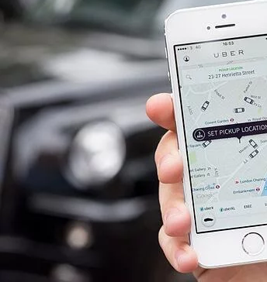
GUNAKAN PEMANFAATAN TEKNOLOGI UNTUK MERAIH PROSES PEMBELAJARAN DAN KONSUMEN

Slide 6
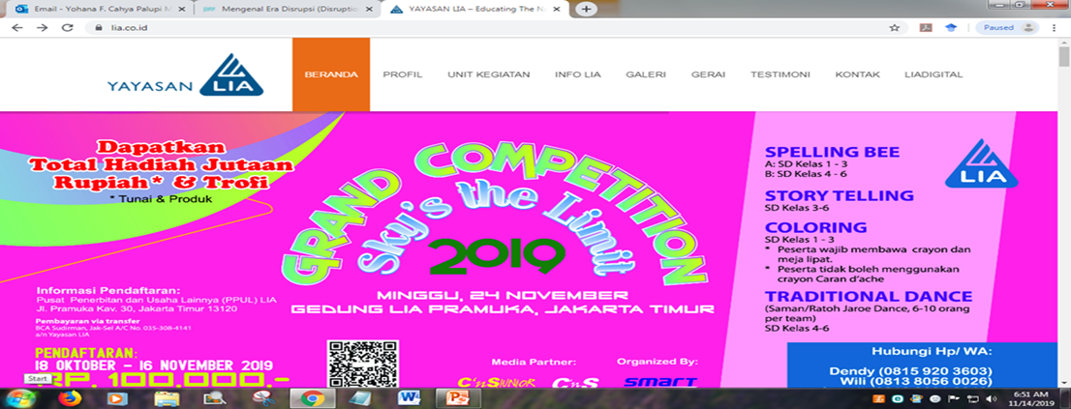
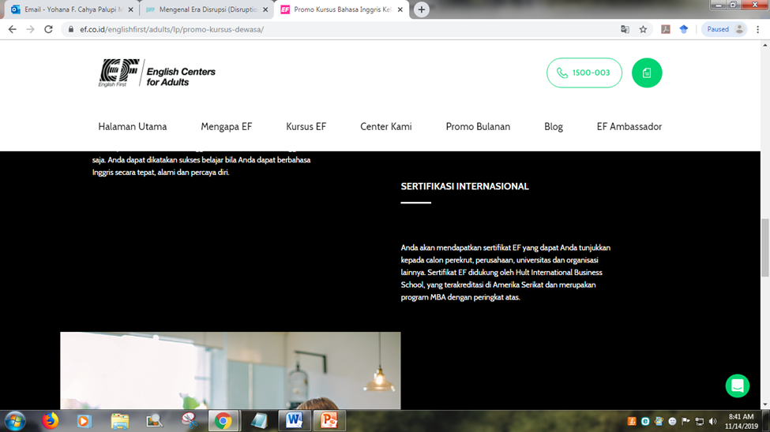

Slide 7
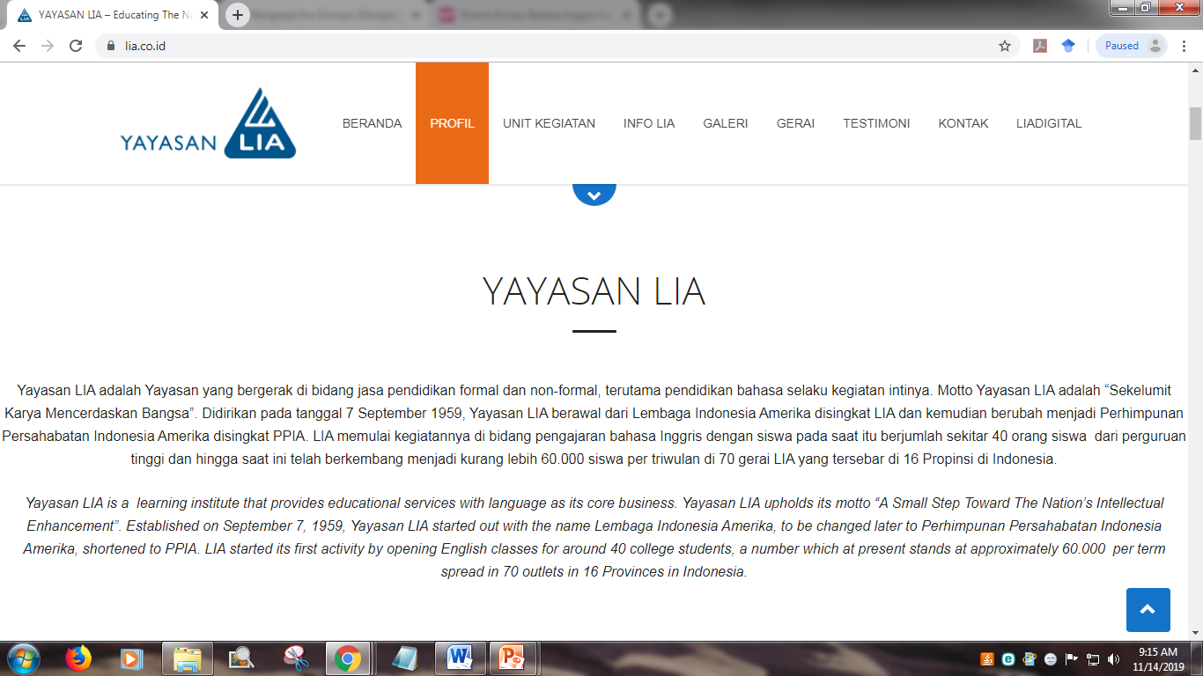

Slide 8
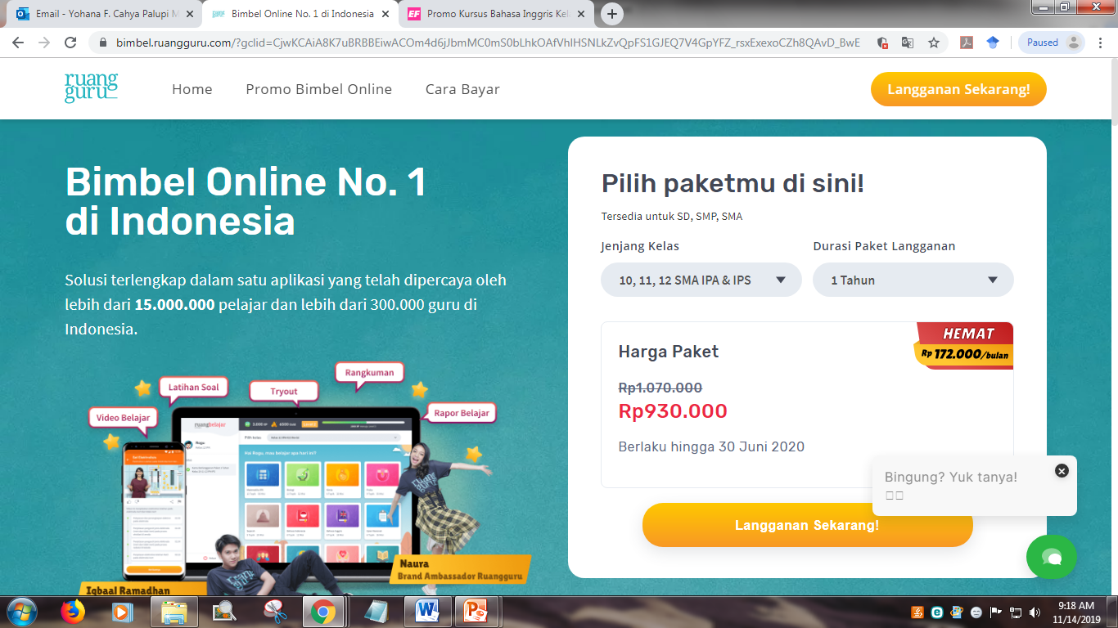

Slide 9
MASALAH
Kian banyaknya waralaba kursus dari luar negeri.
Banyaknya kursus gratis didanai pemerintah sebagai salah satu program pelatihan dan penyaluran kerja guna mengatasi masalah pengangguran.
Akibatnya, dengan bertumbuhnya kursus asing di Indonesia yang biasanya masuk dalam bentuk waralaba berkualitas, lembaga kursus yang tidak profesional akhirnya tutup.
Lembaga kursus LBPP-LIA dituntut membenahi manajemen kelembagaannya seiring dengan semakin ketatnya persaingan tersebut.
TUJUAN Masyarakat tahu, mengenal jasa yang ditawarkan dan tertarik untuk mengikuti LBPP-LIA
PERLU KOMUNIKASI PEMASARAN YANG BERDAYA SAING
Komunikasi pemasaran merupakan pertukaran informasi dua arah antara pihak atau lembaga yang terlibat dalam pemasaran. Semua pihak yang terlibat dalam proses komunikasi pemasaran melakukan cara yang sama, yaitu mendengarkan, bereaksi, dan berbicara sampai tercipta hubungan pertukaran yang memuaskan.

Slide 10
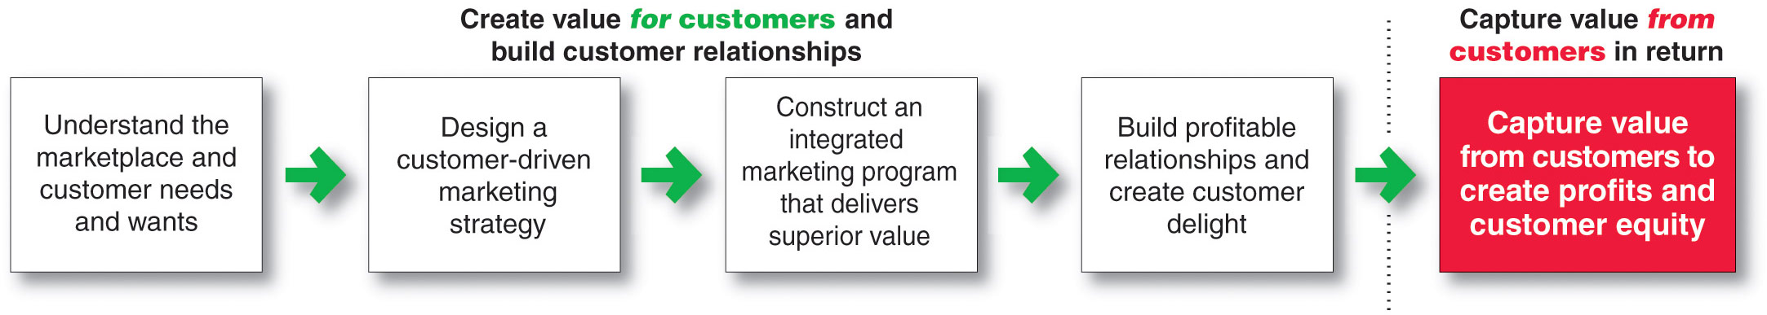
Marketing Process *
Notes:
This important figure shows the simple, five-step model of the marketing process. By creating value for customers, marketers capture value from customers in return.
This five-step process forms the marketing framework for the rest of the chapter and the remainder of the book.
In the first four steps, companies work to understand consumers, create customer value, and build strong customer relationships.
In the final step, companies reap the rewards of creating superior customer value. By creating value for consumers, they in turn capture value from consumers in the form of sales, profits, and long-term customer equity.
In this chapter, we review each step but focus more on the customer relationship steps—understanding customers, building customer relationships, and capturing value from customers..
Marketing is all about creating value for customers. So, as the first step in the marketing process, the company must fully understand consumers and the marketplace in which it operates.

Slide 11
Understanding the Marketplace and Customer Needs*
Customer Needs, Wants, and Demands
Needs
Physical—food, clothing, warmth, safety
Social—belonging and affection
Individual—knowledge and self-expression
Wants
Demands
Form that needs take as they are shaped by culture and individual personality
Wants backed by buying power
States of deprivation
Copyright ©2014 by Pearson Education
Notes:
Discussion Question:
Ask the students to
1) give an example of a product (good or service) they purchased recently
2) Tell how did that product satisfy a need, want or desire.
Marketing must be understood in the new sense of satisfying customer needs.
Human needs are states of felt deprivation. They include basic physical needs for food, clothing, warmth, and safety; social needs for belonging and affection; and individual needs for knowledge and self-expression.
Marketers did not create these needs; they are a basic part of the human makeup.
Wants are the form human needs take as they are shaped by culture and individual personality. An American needs food but wants a Big Mac, french fries, and a soft drink. A person in Papua, New Guinea, needs food but wants taro, rice, yams, and pork. Wants are shaped by one’s society and are described in terms of objects that will satisfy those needs. When backed by buying power, wants become demands. Given their wants and resources, people demand products with benefits that add up to the most value and satisfaction.
Outstanding marketing companies go to great lengths to learn about and understand their customers’ needs, wants, and demands. They conduct consumer research and analyze mountains of customer data.

Slide 12
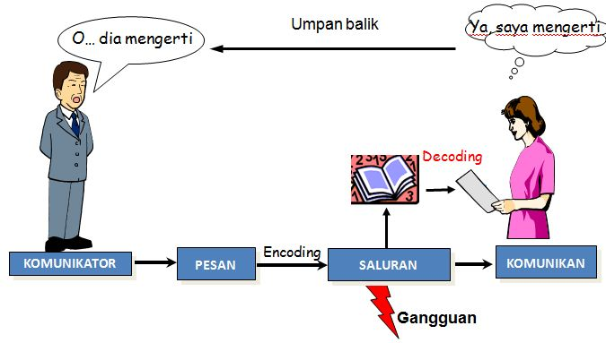
PROSES KOMUNIKASI

Slide 13
Faktor komunikasi
Siapa
Pesan
Media
Tempat
Situasi

Slide 14
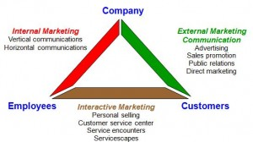

Slide 15

Tahapan Membangun Komunikasi yang Efektif
Tahap 1. Mengidentifikasi Audiens Sasaran
Tahap 2. Menentukan Sasaran
Tahap 3. Merancang Pesan
Tahap 4. Memilih Media
Tahap 5. Memilih Sumber Pesan
Tahap 6. Mengumpulkan Umpan Balik

Slide 16
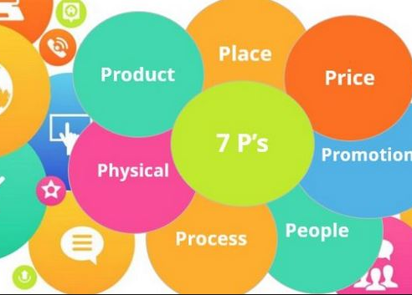

Slide 17
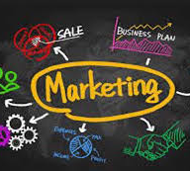
FOKUS BAHASAN 7P pada BAURAN PROMOSI
Konsep yang secara umum sering digunakan untuk menyampaikan pesan disebut sebagai bauran promosi (promotional mix).
Disebut bauran promosi karena biasanya pemasar sering menggunakan berbagai jenis promosi secara simultan dan terintegrasi dalam suatu rencana promosi produk

Slide 18

Bauran Promosi
Periklanan
Personal selling
Promosi Penjualan
Public Relations
Pemasaran Langsung
Digital Marketing

Slide 19
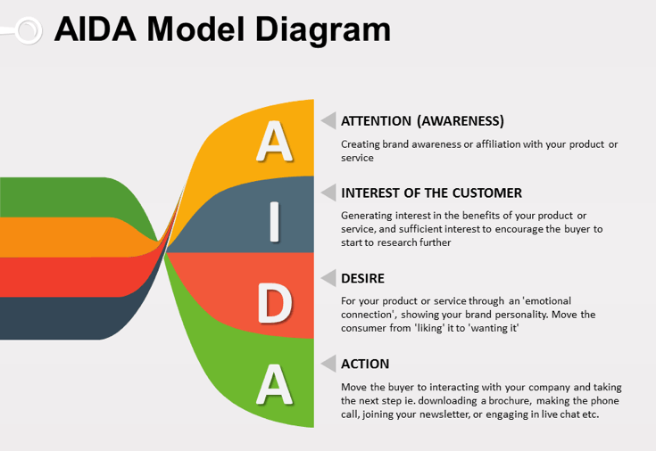

Slide 20
Understanding the Marketplace and Customer Needs
Customer Value and Satisfaction
Expectations
Customers
Value and satisfaction
Marketers
Set the right level of expectations
Not too high or low
Copyright ©2014 by Pearson Education
Notes:
Note to Instructor:
Discussion Question
Ask students what online retailers deliver exceptional value and satisfaction.
Why do marketer’s not always understand customer needs? How can they better identify customer needs?
Marketer’s often work in a vacuum and do not consider the customer’s needs as much as they should. Future chapters will talk about market research and marketing information, important tools for understanding customer’s needs. Students might be familiar with survey research or focus groups as techniques for gathering information or they might be asked for their zip code when they purchase in certain retailers
Marketers must be careful to set the right level of expectations. If they set expectations too low, they may satisfy those who buy but fail to attract enough buyers. If they set expectations too high, buyers will be disappointed. Customer value and customer satisfaction are key building blocks for developing and managing customer relationships.

Slide 21
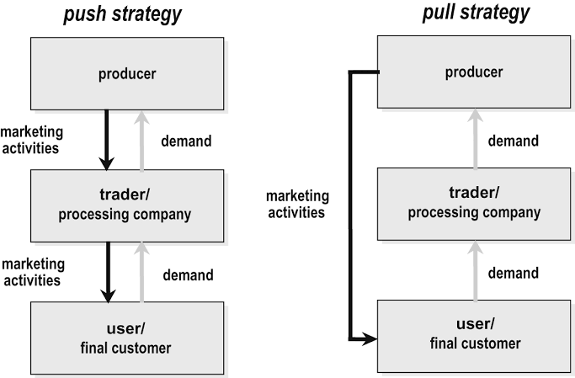
Strategi perusahaan dalam menentukan bauran promosi:
Push Strategy: Trade shows, coupons
Pull Strategy: WoM, Positive Reviews, Ratings, Social media, Ads
Company – intermediary -- Users
Company – Users -- Intermediary

Slide 22
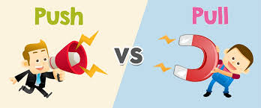
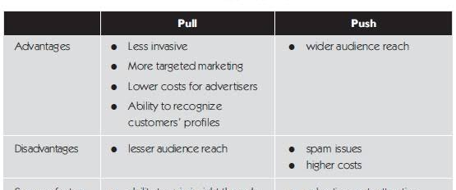
Push and Pull Strategies

Slide 23
Segmentation, Targeting, Positioning
S
Demographic (Who)
Psychographic (Why)
T
Size and growth
Difference
P
Attribute or benefit
Quality and price
Lifestyles (How)
Beliefs and Values
Accessibility
Compatibility
Use or user
Marketing Mix
Undifferentiated
Differentiated (Segmented)
Concentrated (niche)
Micro Marketing

Slide 24
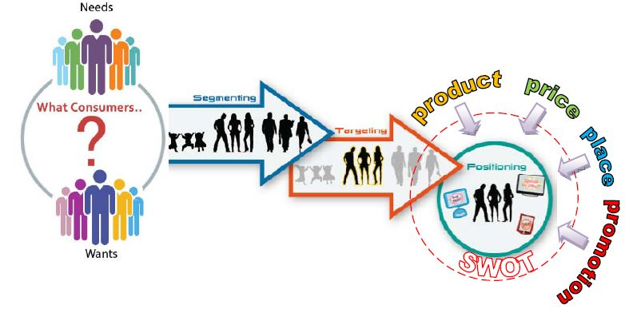
STP
S: Identify meaningful group of customers
T: Select which segment(s) to serve
P: Design marketing mix to attract the targeted segments

Slide 25
Go-to-Market Strategy
What to sell
How to sell
Who to Sell

Slide 26

Mengintegrasikan Bauran Promosi
Mengaudit pengeluaran komunikasi.
Mengidentifikasi kontak poin.
Membangun tim komunikasi.
Buat seluruh unsur komunikasi yang sesuai satu dengan lainnya
Buat ukuran dari seluruh unsur.
Menunjuk orang yang bertanggungjawab.
Menganalisis trend.

Slide 27

DAMPAK KOMUNIKASI PEMASARAN
https://www.youtube.com/watch?v=1koBSRw-dm0https://www.youtube.com/watch?v=1koBSRw-dm0

Slide 28
REFLEKSI LBPP-LIA:
Membuat SWOT LBPP –LIA berkaitan BAURAN PROMOSI yang sudah dilakukan oleh organisasi LBPP-LIA.
DIBAGI 10 ORANG per grup untuk berdiskusi selama 30 menit (break) hasil diskusi dipresentasikan pada sesi berikutnya
PEMBAHASAN PADA SESI II AKAN DIPANDU OLEH DR. MOSES L. HUTABARAT

Slide 29

Sesi II Building Customer Relationships
Customer Relationship Management (CRM)
The overall process of building and maintaining profitable customer relationships by delivering superior customer value and satisfaction
Copyright ©2014 by Pearson Education
Notes:
The first three steps in the marketing process—understanding the marketplace and customer needs, designing a customer-driven marketing strategy, and constructing a marketing program—all lead up to the fourth and most important step: building and managing profitable customer relationships.
Customer Relationship Management
Customer relationship management is perhaps the most important concept of modern marketing. Some marketers define it narrowly as a customer data management activity (a practice called CRM). By this definition, it involves managing detailed information about individual customers and carefully managing customer touchpoints to maximize customer loyalty.
Most marketers, however, give the concept of customer relationship management a broader meaning. In this broader sense, customer relationship management is the overall process of building and maintaining profitable customer relationships by delivering superior customer value and satisfaction. It deals with all aspects of acquiring, keeping, and growing customers.

Slide 30
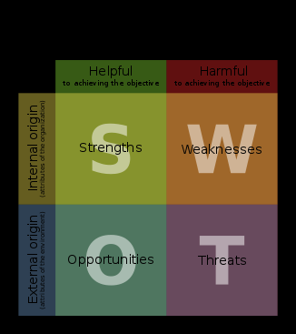

Slide 31


Slide 32
References
For STP
Lancaster G. and Massingham, L. (1988) Essentials of Marketing. Maidenhead, Berkshire, England. McGraw-Hill.
Smith, W. R. (1956). Product differentiation and market segmentation as alternative marketing strategies. Journal of Marketing. (Vol. 21, Issue 1, July). p3-8.

