Slide 1
Instructional Designing for Integrating Faith and Learning
Sandra Sembel, Elysabeth Dame Tarihoran, and R. Marlyn Sihombing
Universitas Pelita Harapan

Slide 2
Good Afternoon!
Marlyn Sihombing
Sandra Sembel
Elysabeth Tarihoran

Slide 3
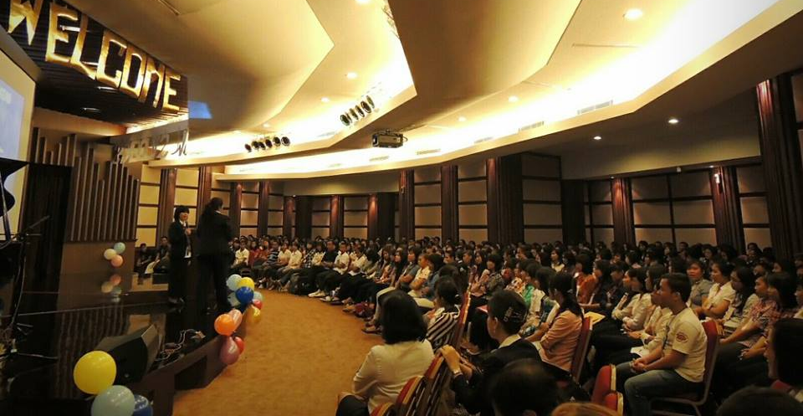
Integrating Faith and Learning?
How we thought about it, think about it, plan around it, and share about it

Slide 4
Which do you like better?

Slide 5
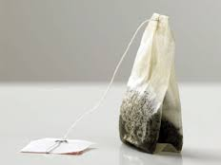
Our understanding of integrating Faith and Learning

Slide 6
Our understanding of integrating Faith and Learning
Wiser?

Slide 7
Integration?

Slide 8
Our students!

Slide 9
Integrating Faith and Learning
Christ
Learning
Practice
Living
Faith

Slide 10
Integrating Faith and Learning
The fear of the Lord is the beginning of knowledge; fools despise wisdom and instruction. (Proverbs 1: 7)
All Scripture is breathed out by God and profitable for teaching, for reproof, for correction, and for training in righteousness, (2 Timothy 3: 16)

Slide 11
HOW?
Tools that we use

Slide 12
Instructional Design Tools
Level of Learning: Bloom’s Taxonomy
Sequence of Activities: Gagne’s Learning Events
Instructional Design Model: ADDIE

Slide 13
Group Activity

Slide 14
Levels of Learning (Bloom’s)

Slide 15
Learning Events (Gagne)
Gain attention
Objectives
Recall of relevant prior learning
Present content
Provide guidance
Elicit performance
Give Feedback
Evaluate
Enhance transfer

Slide 16
Instructional Design Model: ADDIE
Cited in: In Search of the Elusive ADDIE Model, Michael Molenda, Indiana University, http://www.comp.dit.ie/dgordon/courses/ilt/ilt0004/insearchofelusiveaddie.pdf

Slide 17
Process
Analysis
Target Audience
Design
Course/Book
Development
First Draft
Implementation
Evaluation
Needs and interests
Problems
Unit
Editing and Revising
Try out
Feedback
Expert Review

Slide 18
Workshop

Slide 19
Design Document
What?
A document that includes design decisions
Components:
Section/Part
Objective of each section/part
Contents (descriptions and types)
Activities to present the contents
Visual display/organization
Assessment/Evaluation
Source:
http://blog.slickedit.com/2007/05/how-to-write-an-effective-design-document/

Slide 20
Let’s try!

Slide 21
Design Document: Example
Learning Event/ Section | Learning Obj | Contents | Activities | Visual Display (organization) | Assessment/ Evaluation
Gain Attention | Comprehend the meanings of the key words used in the text | Picture and words | Matching picture and words | Pictures + words (side by side) | Filling in the blanks with MC options
Present Materials

Slide 22
Types of Learning
Concepts
Learning Skills
Life Skills
Baumgartner & Kalz)

Slide 23
The Learning Pyramid
Lecturing
Reading
Audio Visual
Demonstration
Group Discussion
Practice
Teaching others

Slide 24
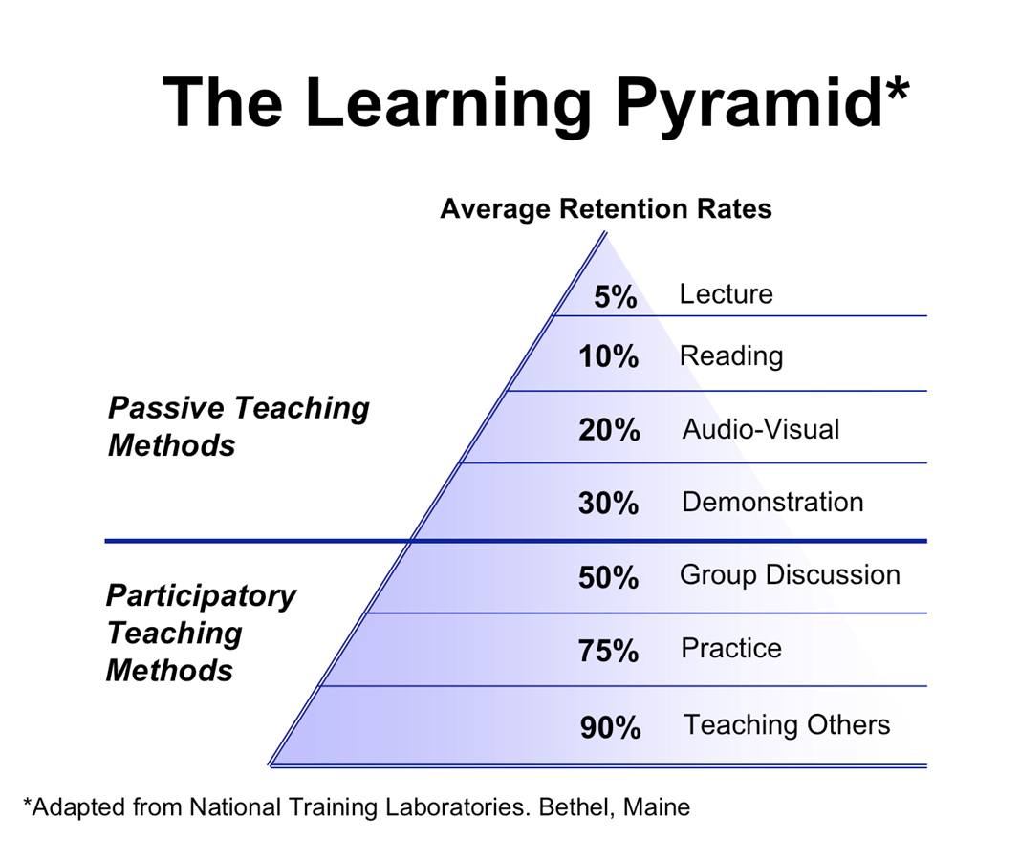

Slide 25
Contents
Concepts
Skills
Life skills: Attitudes/Values
Faith + Learning + Living

Slide 26
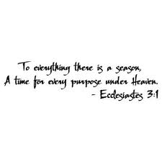
sandrasembel.weebly.com
"Dame E.T. Arna" elysabeth_tarihoran@uph.edu,
"Riama M. Sihombing" riama.sihombing@uph.edu,
"Sandra Sembel" <sandra.sembel@uph.edu>

Slide 27
Thank you and God bless you!
Do your best and let God take care of the rest

