Slide 1
E-learning Architecture
Sandra Sembel
ssembel@gmail.com

Slide 2
Roles of e-learning?
Pre-learning
Learning
Post-learning
Knowledge Management
Assessment
Assessment
Assessment

Slide 3
E-Learning Architecture
Pure
E-learning
F2F
E-learning Support

Slide 4
E-Learning Architecture
Blended Learning
Elearning
F2F
F2F
E-learning

Slide 5
Blended: Flip approach
Briefing
E-learning
Face-to-face
Field practice
E-learning
Elearning support
Elearning support

Slide 6
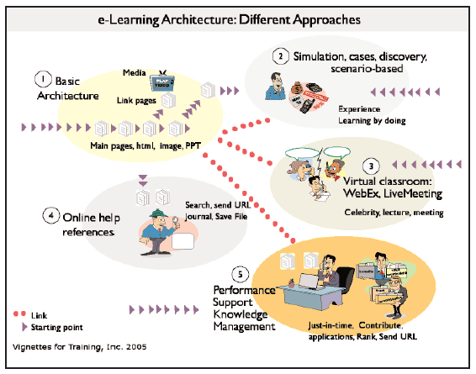
http://www.learningsolutionsmag.com/articles/247/

Slide 7
Download the ppt at sandrasembel.weebly.com

