Slide 1
8 Principles of Differentiated Instructions
(from Carol Tomlinson’s Differentiated Instructions: http://www.caroltomlinson.com/Presentations/Tomlinson%20&%20Murphy%20Learning%20Forward%202014.pdf)

Slide 2
DI

Slide 3
Principle 1: Content
Objectives
Information
Skills
Teacher is clear about what matters in content area.
Guru memiliki pemahaman dan gambaran yang jelas tentang hal yang penting dari CONTENT (materi pembelajarn)

Slide 4
Principle 2: Differences
Teacher understands, appreciates, and builds upon student differences
Guru memahami, mengapresiasi, dan mengembangkan pembelajaran yang memperhatikan perbedaan siswa
Readiness
Interest
Learning profile

Slide 5
Principle 3: Assesment and instructions
Assessment and instruction – inseparable
Pengkajian dan pengajaran merupakan bagian yang tak terpisah
1
2
3
Assessment + instruction at every level along the way

Slide 6
Principle 4: Adjustment
Teacher adjusts content, process and product in response to student readiness, interests, and learning profiles
Guru menyesuaikan konten, proses dan produk sebagai respon terhadap kesiapan, minat dan profil belajar siswa
Content, process, product
Readiness, inerest, learning profiiles

Slide 7
Principle 5: Respectful work
All students participate in respectul work
Semua siswa berpartisipasi dalam tugas dengan saling menghormati
Groups, pairs
Discussion
Sharing

Slide 8
Principle 6: S-T Collaborators
Students and teachers are collaborators in learning
Siswa dan guru adalah mitra kerjasama dalam pembelajaran
Time
Start
Topic
Test

Slide 9
Principle 7: Goals
Goals are maximum growth and continued success
Tujuannya adalah pertumbuhan yang maksimum dan keberhasilan yang terus menerus
Above
Expectation
Below

Slide 10
Principle 8: Flexibility
Flexibility is the hallmark of a differentiated classroom
Fleksibilitas menjadi kunci dari kelas diferensiasi
Responding to the needs of all learners
Alternative learning roadmaps
(relevant, meaningful, potential exploring)

Slide 11
Differentiated Instructions

Slide 12
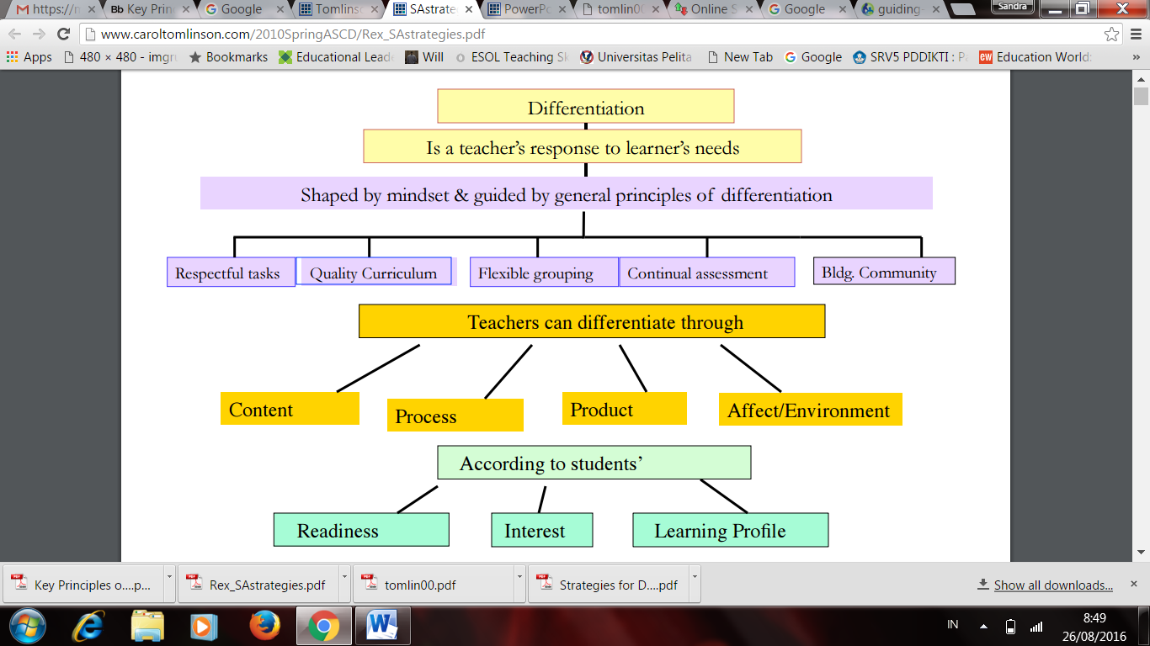
Source: http://www.caroltomlinson.com/2010SpringASCD/Rex_SAstrategies.pdf

