Slide 1
Critical issues in Planning, Design and Development
Sandra Sembel

Slide 2
Key Considerations
E-Learning
Learning Goals
Leadership
Teaching staff
Technology
Learners

Slide 3
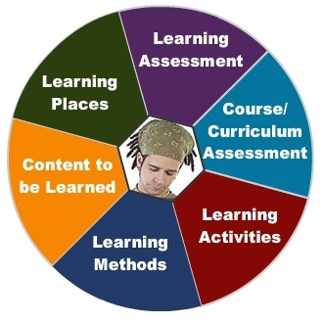
Design Considerations: Learner is the center

Slide 4
Key design questions
What do we want our learners to do?
How do we help them achieve it?
How do we know that they have learned what we want them to do?
What kind of support do they need?

Slide 5
Key Answers
Learning Goals and Objectives
Learning Activities and Experiences
Learning Evaluation
Learning and technology support

Slide 6
Learning goals and objectives
Focus on RELEVANCE
Have CLEAR learning outcomes
Goals
Can be clearly demonstrated
Solutions
Readiness
Needs

Slide 7
Learning Activities and Experiences
Prepare them for the activities
Guide them throughout the activities
Monitor and Mentor their progress
Give them the means to explore the activities
Give them the opportunity to explore beyond the activities

Slide 8
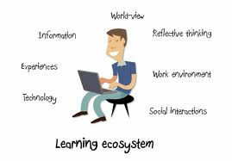
Learning Ecosystem

Slide 9
Learning Evaluation
Give them sufficient time and variety of activities to demonstrate what they have learned
Give them the tools to demonstrate what they have learned
Give them feedback for improvement

Slide 10
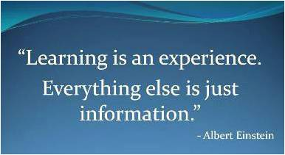

Slide 11
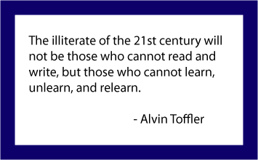

Slide 12
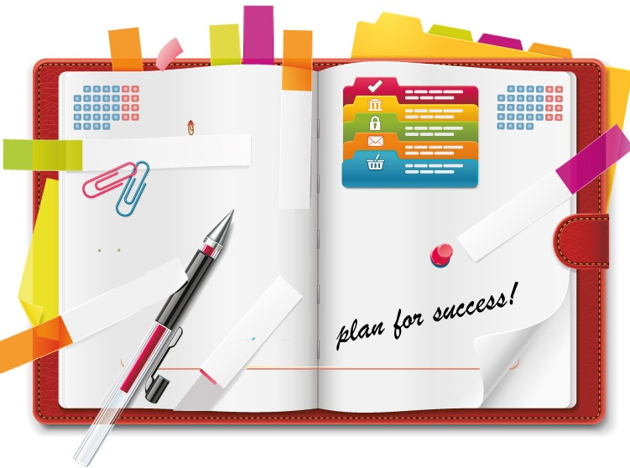
Thank you and have a great day!
sandrasembel.weebly.com
ssembel@gmail.com
Facebook: sandra sembel
Twitter: @ssembel

