Slide 1
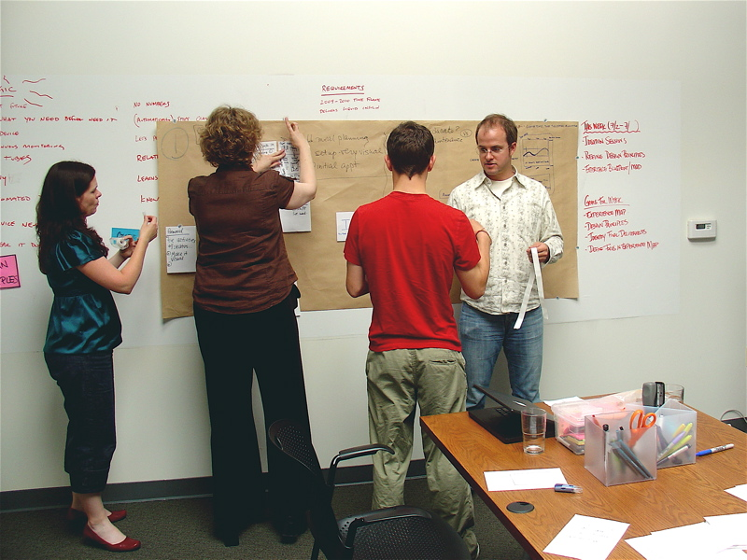
The essentials of Learning and ISD
ssembel@gmail.com

Slide 2
Learning?
Listening
Reading
Watching
Doing
Choosing
Creating

Slide 3
E-Learning?
E-learning is the use of information and computer technologies to create learning experiences that lead to a change in knowledge, skills and attitude

Slide 4
Instructional Design?
Strategies to transform information into learning experiences that produce desired changes (through a variety of learning activities, technology and media)

Slide 5
2. The essentials of learning, and ISD
L E A R N I N G
Need and Problem
→ Goals
Conventional Learning
E-learning
Classroom
On-the-job
Field
INSTRUCTIONAL DESIGN STRATEGIES
Decisions
Motivation
Ease
Interesting
L E A R N I N G G A I N
CHANGE
Solution →
Gains
Knowledge
Skills
Attitude

