Slide 1
We do not learn from experience... We learn from reflecting on experience.
John Dewey

Slide 2
So, what do you remember from the previous discussion?

Slide 3
The How? (Sharing some practical strategies)
1
Learning from researching
2
Learning from collaborating
3
Learning from problem solving
4
Learning from doing real project
5
Learning from publishing or performing

Slide 4
Finally.....

Slide 5
Remember ...
1
We prepare students for their FUTURE, not our PRESENT.

Slide 6
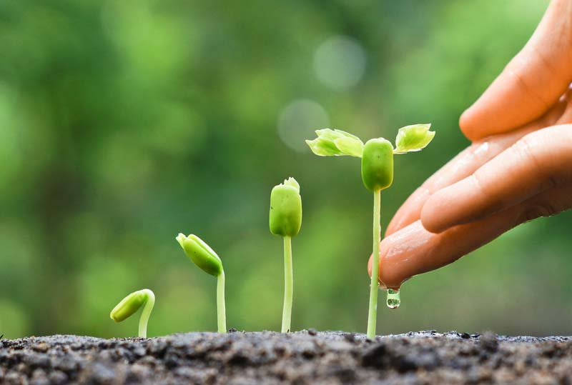
2
Whether we like it or not, technology is here and has become the game changer of the way our students learn and live.
Nurture their learning by providing SMART learning environments using technology that transform learning into living.

Slide 7
3
Use technology to transform LEARNING (Don’t just simply fit learning for the sake of technology)

Slide 8
Thank you and God bless you!

