Slide 1
ELEMENTS OF THE SMART LEARNING ENVIRONMENT

Slide 2
Key Questions to Discuss!
Why can’t I make my students learn the materials taught the way I want them to?
Why can’t I make them sit still and learn from start to end?
Why can’t my students submit assignments on time? Why are they always not excited to take tests?
Why are my students easily bored in during my lesson?
What is the ultimate goal of SMART Learning?

Slide 3
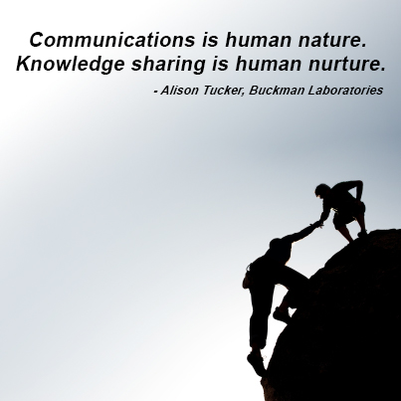
Why can’t I make my students learn the materials taught the way I want them to?
1

Slide 4
Digital life
https://newtheory.com/shocking-facts-about-the-millennial-generation/

Slide 5
Student-centered
1

Slide 6
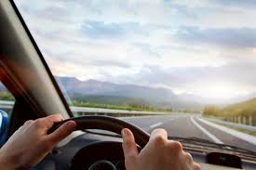
Put them in the driver’s seat of their own learning journey

Slide 7
Let them do what they love in their NATURAL ENVIRONMENT

Slide 8
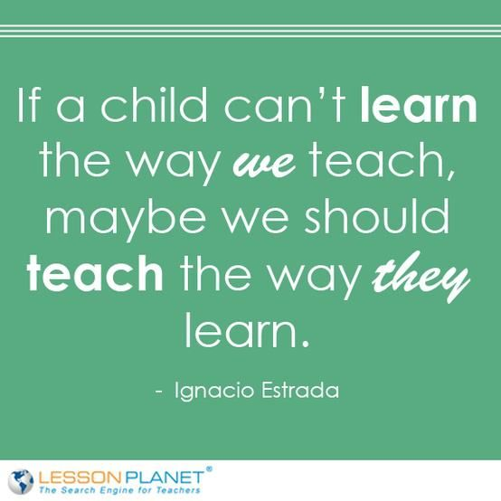

Slide 9
Why can’t I make them sit still and learn from start to end?
2

Slide 10
Move them to do something rather than study something
2

Slide 11
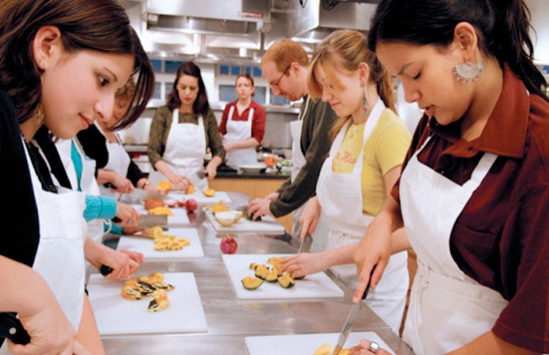
Give the pupils something to do, not something to learn; and the doing is of such a nature as to demand thinking; learning naturally results. John Dewey

Slide 12
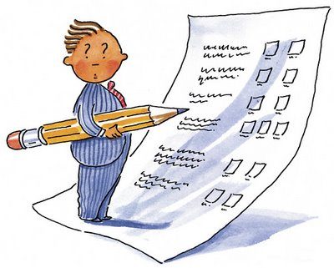
Why can’t my students submit assignments on time? Why are they always not excited to take tests?
3

Slide 13
Assignment and Assessment for REAL PURPOSE and REAL AUDIENCE
3

Slide 14
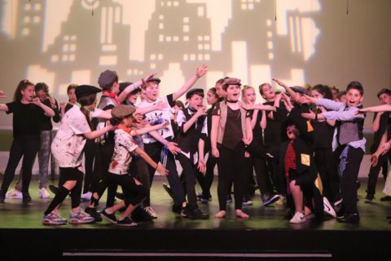
Let them PUBLISH and PERFORM for REAL AUDIENCE not just for the teacher for grading purpose only

Slide 15
Why are my students easily bored during my lesson?
4

Slide 16
4
Relevant Learning

Slide 17
To their Needs and Interests
To their Future

Slide 18
Community Service Projects
Recognize
Research
Reorganize
Resolve

Slide 19
Team Work
Collaborate
Sharing
Helping
Participate

Slide 20
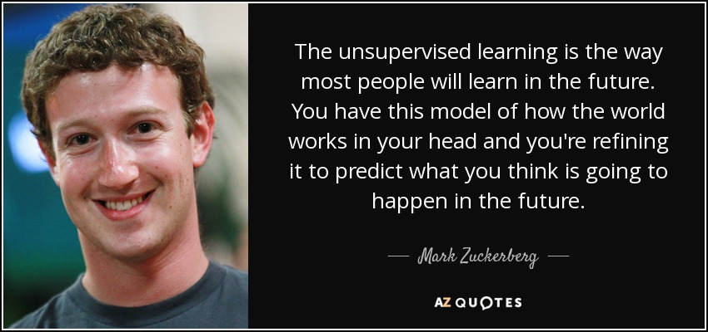
The Future of Learning: Unsupervised Learning

Slide 21
What is the ultimate goal of SMART Learning?
5

Slide 22
5
Trasnformation

Slide 23
TRANSFORM!
Society
Learning

Slide 24
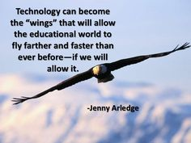

Slide 25
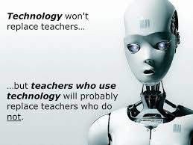

Slide 26
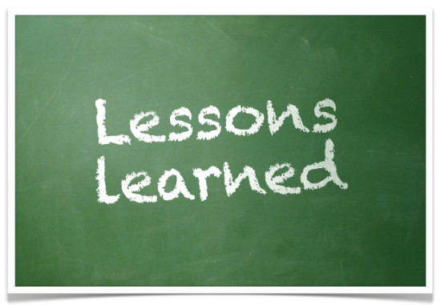
So, what are the lessons learned?

Slide 27
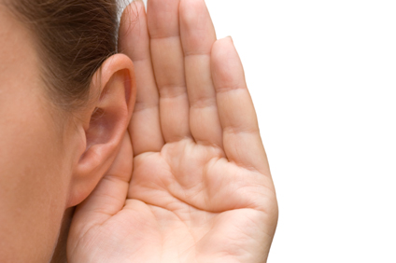
Summary: SMART Learning Environment (Key elements)
S | M | A | R | T
Student | Movement | Assessment | Relevance | Transformation

Slide 28
Next, please! (03)

