Slide 1
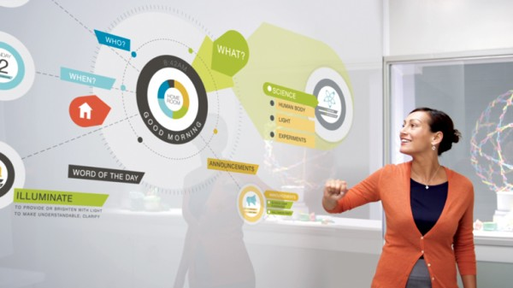
Teachers and Technology
Sandra Sembel
(ssembel@gmail.com)

Slide 2
Introduction
3 TRUE
1 FALSE
I have one son
I like chocolate ice cream
I have a black belt in Karate
I drive to work every day

Slide 3
A glimpse to the future!
https://www.youtube.com/watch?v=jZkHpNnXLB0&list=PL363989F7BCF53A36
A Day Made of Glass 2

Slide 4
Learning Objectives
Participants can identify the reason for blending technology in teaching
Participants can recognize the various benefits of blening technology in teaching
Participants can describe changes needed in blending technology in teaching.
1. REASON
2. BENEFITS
3. CHANGES

Slide 5
reasons
1. REASONS
Learning Objective 1

Slide 6
Video 1: Reasons?
https://www.youtube.com/watch?v=ulb4jl3xqs8

Slide 7
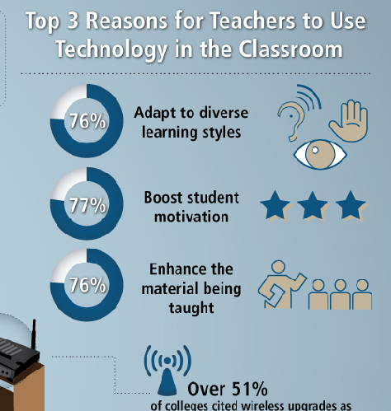

Slide 9
Revisit! 1: REASONS

Slide 10
BENEFITS
2. BENEFITS
Learning Objective 2

Slide 11
BENEFITS
Engage
1
Resources
2
Beyond classroom
3
5
Multimedia
4
Collaborate
Real time
6

Slide 12
Revisit! 2: BENEFITS?

Slide 13
To keep leveraging these benefits, it’s essential that educators and parents continue to discuss the ways to use this technology with their students.

Slide 14
changes
3. CHANGES
Learning Objective 3

Slide 15
Agree or Disagree
Knowledge is power?

Slide 16
New Normal 1
Knowledge is Power
Learning Skill is Power
☹
☺

Slide 17
Agree or Disagree
It is important for student to learn the subject matter in class.

Slide 18
New Normal 2
You go to the Learning Centers
The Learning goes with You
☹
☺

Slide 19
Agree or Disagree?
We aim to help students understand the lesson.

Slide 20
New Normal 3
Learning Subject Matter
Researching Subject Matter
☹
☺

Slide 21
Agree or Disagree?
It is more effective for Students to learn one aspect of a subject at a time.

Slide 22
New Normal 4
Single Focus
Holistic
☹
☺

Slide 23
Agree or Disagree?
Students need to do and submit their assignments to be graded by the teacher.

Slide 24
New Normal 5
Submit Class Assignments
Publish Assignments
☹
☺

Slide 25
Revisit! 3: CHANGES?

Slide 26
Points to Ponder
While there is significant value to having face-to-face interaction in class, student abilities are enhanced when these are supplemented with technology.

