Slide 1
Introduction to Blended learning
sandrasembel.weebly.com

Slide 2
Key Issues
What is blended learning?
Why blending learning?
Blended learning models
Important notes

Slide 3
What is blended learning?
1
sandrasembel.weebly.com

Slide 4
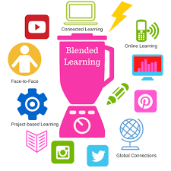
Learning
Conventional
Classroom learning
Community-based learning
Family-based learning
Non-Conventional
Computer-based learning
Video-based learning
M-learning
E-learning
Blended-Learning

Slide 5
Blended learning is NOT moving lessons online

Slide 6
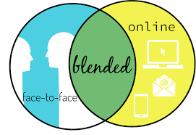
Blending the best of
DIFFERENT AVENUES of learning
TO MAKE LEARNING HAPPEN

Slide 7
Blended learning is a combination of offline and online learning in a way that the one compliments the other.
https://www.talentlms.com/elearning/blended-learning
HYBRID
MULTI-CHANNELED
LEARNING

Slide 8
is a LEARNING program (formal or non-formal) that combines the power online digital media with traditional classroom methods to MAKE LEARNING HAPPEN.
Blended Learning

Slide 9
Why Blended Learning?
2
Let’s begin!

Slide 10
People
Process
Technology
Styles
Motivation
Needs
Time
Place
Relevance
IoT
Big Data
Human-centered

Slide 11
Blended Learning models?
3
sandrasembel.weebly.com

Slide 12
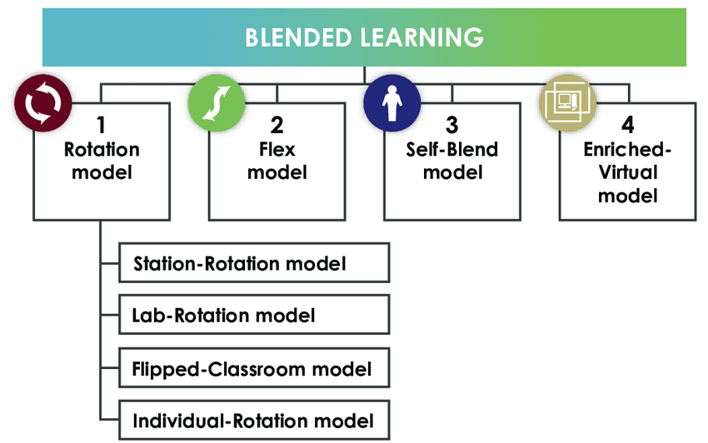
Blended Learning Models

Slide 13
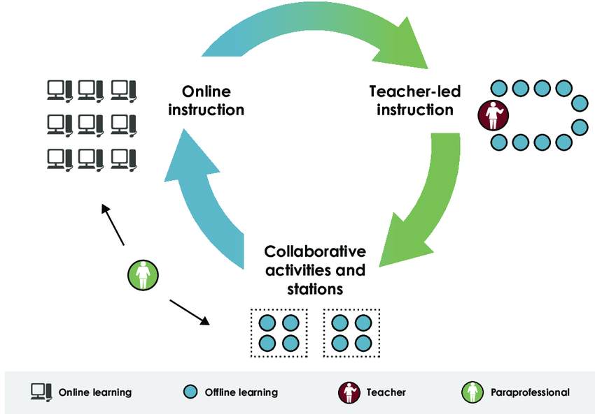
Rotation Model

Slide 14
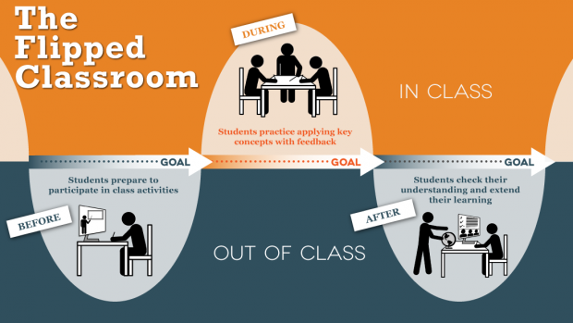

Slide 15
Learning delivery
Synchronously
Real-time
Live
Examples:
chat conversations and audio/video conferencing
Asynchronously
Self-paced
Convenient time
Examples:
Discussion forum
Email

Slide 16
Blended Learning Approaches?
4

Slide 17
Blended learning approaches
Learning
Self-paced
Instructor’-lead
Customized

Slide 18
Important Notes
5

Slide 19
Remember ...
1
We prepare students for their FUTURE, not our PRESENT.

Slide 20
Our future or theirs?
We teach in DISCONNECTED departments. Learners live in INTERCONNECTED world. We teach INDEPENDENT lessons Learners live in INTERDEPENDENT world We teach learners about OUR PAST, OUR PRESENT AND OUR FUTURE Learners live in THEIR PRESENT AND THEIR FUTURE We teach what we KNOW Learners live to face the UNKNOWN We teach KNOW WHAT learning Learners live in KNOW WHERE learning We tell learners to respect the ULTIMATE SOURCE OF LEARNING: THE TEACHER Learners can get access to DIFFERENT SOURCES OF LEARNING

Slide 21
So, Remember ...
2
Use technology to support LEARNING (Don’t just simply fit learning for the sake of technology)

Slide 22
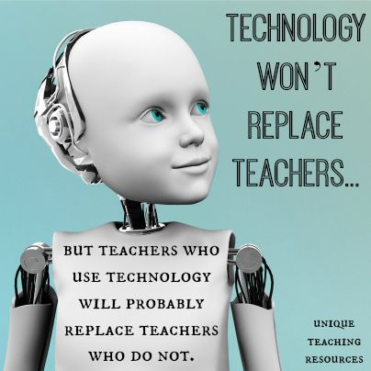
So, Remember ...
3

Slide 23
Kahoot.it
Game Pin: 3025

Slide 24
Summary

Slide 25
Key issues
What is blended learning?
Why blending learning?
Blended learning models
Blended learning approaches
Important notes

Slide 26
Remember!
The soul of e-learning is LEARNING not the ‘c’, the ‘e’ or the ‘b’.
The goal should make learning happen in the most relevant way.

Slide 27
Any Questions?

Slide 28
Go to flipgrid https://flipgrid.com/8803d3f8

