Slide 1
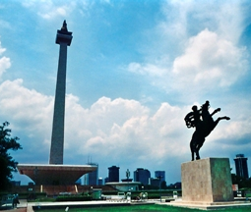
Good afternoon!

Slide 2
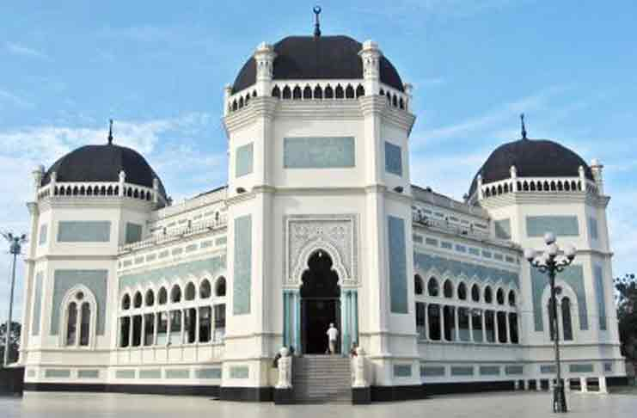
Where is it?

Slide 3
Masjid Raya Al-mashun, MEDAN

Slide 4
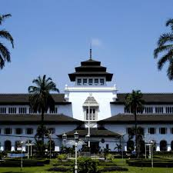
What about this building? Where is it?

Slide 5
Gedung Sate, BANDUNG

Slide 6
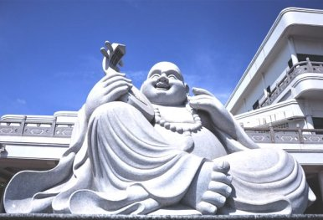
Where is it?

Slide 7
Maha Vihara Duta Maitreya Buddhist temple, BATAM
One of the largest Buddhist temples in Southeast Asia, Maha Vihara Duta Maitreya is also known as the Laughing Buddha Temple.

Slide 8
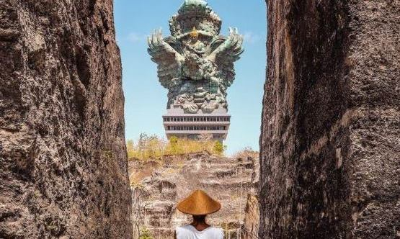
Where is it?

Slide 9
Garuda Wisnu Kencana, Denpasar

Slide 10
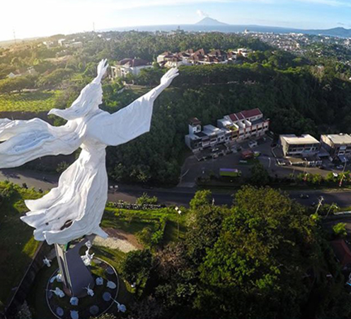
Where is it?

Slide 11
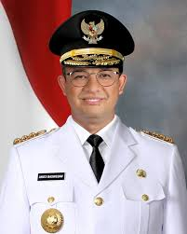
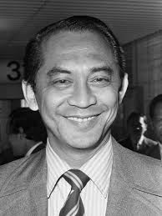
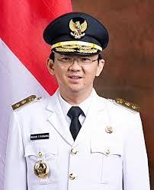
Who are they? What is the similarity of these people?

Slide 12
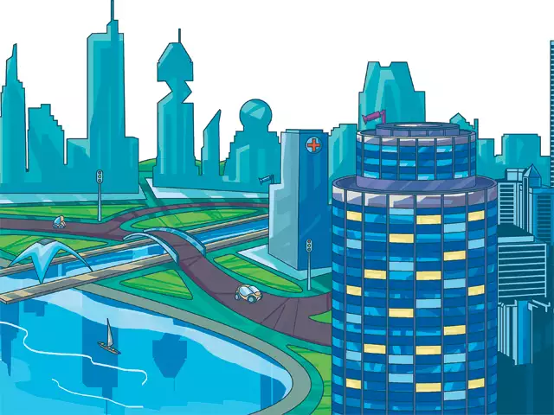
Dream city to live in Indonesia other than Jakarta and Surabaya?

Slide 13
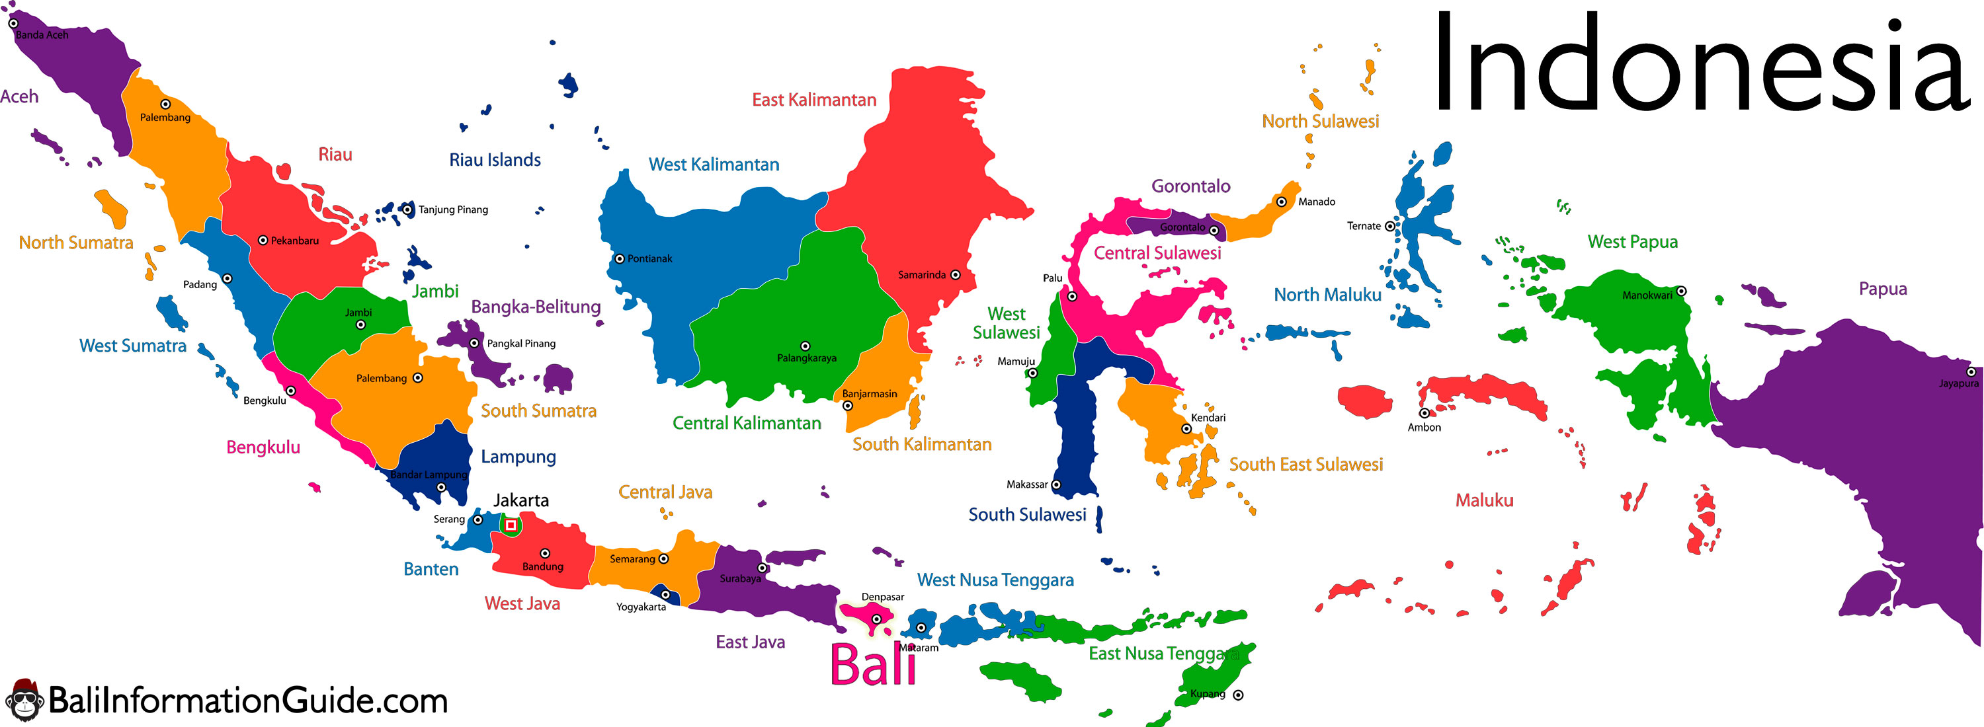
Best city to live in Indonesia

Slide 14
Building your arguments
Statement of opinion
I think …
Supporting argument(s)
First of all, …
Brief explanation
For example, ..
Conclusion
I believe …
In my opinion …
Another reason is …
In addition
Finally
This is because …
Let’s compare it with/to …
In conclusion, …
Therefore, ….
Notes:
Compare with is used to juxtapose two or more things with each other, looking at similarities and differences.
Compare to is used when likening two things together.
(Source: https://writingexplained.org/compare-to-or-compare-with)

Slide 15
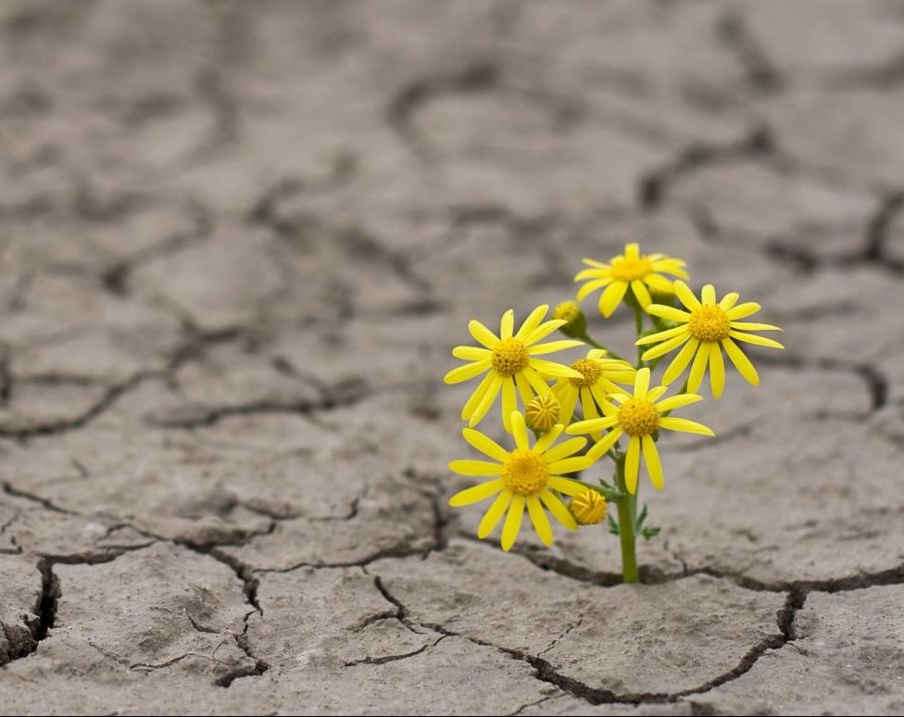
We can be in a helpless situation, but with God we can remain hopeful. Helplessness is a situation. Hopefulness is a decision.
My flesh and my heart may fail, but God is the strength of my heart and my portion forever.
(Psalm 73: 26)

Slide 16
Thank you!

