Slide 1
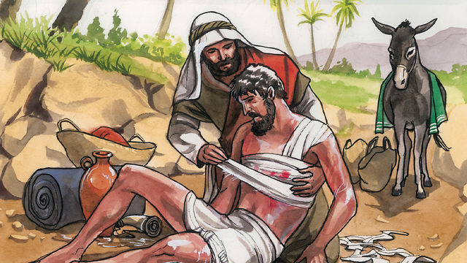
The Parable of the Good Samaritan
Luke 10: 25 - 37

Slide 2
The Parable of the Good Samaritan
²⁵ On one occasion an expert in the law stood up to test Jesus. “Teacher,” he asked, “what must I do to inherit eternal life?”
²⁶ “What is written in the Law?” he replied. “How do you read it?”
²⁷ He answered, “‘Love the Lord your God with all your heart and with all your soul and with all your strength and with all your mind’^{[a]}; and, ‘Love your neighbor as yourself.’^{[b]}”
²⁸ “You have answered correctly,” Jesus replied. “Do this and you will live.”
²⁹ But he wanted to justify himself, so he asked Jesus, “And who is my neighbor?”

Slide 3
³⁰ In reply Jesus said: “A man was going down from Jerusalem to Jericho, when he was attacked by robbers. They stripped him of his clothes, beat him and went away, leaving him half dead. ³¹ A priest happened to be going down the same road, and when he saw the man, he passed by on the other side. ³² So too, a Levite, when he came to the place and saw him, passed by on the other side. ³³ But a Samaritan, as he traveled, came where the man was; and when he saw him, he took pity on him. ³⁴ He went to him and bandaged his wounds, pouring on oil and wine. Then he put the man on his own donkey, brought him to an inn and took care of him. ³⁵ The next day he took out two denarii^{[c]} and gave them to the innkeeper. ‘Look after him,’ he said, ‘and when I return, I will reimburse you for any extra expense you may have.’
³⁶ “Which of these three do you think was a neighbor to the man who fell into the hands of robbers?”
³⁷ The expert in the law replied, “The one who had mercy on him.”
Jesus told him, “Go and do likewise.”

Slide 4
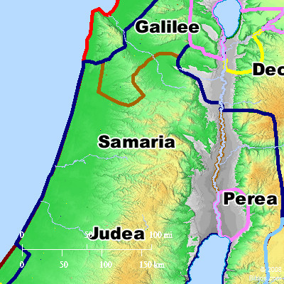
Samaritans
Samaritans, from the area sandwiched between Galilee to the north and Judea to the south, were hated by Jews because they intermarried with non-Jews and did not strictly observe Mosaic law.

Slide 5
Lessons Learned!
Only with God’s grace we are enabled to love
Love must come before prejudice, hatred, anger, enmity.
Love brings compassion.
Compassion results in action of love
Action of love will glorify God
God is love so He will enable His creation to glorify Him with love.

