Slide 1
SYNTHESIZING INFORMATION

Slide 2
The Process of Synthesizing Information
New Information
Information 1
Information 2
Information 3

Slide 3
Synthesizing Information
As you read, you constantly accumulate information, and you keep this information in mind by combining smaller facts into larger generalizations.
You summarize, conclude, infer, and generalize, and then your read some more, incorporate the new information, and draw even bigger conclusions.”

Slide 4
For example

Slide 5
Interesting information about Our Brain (1)

Slide 6
KWLP chart
KNOW | WANT | LEARNED | PLAN

Slide 7
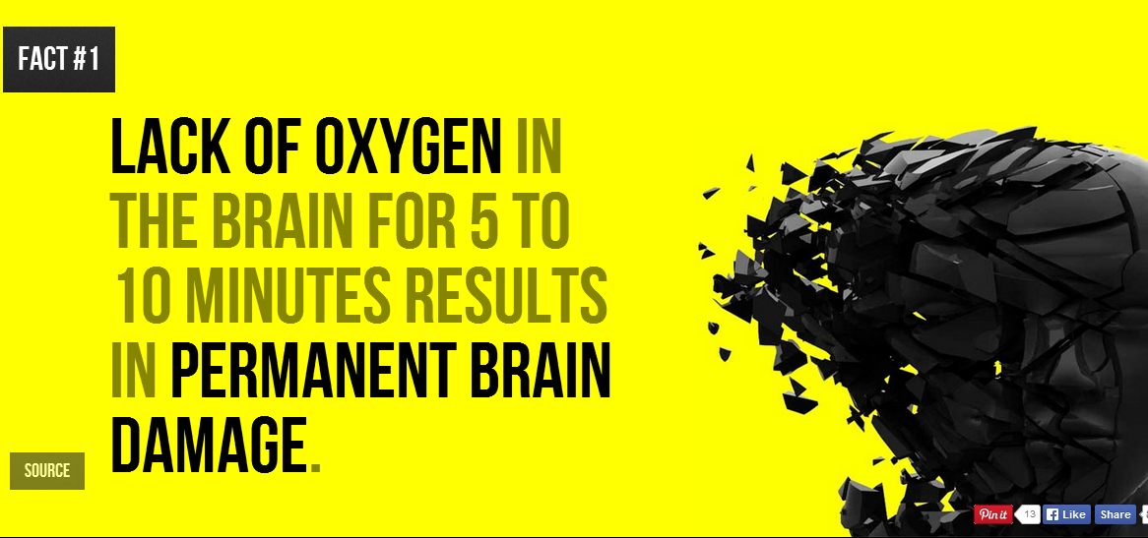

Slide 10
Synthesizing Information
Things that are harmful to our brain
Lack of Oxygen in 10’ – Permanent brain damage
Affect of Violent Homes on Children
Long-term Mobile Phone use -- Tumor

Slide 11
Interesting information about Our Brain (2)

Slide 12
KWLP chart
KNOW | WANT | LEARNED | PLAN

Slide 13
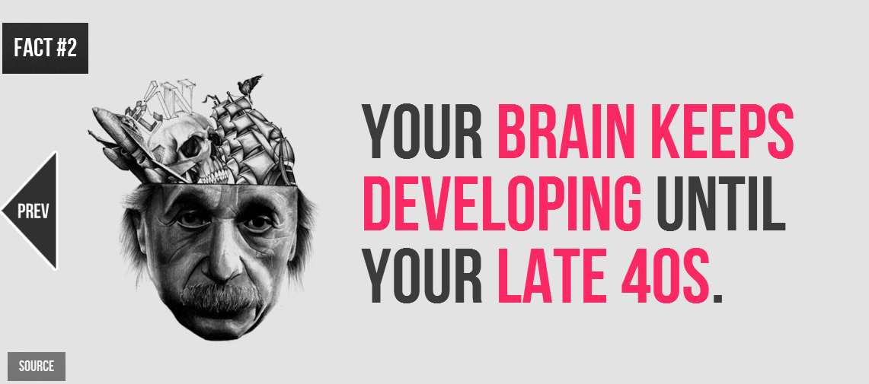

Slide 16
Synthesizing Information
Brain development – late 40’
Memory -- New brain connections
Smells of chocolate – theta brain waves--relaxation

Slide 17
Internet

Slide 18
KWLP chart
KNOW | WANT | LEARNED | PLAN

Slide 22
Synthesizing Information
?
?
?
?

Slide 23
Water

Slide 24
KWLP chart
KNOW | WANT | LEARNED | PLAN

Slide 28
Synthesizing Information
?
?
?
?

Slide 29
Trees

Slide 30
The world’s tallest tree? The world’s oldest tree? The fastest-growing tree?
The world's tallest-growing tree is the coast redwood (Sequoia sempervirens), which grows along the Pacific Coast of the United States, mainly in California.
Interestingly enough, it's not the world's oldest-growing tree; that award goes to a bristlecone pine (Pinus aristata).
Bamboo is the fastest-growing woody plant in the world; it can grow 35 inches in a single day.

