Slide 1
synthesizing
Sandra Sembel

Slide 2
Summarizing: Strategy 1
Someone
Who is the main character?
wanted
What did the character want or want to do?
But
So
Then
What was the problem?
How did the character do to solve the problem?
What was the result?
Summarizing
A story
A sequence of events
A problem-solution article

Slide 3
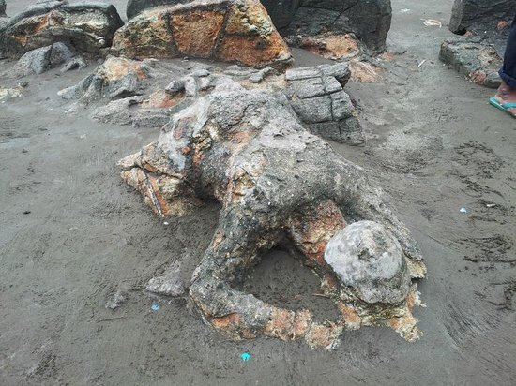
Example: The Story of Malin Kundang
Malin’s mother
Wanted to see her son
But her son didn’t want to admit the poor mother
So the mother was sad and angry
Then she cursed Malin to be a stone.

Slide 4
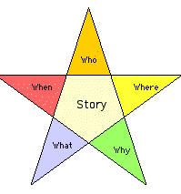
Summarizing: Strategy 2
Who does this involve?
What happened?
When did it happen?
Where did it happen?
Why did it happen?

Slide 5
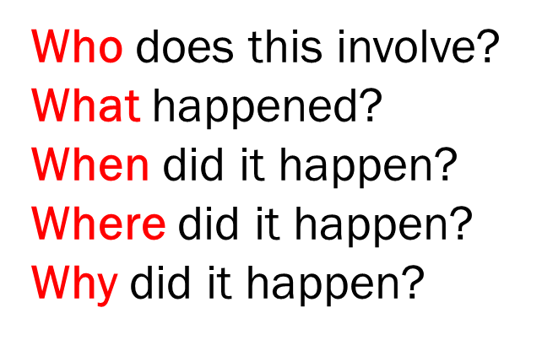
Example: News Story
The President
Gave press conference
On Friday around mid-night
In Presidential palace
To calm down the people of Jakarta and Indonesia

Slide 6
SYNTHESIZING
Pieces of information from different sources
Collect, combine, process
New insight, new idea, new point of view

Slide 7
Synthesizing
Collecting, combining, *processing pieces of information from different sources to create new insight, new understanding, or new point of view.
*Paraphrasing, Inferencing, summarizing

Slide 8
Synthesizing examples

Slide 9
1. The Human Brain

Slide 10
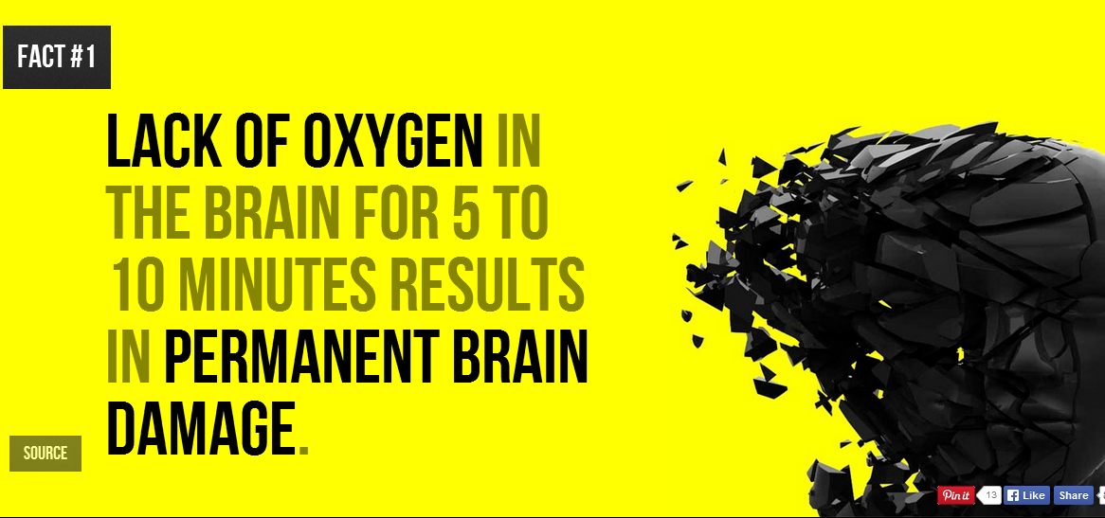

Slide 13
Synthesizing Information
Things that are harmful to our brain
Lack of Oxygen in 10’ – Permanent brain damage
Affect of Violent Homes on Children
Long-term Mobile Phone use -- Tumor

Slide 14
2. Water

Slide 18
Synthesizing Information
?
?
?
?

Slide 19
References
Comprehension Strategy – Synthesis / Summarization / Concluding http://www.readinglady.com/mosaic/tools/Synthesis%20handout%20by%20Deb%20Smith.pdf
How to Synthesize Multiple Sources http://home.cerrocoso.edu/swiridoff/Resources/Composition/ how_to_synthesize_multiple_sourc.htm
What is a Synthesis Question? http://www.passged.com/student_blogs/maria/2008/10/07/ged-reading-what-is-a-synthesis-question/
What it means to comprehend http://www.suite101.com/content/what-it-means-to-comprehend-a72619
Reading Strategies http://www.mindtools.com/rdstratg.html

