Slide 1
Summarizing Practice

Slide 2
What is a summary?
Summary
Original text
A summary is a shortened version of the original text.
A summary contains the key ideas.

Slide 3
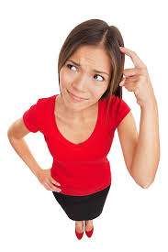
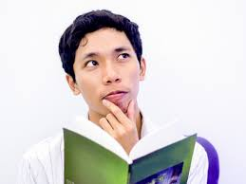
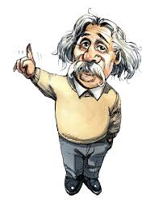
Why Summarizing?
Communicate
Being able to communicate important point is important in life:
Business people want to know the summary of the company profile.
Nurses must summarize the condition of a patient
Lawyers can win cases with good summaries.
Newscasters summarize the day’s events.
Understand
Remember
If you can’t explain it simply, you don’t understand it well enough. (Albert Einstein)
a lecture, an essay, an article, a movie, a report, a research, a piece of news, a short story.

Slide 4
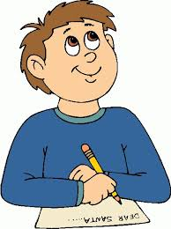
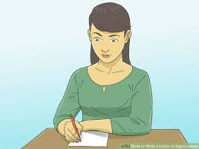
How to summarize?
Read the text to understand it
Read again to identify the topic (general idea)
Read to get the important ideas
Delete small details
Exclude personal opinion
Replace the details with the umbrella idea (for example: rose, tulips, jasmine → flowers)
Flowers
Write the summary (10-20%)
Roses
Tulips
Jasmines

Slide 5
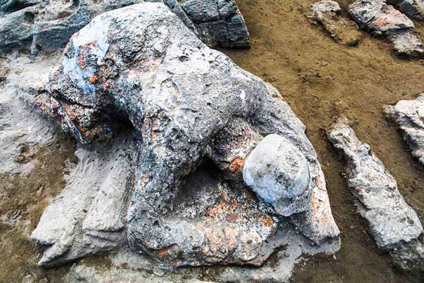
Summarizing Strategies
Strategy 1:
Somebody (name) Wanted to (activity) But (problem) So (result)
The story of Malin Kundang
Malin Kundang’s mother wanted to see her son, but Malin Kundang didn’t want to admit his poor mother, so the mother cursed Malin Kundang to be a stone.
Story, problem/solution

Slide 6
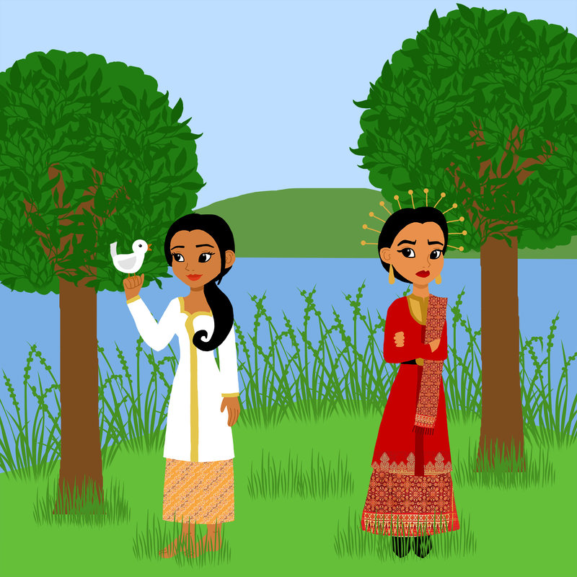
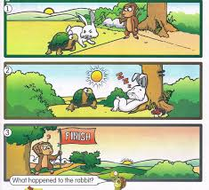
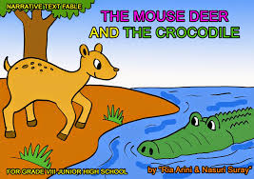
Let’s Try!
Bawang Merah and Bawang Putih
(Red and White Onions)
Summarize a legend or folk tale that you know!
Somebody (name) Wanted to (activity)
But (problem)
So (result)

Slide 7
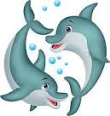
Text 1
Strategy 2: Who? What? When? Where? Why? Result?
Kayla and Kiki are two dolphins in a show at the local aquarium. Each afternoon they perform for the audience who comes to watch them. Kayla and Kiki know many tricks. They jump through hoops. They walk across the water using their tails. They leap high out of the water to take a fish from the dolphin trainer. Kayla and Kiki are very gentle animals. The audience loves seeing them perform and learning about them.

Slide 8
Text 1
Who? Two Dolphins, Kayla and Kiki
What? Perform many tricks
When? Every afternoon
Where? Local aquarium
Why? They are gentle
Result? Audience love them
Two dolphins named Kayla and Kiki perform many tricks at the local aquarium every afternoon. They are nice animals so the audience love them.

Slide 9
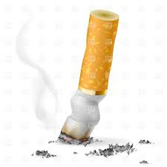
Text 2
Who? What? When? What event? Where? Why?
I am so proud of my aunt. She quit smoking! Today marks the 90th day from when she quit. The family is going out to dinner to celebrate. We will go to her favorite restaurant, La Taliano.
My aunt had smoked for twenty years. Recently, she was told by her doctor that she had better quit. There are many health risks associated with smoking. She told me she wanted to live a long time to see me grow up.

Slide 10
Text 2
Who? My aunt
What? Quit smoking
When? 90 days ago
What event? Celebration
Where? La Taliano
Why? Doctor’s advice and wanted to live long
My aunt quit smoking 90 days ago. Today, the family celebrate it together. She quit because of doctor’s advice and her willingness to live long.

Slide 11
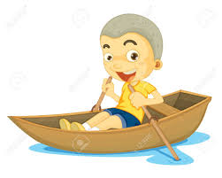
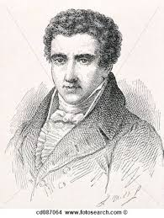
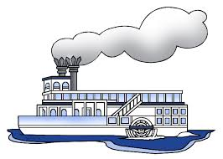
Text 3
What? Who? Why? When?
Boats have been around for a long, long time. Some used the wind to move. Some used the tide. Some were rowed by people. Then, Robert Fulton had a new idea. He designed a boat that could move by the power from steam. This first steamboat was named the Clermont. In August 1807, it traveled up the Hudson River from New York City. It traveled over 100 miles because of the steam power.

Slide 12
Text 3
What? Boat
Who? Robert Fulton
Why? designed steamboat
When? 1807
People have used boat for a long time. There are different kinds of boat. Robert Fulton designed steam boat and it started the first travel in 1807.

