Slide 2
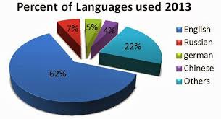

Slide 4
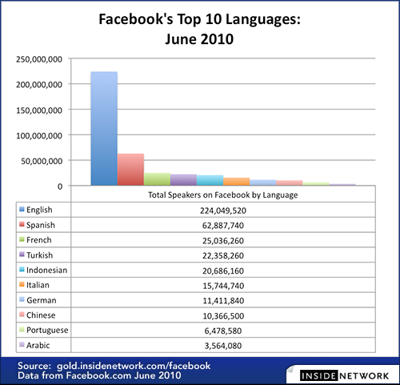

Slide 6
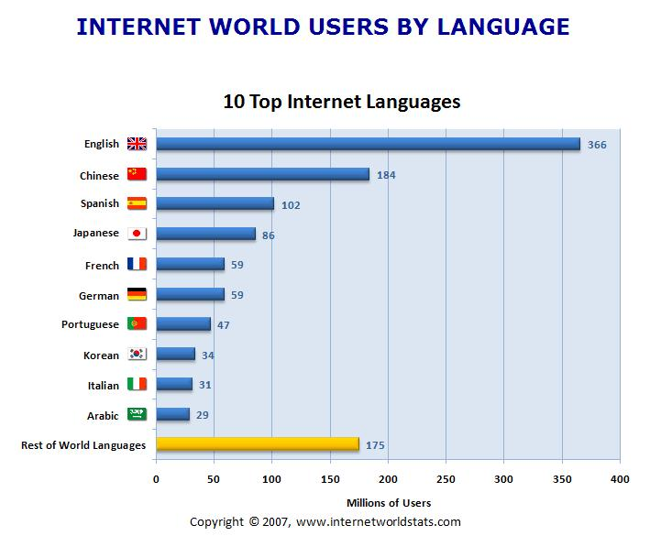

Slide 7
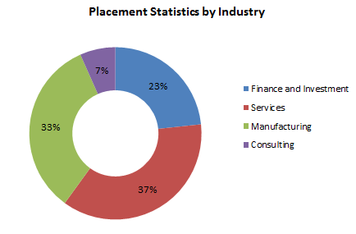

Slide 8
Why Learn English?
English is the most commonly spoken language in the world. One out of five people can speak or at least understand English!
English is the language of science, of aviation, computers, diplomacy, and tourism. Knowing English increases your chances of getting a good job in a multinational company within your home country or of finding work abroad.
English is the official language of 53 countries. That is a lot of people to meet and speak to.
English is spoken as a first language by around 400 million people around the world.
English is the language of the media industry. If you speak English, you won’t need to rely on translations and subtitles anymore to enjoy your favourite books, songs, films and TV shows.
English is also the language of the Internet. Many websites are written in English – you will be able to understand them and to take part in forums and discussions.
English is based on a simple alphabet and it is fairly quick and easy to learn compared to other languages.
English is not only useful — it gives you a lot of satisfaction. Making progress feels great. You will enjoy learning English, if you remember that every hour you spend gets you closer to perfection.
Since English is spoken in so many different countries there are thousands of schools around the world that offer programmes in English. If you speak English, there’re lots of opportunities for you to find an appropriate school and course to suit your academic needs.
Because it’s fun! By learning English, you will also learn about other cultures. Few experiences will make you grow as a person more than learning the values, habits and way of life in a culture that is different from yours.
(Source: http://www.experienceenglish.com/social-english/articles/10-reasons-learn-english)

