Slide 1
Skimming and Scanning

Slide 2
Flyer 1
What event is advertised here?
How do you know?
Do you have to pay to come here?
What are the activities?

Slide 3
Flyer 2
What is the event advertised?
Date?
Time?
Activities?

Slide 4
Important Reading Skills
Skimming
Scanning
The general idea of what we read
Identifying specific information in what we read

Slide 5
Learning Targets
Skimming
Brief explanation
Example
Practice
Scanning
Brief explanation
Example
Practice

Slide 6
Skimming
What, Why, When, How

Slide 7
What is Skimming?
Skimming refers to reading quickly to get a general idea of what it is about, without trying to understand its details.
This is a technique used to identify the main ideas of a text.

Slide 8
Why skimming?
Previewing
To predict content and determine if it is worth your time and energy to spend any more time with it.
Reviewing
To recall the key points of what we have read
Reading
To quickly read text selection that does not need detailed attention

Slide 9
When do we skim?
To identify topic
To review key points
To read for general ideas
Examples:
Headline news
Advertisements

Slide 10
How do we skim?
Read the Title
Read the introduction (lead in)
Read the first and/or the last paragraph
Read the subheadings
Read the summary
Read the clue words (boldface, italics, underlined, proper nouns)
Look at pictures and captions

Slide 11
Rain Forest

Slide 12
Try it yourself!
Find an article
Share with us the key ideas of the articles (3 to 5 key ideas)
Remember to use skimming strategies: Read the title, the first paragraph and/or last paragraph, Subheadings, first and last sentence of a paragraph, picture and captions
Discovery
BBC
CNN
Times
Reader’s Digest
Jakarta Post
National Geographic
Tempo

Slide 13
Scanning

Slide 14
What is Scanning?
Scanning refers to reading a text quickly in order to locate specific pieces of information.

Slide 15
Why Scanning?
Scanning is useful to find specific piece of information quickly (e.g. date, names, numbers) without reading the entire article.

Slide 16
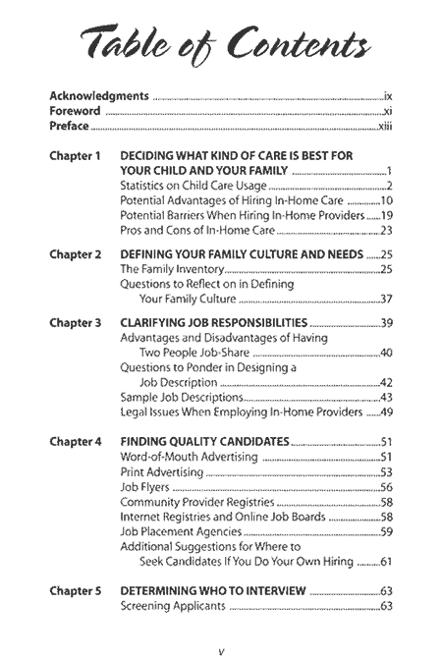
When do we scan?
Table of contents
Time Table
Book index
TV Guide
Advertisements
Telephone directory

Slide 17
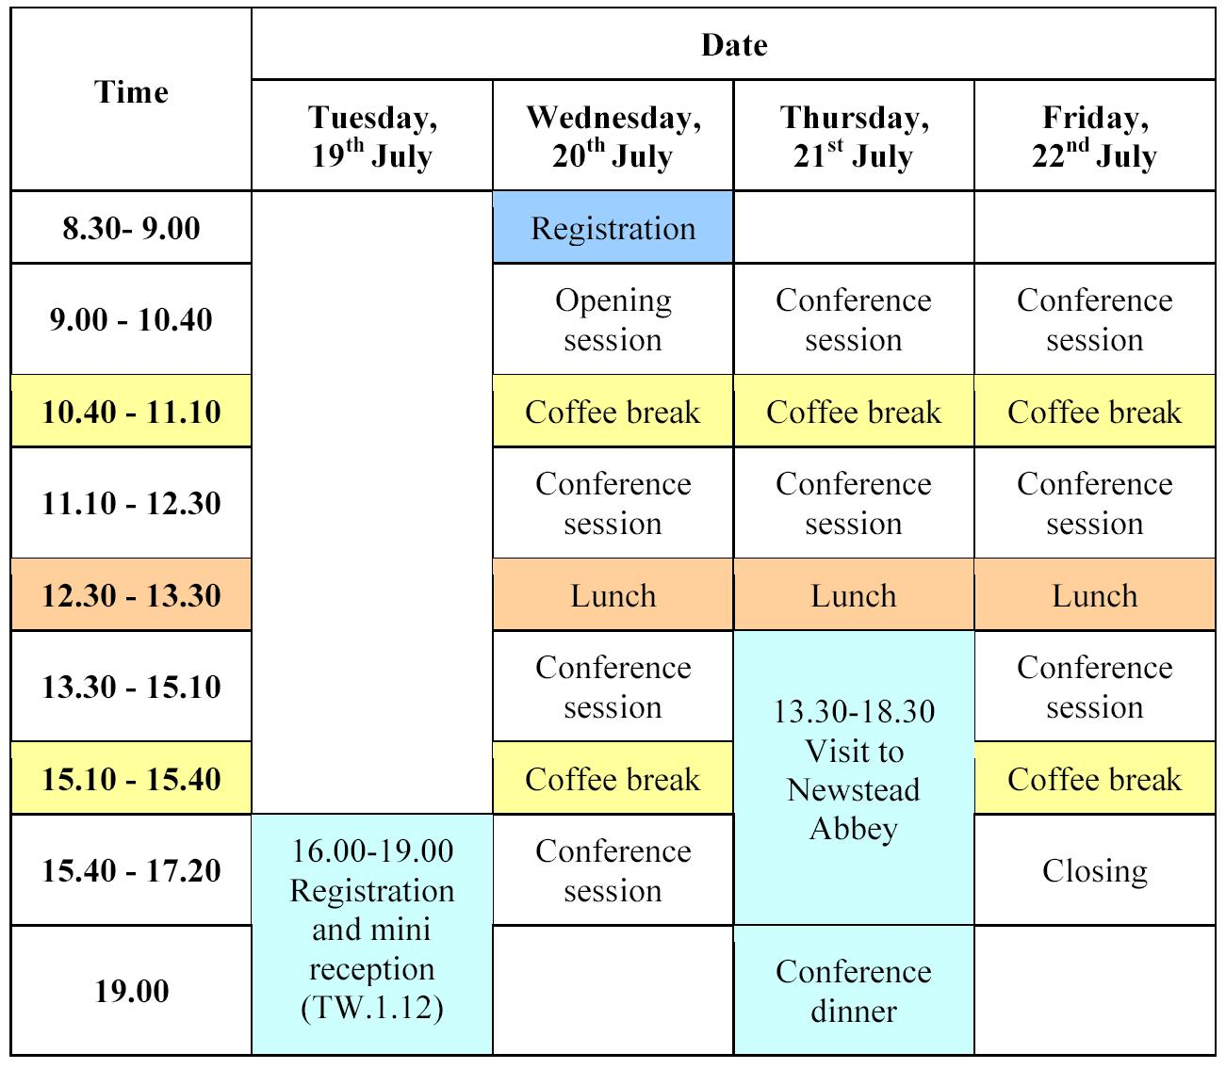
Time table

Slide 18
How Scanning?
Analyze content organization (e.g. page number, alphabetical order, sequence of events)
Keep the ‘key word’ in mind all the time
Read quickly to locate the information about the key word
Jump around in the text, skip unnecessary parts

Slide 19
Example

Slide 20
Page 6-7
Group 1
Group 2
All Names
All Numbers
Group 3
Group 4
Unfamiliar words
Prepositions (to, in, on, down, by, with)
Group 5
Pronouns: I, He, She, We, You, They, Us, them, him, her, me, our

Slide 21
Skimming and Scanning Practice

Slide 22
Technology and the News
Page 10

Slide 23
Page 10 Technology and the News
Main Idea: ?
Major Supporting Detail 1: ?
Minor Supporting Details?
Major Supporting Detail 2: ?
Minor Supporting Details?

Slide 24
Page 10 Technology and the News
Main Idea: With technology, people are now better informed
Major Supporting Detail 1: No problems with time and access
TV Cable and Internet for Live coverage – 24-h
Email and Cellphone for Personal access to the news
Major Supporting Detail 2: No problems with geography and distance
Global news
Global audience

Slide 25
References
Skimming and Scanning Exercise, http://web2.uvcs.uvic.ca/elc/studyzone/570/pulp/hemp1.htm
Skimming and Scanning, Reading Strategies, http://yasmeenshakoor.edublogs.org/category/skimming-and-scanning/
Reading and Study Skills Lab, Skimming and Scanning, http://www.aacc.edu/tutoring/file/skimming.pdf
NorthStar, Building Skills for the TOEFL, High Intermediate, Helen S. Solorzano, Unit 1: Media, Pearson-Longman

Slide 26
Thank you!

