Slide 1
Summarizing

Slide 2
What is a Summary?
Do’s
Condensed
Short
Original Source
Don’ts
No Details
No interpretation
No additional opinion

Slide 3
Why Summarizing?
Comprehension of key points
Research Paper: Analysis and Critical thinking

Slide 4
How long?
About 10% to 20% of the original text.

Slide 5
Steps to Summarizing

Slide 6
1. Previewing
Title and subtitle
Headings and subheadings
First and last paragraphs
Other attention grabbing items (bold-face words, pictures, charts, diagrams that illustrate the main ideas)

Slide 7
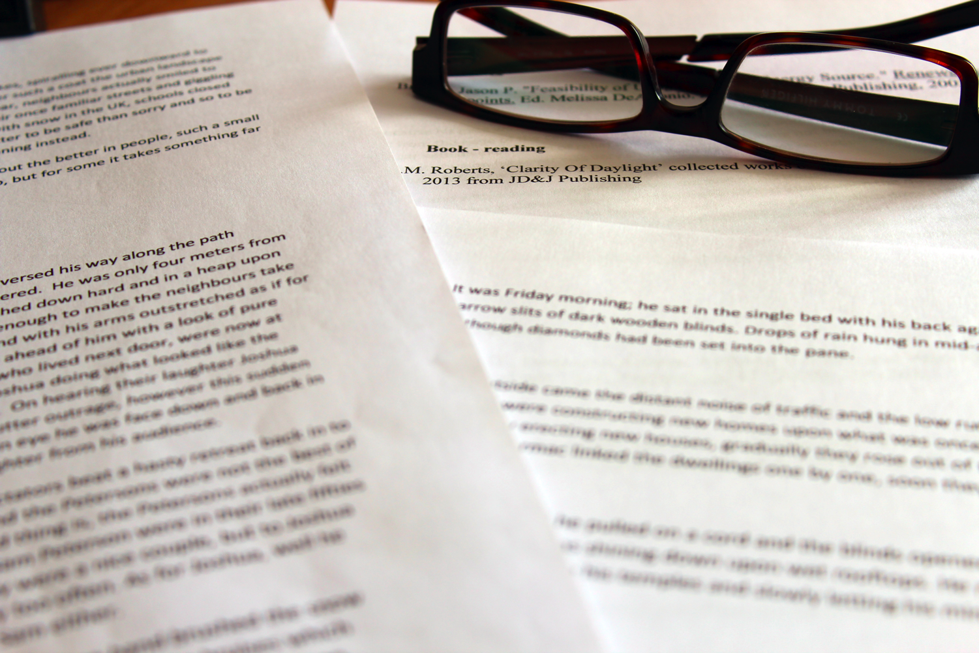
2. Skimming
Read once through
Skim for key ideas
Don’t focus on details
Understand the main idea

Slide 8
3. Take Notes
Read for the second time.
Take notes of the Author, publisher, time of publication
Identify the important ideas (underline, highlight circle)

Slide 9
4. Organize ideas
Organize the key points similar to the original text organization.

Slide 10
5. Write Your Summary
Start the summary with the title and author
Write the author main points in your own words (eliminate details).
Write the writer’s conclusion in your own words

Slide 11
Examples
(Source: http://www.uhv.edu/ac/style/summary.aspx)

Slide 12
Original paragraph
Height connotes status in many parts of the world. Executive offices are usually on the top floors; the underlings work below. Even being tall can help a person succeed. Studies have shown that employers are more willing to hire men over 6 feet tall than shorter men with the same credentials. Studies of real-world executives and graduates have shown that taller men make more money. In one study, every extra inch of height brought in an extra $1,300 a year. But being too big can be a disadvantage. A tall, brawny football player complained that people found him intimidating off the field and assumed he "had the brains of a Twinkie." (p. 301)
Source: ---Locker, K. O. (2003). Business and administrative communication (6th ed.). St. Louis, MO: Irwin/McGraw-Hill

Slide 13
Identify the main ideas
Let’s first identify the main points in the original passage.
Topic sentence: “Height connotes status in many parts of the world.”
Main point: “Even being tall can help a person succeed.”
Main point: “Executive offices are usually on the top”
Main point: “being too big can be a disadvantage”

Slide 14
Summary A
Throughout the world, being tall will lead to professional success. In fact, research shows that employers are more likely to hire taller men and to pay them more, as compared to shorter men with the same qualifications (Locker, 2003).
[This summary is too brief. Further, it changes the meaning slightly, giving the impression that being tall guarantees success.]

Slide 15
Summary B
In most countries, height suggests status. For instance, higher executives normally use top floors of office buildings. Further, research shows that men over six feet tall are more likely to be hired than those shorter than them but with the same qualifications. Taller men also receive greater incomes, possibly as much as $1,300 a year more than those only one inch shorter than them. However, as a tall and muscular football player points out, a disadvantage to being tall is that some individuals may perceive you as threatening or even dumb (Locker, 2003).
[This summary is too long. Instead of focusing on the main points, it includes all of the details that are in the original passage.]

Slide 16
Summary C
Though height may connote slowness to some people, in the business world, it is almost universally associated with success. For example, taller men are more likely to be hired and to have greater salaries. Further, those in top positions within a company are more likely to work on the top floors of office buildings (Locker, 2003).
[This summary is the most effective. In addition to including all of the main points, it leaves out the unimportant details.]

Slide 17
Let’s Try

Slide 18
Exercise 1
Knowing how to argue is a useful skill. We use it on ourselves in order to arrive at decisions; we use it with others as we discuss business strategies or policy changes on committees, as members of the local PTA, a law office, an environmental action group; we use it as fundraisers for a cause, like saving whales, we use it in applying for foundation grants and in drafting a letter to the editor of our hometown paper; we use it when we discuss child abuse, toxic waste, tax cuts, pothole repair, working mothers, and university investment policies. Our ability to express opinions persuasively—to present our views systematically as arguments—will allow us to make some difference in public life. If we lack the necessary skills, we are condemned to sit on the sidelines. Instead of doing the moving, we will be among the moved; more persuasive voices will convince us of what me must do. (pp. 222-223).
--Hall, B. & Birkerts, S. (1998). Writing well (9th ed.). New York: Longman.

Slide 19
Exercise 2
Audiences want the sense that you’re talking directly to them and that you care that they understand and are interested. They’ll forgive you if you get tangled up in a sentence and end it ungrammatically. They won’t forgive you if you seem to have a “canned” talk that you’re going to deliver no matter who the audience is or how they respond. You can convey a sense of caring to your audience by making direct eye contact with them and by using a conversational style. (p. 475)
---Locker, K. O. (2003). Business and administrative communication (6th ed.). St. Louis, MO: Irwin/McGraw-Hill

Slide 20
Exercise 3
Writing a memo is essentially like writing any other form of technical communication. First you have to understand your audience and purpose. Then you gather your information, create some sort of outline, write a draft, and revise it. Making the memo look like a memo- adding the structural features that your readers will expect—is relatively simple. Your software has templates, or you can build the structure into your outline or shape the draft at some later stage. (p. 424)
--Markel, M. (1996). Technical communication: Situations and strategies. New York: St. Martin’s Press.

Slide 21
Summary and Paraphrase
Summary:
Paraphrase:
When you paraphrase, you restate part of the passage in your own words. Paraphrased text should always include all of the same details as the original text, and is usually about the same length as the original text. It just uses different words in a different order to tell the author’s ideas.
A short retelling of a text. When you summarize, write the main idea and the most important details from the passage.

Slide 22
References
Guidelines for writing a summary with in-text citations: http://academics.smcvt.edu/cbauer-ramazani/AEP/EN104/summary.htm
Purdue Online Writing Lab, https://owl.english.purdue.edu/owl/resource/930/11

