Slide 1
Making Business Call on the Phone
https://www.youtube.com/watch?v=Tw2r9DkL5co

Slide 2
Making a business call
Receptionist: Good morning, Chic boutique. How may I help you?
Caller: I’d like to speak to Mr. Morgan, please.
Receptionist: Who’s calling, please?
Caller: This is John Wright from International Fashion supply.
Receptionist: Sorry, I couldn’t catch your name.
Caller: It’s John Wright. W-R-I-G-H-T
Receptionist: Ok. Mr. Wright. I’ll try to put you through.
(after a while) I’m afraid the line’s engaged. Would you like to hold?

Slide 3
… continuation
Caller: Can I leave a message?
Receptionist: Certainly.
Caller: Could you please tell Mr. Morgan that our latest shipment has been delayed and the 300 dresses he ordered shall arrive next Friday.
Receptionist: Dress order delayed. Arriving next Friday.
Caller: Yes. And would you please ask him to give me a call as soon as he arrives?
Receptionist: Of course. Could you help me have your number, please?
Caller: It’s 01632960994.
Receptionist: That’s 01632960994.
Caller: Yes. That’s right. Thanks for your help. Good bye.
Receptionist: Good bye.

Slide 4
Receiving a call
(Greeting → Company’s name → Offer help)
Good morning.
Chic boutique.
How may I help you?
/How can I help you?
/What can I do for you?
Let’s try.
(Morning. General Motor. Offer help)
(Afternoon. Johnson and Johnson, Offer help)
(Morning. Facebook Indonesia. Offer help)

Slide 5
Asking to speak to someone
(Speak, Name of the person to talk to)
I’d like to speak to Mr. Morgan, please.
/Can I speak to Mr. Morgan, please?
/May I speak to Mr. Morgan, please?
Let’s try
(Speak, Mr. James Shoemaker)
(Speak, Mr. Bill Gates)
(Speak, Mr. Jeff Bezos)
(Speak, Mrs. Sheryl Sandberg)

Slide 6
Asking who the caller is
(Who, calling)
Who’s calling, please?
May I know who’s calling, please?
Let’s try.
(Calling?)
(May I?)

Slide 7
Giving name and company name
(Name, Company)
This is John Wright from International Fashion supply.
My name is John Wright from International Fashion Supply
Let’s try.
(Your name, Microsoft Indonesia)
(Your name, IBM Indonesia)
(Your name, Phillips Indonesia)

Slide 8
Clarifying name
(Sorry, ask for clarification)
Receptionist: Sorry, I couldn’t catch your name.
Or
Sorry, could you spell your name, please?
Sorry, may I have your name again, please?
Let’s try:
(Couldn’t catch)
(Spell)
(name again)

Slide 9
Spell your name
(Spell the unfamiliar name)
It’s John Wright. W-R-I-G-H-T
My name is John Wright. W-R-I-G-H-T.
Let’s try.
(Spell your name)

Slide 10
Connecting to the other person
(put through)
Ok. Mr. Wright. I’ll try to put you through.
Ok. Mr. Wright. I’ll connect you to Mr. Morgan.
Let’s try
(Ok. Put through)
(Ok. Connect)

Slide 11
Trouble connecting
(Afraid, engaged, hold?)
I’m afraid the line’s engaged. Would you like to hold?
I’m sorry. The line is busy. Would you like to leave a message?
Let’s try
(afraid, engaged, hold?)
(sorry, busy, message?)

Slide 12
Asking permission to leave a message
Caller:
(leave/message?)
Can I leave a message?
Could I leave a message?
May I leave a message?
Receptionist:
Certainly.
Sure.
Go ahead
Let’s try.
Caller
Can I?
Could I?
May I?
Receptionist
Answer?

Slide 13
Giving and taking message
Caller:
(Please, tell, message)
Could you please tell Mr. Morgan that our latest shipment has been delayed and the 300 dresses he ordered shall arrive next Friday.
Let’s try
(Tell Mr. Morgan, shipment, delayed, 300 dresses, next Friday)
Receptionist:
(Repeat key information of the message)
Dress order delayed. Arriving next Friday.
Shipment delayed. Will arrive next Friday
Let’s try
(delayed, next Friday)

Slide 14
Leave another message
(ask to call)
And would you please ask him to give me a call as soon as he arrives?
And would you please ask him to call me as soon as he comes?
Let’s try
(Give me a call)
(call me)

Slide 15
Ask for phone number
(have, number)
Of course. Could you help me have your number, please?
Certainly. May I have your number please?
Let’s try
(Could you, help, have, number)
(May I, number)
(give number in chunks)
Caller: It’s 01632-960994.
Receptionist: 01632-960994.
Let’s try:
(Give your number)
(Repeat number)

Slide 16
Ending the call
(Confirming the message
Thank you. Good bye)
Caller
Yes. That’s right.
Thanks for your help. Good bye.
Receptionist:
Good bye.
Let’s try
Caller
(+, thanks. Bye)
Receptionist
(respond to the caller)

Slide 17
Let’s try the whole dialog

Slide 18
Receptionist: Goodmorning, Chic boutique. How may I help you?
Caller: I’d like to speak to Mr. Morgan, please.
Receptionist: Who’s calling, please?
Caller: This is John Wright from International Fashion supply.
Receptionist: Sorry, I couldn’t catch your name.
Caller: It’s John Wright. W-R-I-G-H-T
Receptionist: Ok. Mr. Wright. I’ll try to put you through.
(after a while) I’m afraid the line’s engaged. Would you like to hold?
R: Greetings, offer help
Caller: Ask to speak to …
Caller: give name and company
R: Ask to repeat the name
R: Connect the call
Caller: Spell the name
Line busy – hold?
R: Who?

Slide 19
Caller: Can I leave a message?
Receptionist: Certainly.
Caller: Could you please tell Mr. Morgan that our latest shipment has been delayed and the 300 dresses he ordered shall arrive next Friday.
Receptionist: Dress order delayed. Arriving next Friday.
Caller: Yes. And would you please ask him to give me a call as soon as he arrives?
Receptionist: Of course. Could you help me have your number, please?
Caller: It’s 01632960994.
Receptionist: That’s 01632960994.
Caller: Yes. That’s right. Thanks for your help. Good bye.
Receptionist: Good bye.
Caller: Leave message?
R: Agree
Caller: Give message (shipment, delayed, Friday)
R: Repeat message

Slide 20
Communication strategies
You are representing your company, so present your name and company name.
When leaving a message, make the message, concise (short) but clear.
When Confirming a message, repeat the key points in the message.
Don’t forget the three expressions of politeness: Please (when making a request), Thank you (when receiving help), Sorry (when you cannot hear something, or something is incorrect)

Slide 21
Cultural notes
Don’t make a call during a business meeting or conversation.
If you are expecting an important call, tell your speaking partner in advance.
If you are taking an important call during a meeting, ask for permission and tell the urgency of taking a call.

Slide 22
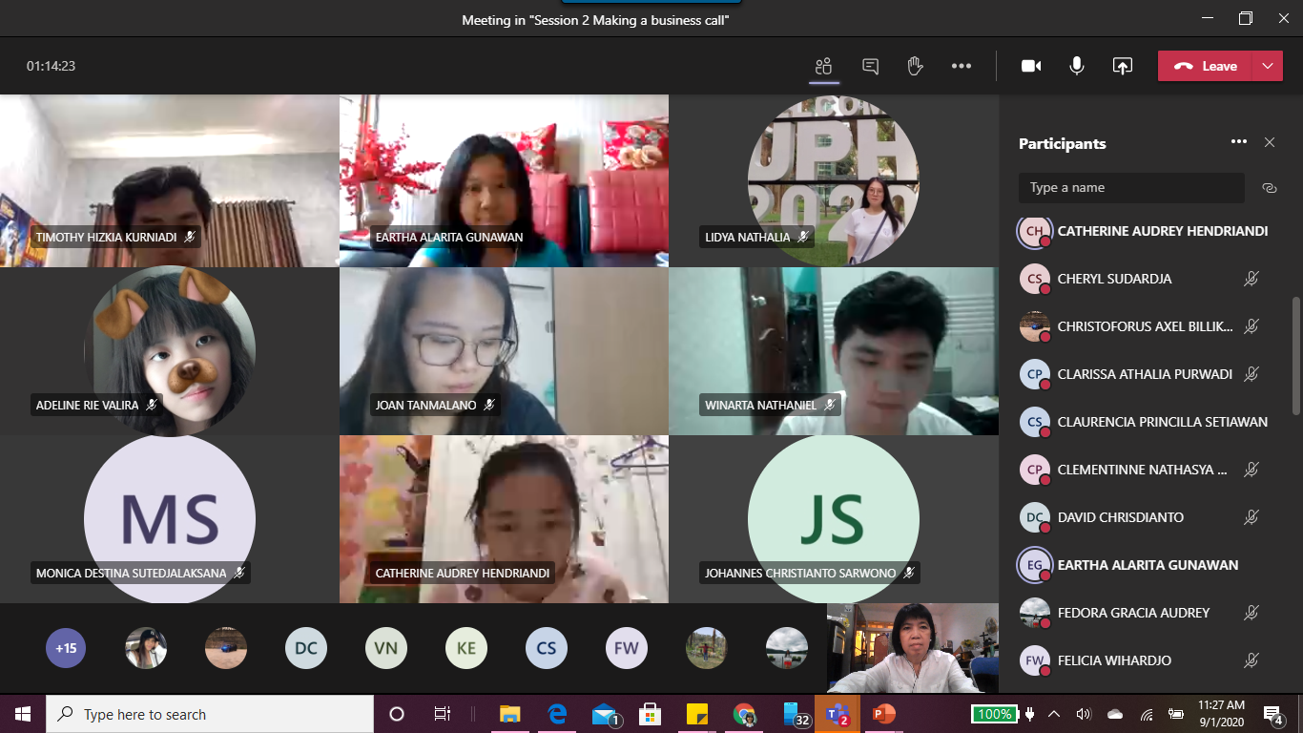
Tuesday, 10.15 – 11.55

