Slide 1
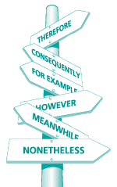
Signal Words
(Transitional Words)

Slide 2
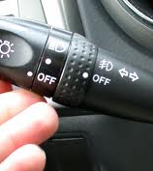
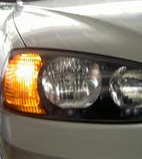
What is this?

Slide 3
Do you know these signs?
Number 1
Stop
Number 2
Traffic light
Number 3
No U-turn
Number 6
Number 5
Two-Way Street
Number 4
Construction Ahead
Warning: Slippery Road

Slide 4
So, ….
What does ‘SIGN’, ‘SIGNAGE, or ‘SIGNAL’ mean?

Slide 5
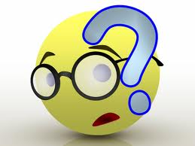
And, What does ‘SIGNAL WORDS’ mean?

Slide 6
What are Signal Words?
SIGNAL WORDS
Help readers understand pattern of organization in a reading text.
Help readers predict what is going to happen in what they are reading.
In conclusion:
Signal words are important to help readers understand the text.

Slide 7
Why Signal Words?
Allow audience to flow smoothly from one idea to another
Enhance logical organization and understandability
Clarify categories of relationships between ideas
Enhance comprehension of the text

Slide 8
Addition
List of words:
also, again, as well as, besides, coupled with, furthermore, in addition, likewise, moreover, similarly
Example:
Trusting relationship as well as positive reinforcement are needed by the team to overcome difficult situations.

Slide 9
Consequence
List of words:
accordingly, as a result, consequently, for this reason, for this purpose, hence, otherwise, so then, subsequently, therefore, thus, thereupon, wherefore
For example:
Highway traffic came to a stop as a result of an accident that morning.

Slide 10
Comparison and Contrast
contrast, by the same token, conversely, instead, likewise, on one hand, on the other hand, on the contrary, rather, similarly, yet, but, however, still, nevertheless, in contrast
The children were very happy. Likewise, their parents were very proactive in providing good care.

Slide 11
Directions
here, there, over there, beyond, nearly, opposite, under, above, to the left, to the right, in the distance
In the distance, she could see smoke billowing up from the burning building.

Slide 12
Practice 1
Please connect the following ideas using signal words.
Harry is rich. Harry is smart.
Bali has unique culture and nature. Bali attracts many tourists to come.
Volunteers don’t get paid. Volunteers can enjoy many life-enriching benefits.
I usually get up around 5 o’clock. I take a bath. I eat breakfast.
I love my parents. I love my brother and sister. I love my family.

Slide 13
Practice 2
Make a sentence or sentences using each of the following signal words.
As a result
Furthermore
More than
Before
Hence
And
In conclusion

Slide 14
Practice 3
Group Work:
Choose around 5 signal words. Then, make a paragraph using the five signal words.

Slide 15
References
Study guide: http://www.studygs.net/wrtstr6.htm
Resource Room: http://www.resourceroom.net/comprehension/literature/signalwordsHP2.asp

