Slide 1

Scanning Practice

Slide 2

Let’s Practice!
Find flight information from Tangerang to Denpasar, one ticket, February14th, 2018, morning flight (before lunch), economy class. You have a limited budget, but you don’t want to take lion air.

Slide 3
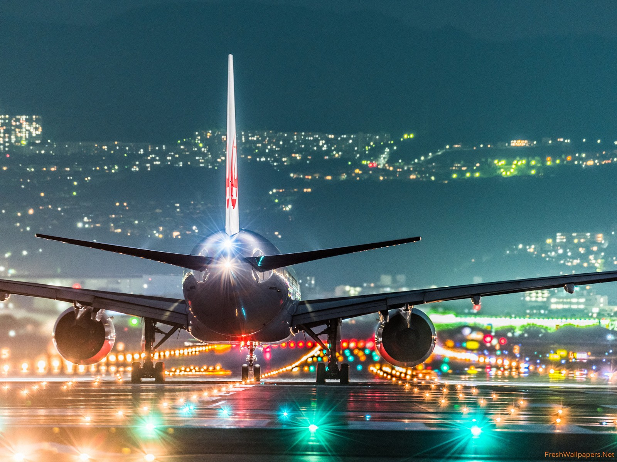
Find flight information from Tangerang to Perth, one ticket, May 23rd, 2018, evening flight, economy class. Find the cheapest one from your budget, your budget is 2.5-3 millions IDR.

Slide 4
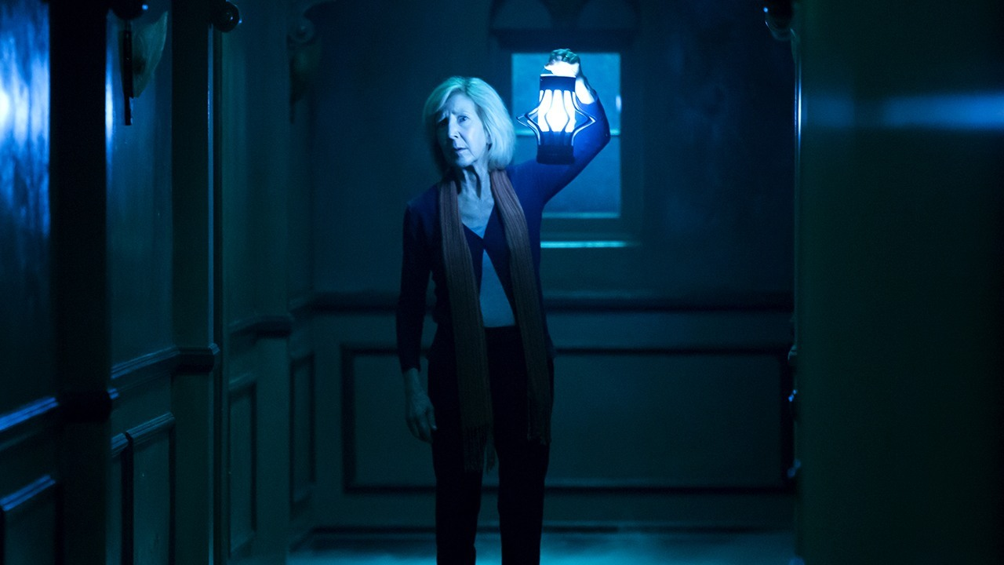
Insidious 3 is now playing. You want to ask your crush to watch it. Using the internet browser, find the movie’s schedule for after today’s class and find the nearest cinema.

