Slide 1
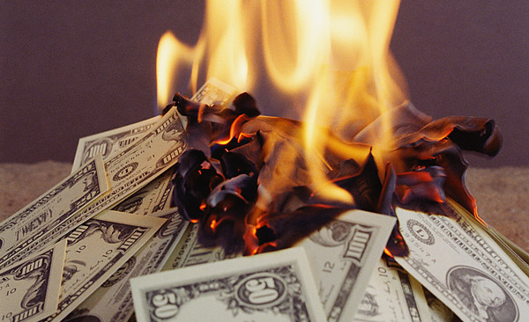
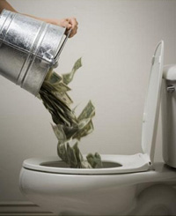
STOP WASTING MONEY

Slide 2
Do you spend your money wisely??

Slide 3
Indonesian Consumer Rate
By Mckinsey & Company
57% every year

Slide 4
TIPS
Record your expenses
Make of budget
Plan on
saving money

Slide 5
Saving money is very important thing so we must not wasting money for unimportant things

Slide 6
“Do not save what is left after spending, but spend what is left after saving.”
Final
Massage

