Slide 1
Persuasive Speech

Slide 2
Persuasive speech
Moves your audience to believe you
Influences your audience to take action.

Slide 3
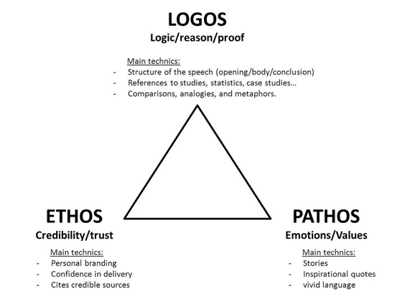
Persuasive Tools
Source: entrepreneursspeaking.com

Slide 4
Examples
Logos: Logical appeal - using facts, details, statistics
"The data is perfectly clear: this investment has consistently turned a profit year-over-year, even in spite of market declines in other areas."
Ethos: Credibility appeal – competence, experience, character
"As a doctor, I am qualified to tell you that this course of treatment will likely generate the best results."
Pathos: Emotional appeal - arousing strong feelings
"If we don’t move soon, we’re all going to die! Can’t you see how dangerous it would be to stay?"

Slide 5
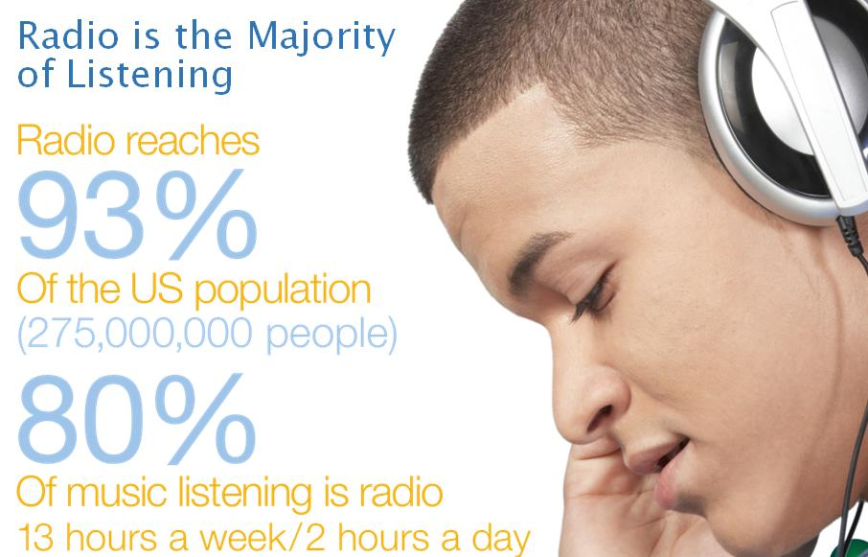
Logos, pathos, ethos?

Slide 6
Logos, pathos, ethos?

Slide 7
Logos, Pathos, Ethos?

Slide 8
Tips
Present a topic that the audience needs or are interested in – to solve their problem
Show your credibility:
explaining your competence, by being honest and careful with speech material, by remaining open-minded, and by showing common ground with listeners.
Use sound reasoning as a powerful tool of persuasion:
Build your case by using strong evidence (such as statistics, examples, and testimony) that is accurate, up-to-date, and typical. Try to use a variety of sources, all of them reliable and reputable.

Slide 9
Problems - Topics
Health problems
Healthy diets/eating habits
Prevention of spreading of germs in the dormitory
First aid in classroom
Learning facility problems
Computer lab
Classrooms
Clinical lab
Learning problems
Group learning
Individual learning
Dormitory problems
Spiritual growth problems
6. Academic problems
7. Time management problems
8. Social problems
Conflict
9. Technology problem
Moodle
Wi fi
Computer/lap top
10. Personal problems
Stress
Grieve
Broken heart
Financial problem

Slide 10
Information Organization (Outline)
Title:
Name(s) + NIMs:
Opening
Attention grabber
Background
Credibility
Your persuasive message (Main ideas in Thesis Statement)
Body
Main idea 1
Supporting Argument 1
Main idea 2
Supporting Argument 2
Closing
Conclusion/summary
Final message → invitation

Slide 11
Supporting arguments
Facts, figures, statistics
Use examples from “real life”
Narratives—make your audience witness to a living drama
Use Expert Testimony/Witnesses
When you quote others, you are associating yourself with them, so be careful whom you choose!
Reluctant witnesses are those who testify against their apparent self-interest and so are often more powerful (such as Democratic critics of a Democratic president).

