Slide 1
Paraphrasing: Brief Explanation
Sandra Sembel

Slide 2
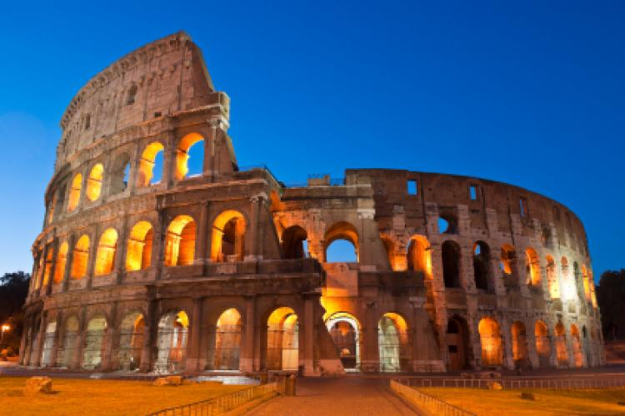
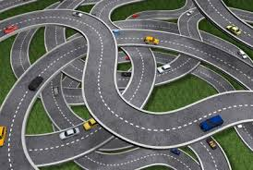
Look at the picture!
There are many roads to Rome
Colosseum – Historical Ruins
What does it mean?

Slide 3
What is Paraphrasing
What we read
With our own words
Retell
What we hear
Paraphrasing is retelling what we read or what we hear with our own words.

Slide 4
Look at these sentences!
My name is Sandra.
Just call me Sandra
I am Sandra
I live in Jakarta.
My house is in Jakarta.
Jakarta is the place where I Iive.
People call me Sandra
Sandra is my name
The place where I live is Jakarta.

Slide 5
Let’s try
If you go to New York in Winter time, be sure to bring your warm clothes.
Be sure to bring your warm clothes, if you go to New York in Winter time.
If you visit New York in Winter time, don’t forget to take along your warm clothes.
Don’t forget to take along your warm clothes, If you visit New York in Winter time.
Change word order
Use synonyms
Combination

Slide 6
Now, it’s your turn!
I will go with you if you go to the party.
Because I don’t have the book, I will borrow the book from the library.
If the weather is good, we will go to the beach.
I didn’t go swimming with them because I wasn’t feeling well.

Slide 7
Try this!
Even though the weather was good, we didn’t go.
I will go with you if you go to the party.
Because I don’t have the book, I will borrow the book from the library.
If the weather is good, we will go to the beach.
I didn’t go swimming with them because I wasn’t feeling well.

