Slide 1
Paragraph Writing

Slide 2
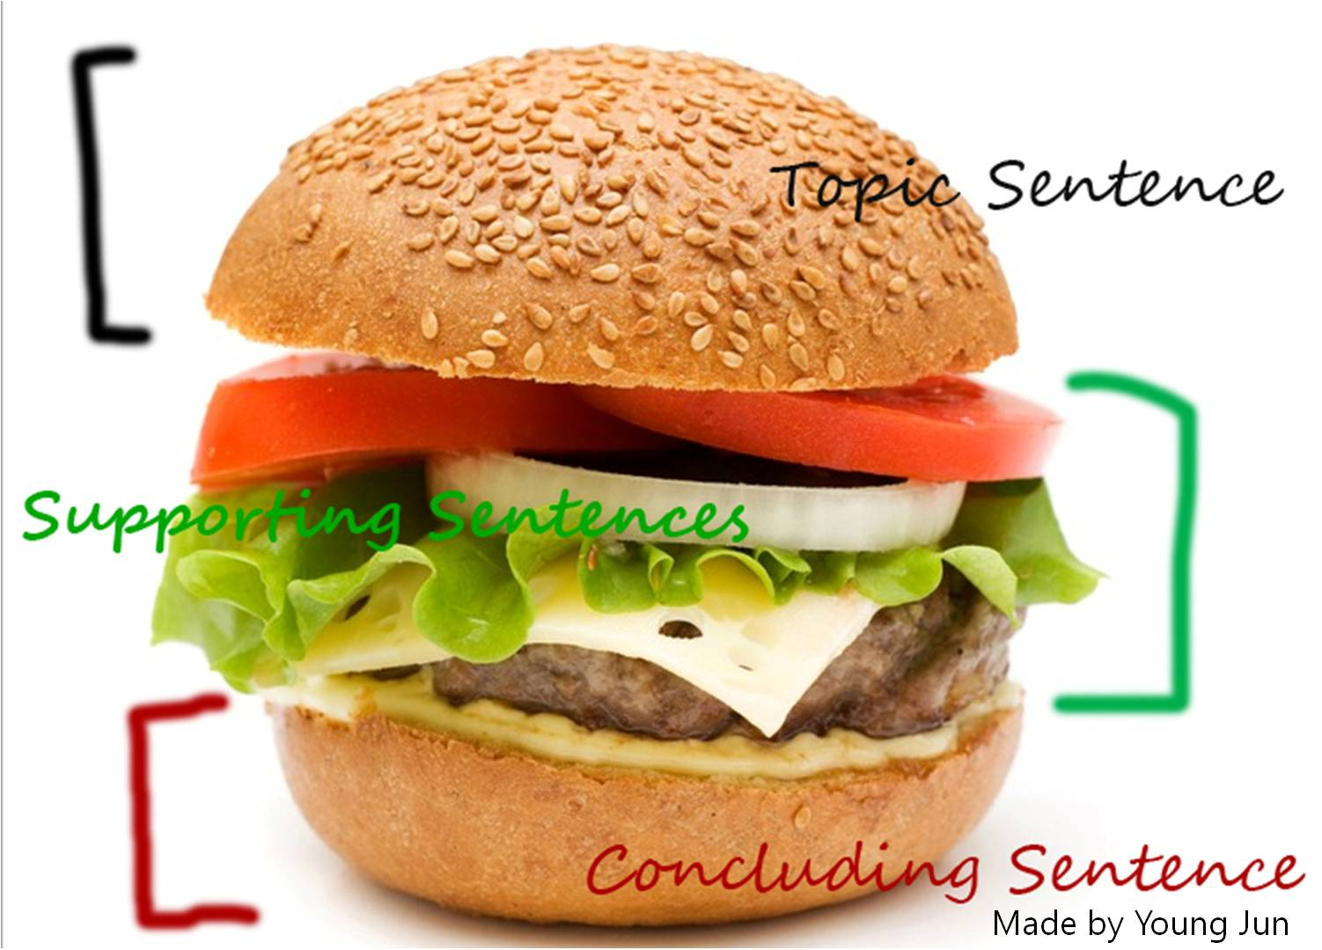
Parts of a Paragraph

Slide 3
Paragraph
Title
XXXXXXXXXXXXINTRODUCTIONXXXXXXXXXXXX. XXXXXXXTOPIC SENTENCEXXXXXXXXXXXXXXXXXXX.
First, XXXXXXXXX (supporting idea 1) XXXXXXXXXXX XXXXXXXXXXXX. In addition, XXXXXXXXXXXXXXXXX (supporting idea 2) XXXXXXXXXXXXXXXXXXXXXXXX
Finally, XXXXXXXX (supporting idea 3) XXXXXXXXXXX XXXXXXXXXXXXXXXXXXXXXXXXXXXXXXXXXXXXXXX.
In conclusion, XXXXXXXXXXXXXXXXXXXXXXXXXXXXX
XXXXXXXXXXXXXXXXXXXXXXXXXXXXXXXXXXXXXXXX

