Slide 1
Cohesive devices
Meeting 4

Slide 2
Compare these two paragraphs
Which paragraph is more effective/easier to read?
What words are in this (effective) paragraph but are not in the other paragraph? List them down.
How do these words make the (effective) paragraph easy to read?
Paragraph 1 | Paragraph 2
I like bananas. I like apples. Bananas are sweet. Apples are sweet. My sister doesn’t like bananas. My sister doesn’t like apples. My sister likes strawberries. Our parents usually take us to Fresh and Healthy. We buy our favorite fruits in Fresh and Healthy. | I like bananas and apples because they are sweet. My sister doesn’t like them, but she likes strawberries. Our parents usually take us to Fresh and Healthy where we buy our favorite fruits.

Slide 3
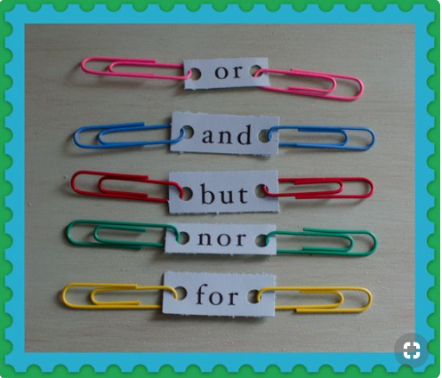
What are these words?

Slide 4
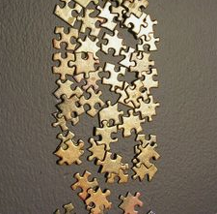
Cohesive Devices
Cohesive devices are words or phrases that are used to link or clarify the relationships among ideas (in sentences, or paragraphs).

Slide 5
For the writer
Without cohesive devices, a paragraph or an essay will be just a group of unrelated sentences or paragraphs that may be difficult to understand.
So, an essay that has cohesion appears as a single unit (not a random sequence of sentences)

Slide 6
For the reader
Help a reader to understand relationships between parts of sentences, between sentences and between paragraphs in an easy.
Help a reader to identify a change in meaning in a sentence, or paragraph.

Slide 7
Types of Cohesive Devices
Addition/
Similar Ideas
Cause and effect
Choice
Contrast
Time
Condition

Slide 8
ADDITION or SIMILAR IDEAS
And, both … and, not only… but also
The nursing process is a method of organizing and delivering nursing care.
Both my uncle and my aunt are nurses.
The nurse is not only friendly but also helpful.

Slide 9
CONTRAST
But, yet, although
Billy tried hard to quit smoking, but he failed.
She is ill, yet she refuses to see a doctor.
The junior doctors are hired by the clinic although they are inexperienced.

Slide 10
Cause and effect
Because, So
Because Diana had a headache, she took two tablets of paracetamol.
I got a stomachache, so I visited the clinic.

Slide 11
TIME
Before, after, as soon as
Before the nurse dressed the wound, she disinfected it.
Please drink a lot of water after taking the medicine.
The nurse gave the information about the patient as soon as the doctor arrived.

Slide 12
Choice
Or, either….or
You can consult Doctor Brown or Doctor Smith about your condition.
You can buy the medicine either from the hospital pharmacy or the one outside the hospital.

Slide 13
Condition
If, Unless
If the patient’s blood pressure drops suddenly, you will have to inform the doctor immediately.
Unless you strictly follow the doctor’s instructions, you will not recover soon.

