Slide 1
Making Inferences

Slide 2
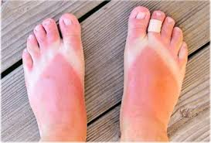
Look at the picture!
Has the person visited the mountain or the beach recently?
How do you know?
Is this person a man or a woman?
How do you know?

Slide 3
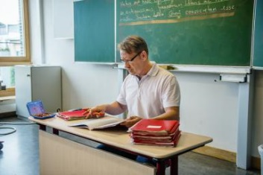
Here is another picture!
Where is this person?
Hospital
Airport
School
What is the job of this person?
Police officer
Teacher
Architect?

Slide 4
So, …
You have just made some inferences about the picture.
You make an inference when you use what you see + what you know to make a statement.

Slide 5
What is Inference?
an idea/statement made based on
the observable facts or details +
general knowledge of the reader about it
What you see or read!
What you know or learn

Slide 6
Inference and conclusion

