Slide 1
Main Idea and Supporting Details
(Sandra Sembel)

Slide 2
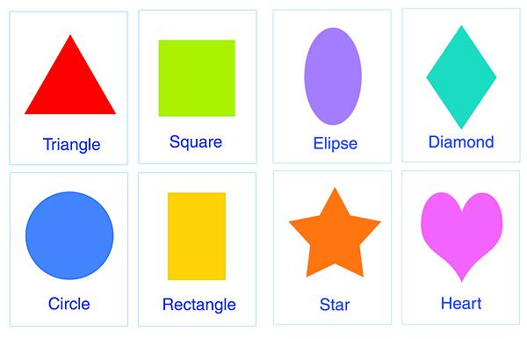
What is it about?
Blue
Red
Green
Yellow
Topic?
Colors
Triangle
Square
Ellipse
Diamond
Circle
Rectangle
Star
heart
Topic?
Shapes

Slide 3
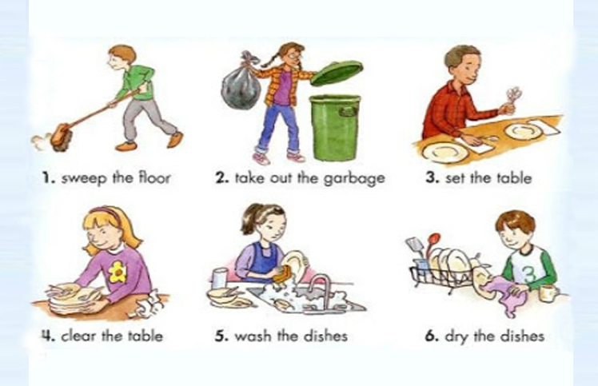
Topic?

Slide 4
Topic?
House Work
(Household chores)

Slide 5
What is it about?
Topic?
Team Sports
Basketball, Soccer, Volleyball

Slide 6
Main Idea
Main idea
Colors
Shapes
Household chores
Team Sports
Main idea is key or central idea
Supporting details are statements that explain the main idea.

Slide 7
Try this!
Paragraph 1
¹Last weekend, I did many things. ²On Saturday morning, I stayed at home and did my household chores (washing my clothes, cleaning the house). ³In the afternoon, I went to a friend’s house. ⁴We just talked about many things. ⁵And, in the evening, I just watched TV at home. ⁶On Sunday morning, I went to church. ⁷Then, in the afternoon, I spent time with my family. ⁸We cooked lunch and ate lunch together. ⁹In the evening, I stayed home relaxing and preparing for the next day. ¹⁰Those are the interesting things that I did last weekend.
(B) Last Weekend’s Activities
Which one is the main idea?
Doing household chores
Last weekend’s activities
Watching TV
Spending time with family
Preparing for the next day
How many supporting details?
What are they?

Slide 8
Try another one!
Paragraph 2 (Group/pair work)
It takes a lot of trucks to get an airplane ready to fly. Fuel trucks are very important. They fill the fuel tanks of planes. Baggage trucks carry people’s suitcases to and from planes. Still other trucks deliver food. You might also see mail trucks and cargo trucks. Also standing by at airports are repair trucks.
The main idea of the paragraph is:
A. airplanes are like trucks
B. some trucks carry food
C. how trucks help planes
C. how trucks help planes
How many supporting details?
What are they?

Slide 9
What about this one?
Paragraph 1 (Class work)
1 Several factors can affect having a good memory. 2 First is a lack of motivation. 3 Without a real motivation to learn or remember something, you probably won’t. 4 Another factor is a lack of practice. 5To stay sharp, memory skills, like any other skill, must be used on a regular basis. 6Yet another factor that can hurt memory is self-doubt. 7If you’re convinced you won’t remember something, you probably won’t. 8In addition, distraction can also affect memory. 9If you’re distracted by a television or by conversation nearby, try to find a quiet environment before trying to commit something to memory.
Main Idea? Sentence?
How many supporting details? What are they?

Slide 10
Topic 1: BEST FRIENDS
Possible main ideas?
Reasons why we became best friends
Supporting details?
Positive qualities of my best friends
Supporting details
Favorite activities I do with my best friends
Supporting details?
… ?

Slide 11
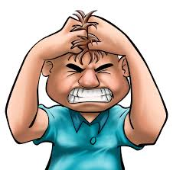
Topic 2: Stress
Possible Main Ideas?
Causes of stress
Supporting details?
Negative impacts of stress
Supporting details?
Strategies to overcome stress
Supporting details?
Activities to release stress
Supporting details?

Slide 12
Topic 3: Learning
Possible main ideas
Learning problems
Supporting details?
Learning tips
Supporting details?
Learning partners
Supporting details?

Slide 13
Topic 4: My hometown
Possible main ideas?
Interesting places?
Supporting details?
Traditional foods and drinks?
Supporting details?
Unique Cultures?
Supporting details?
People?
Supporting details?

Slide 14
Learning Points
Main idea is key or central idea
Supporting details are statements that explain the main idea.
Make your communication effective by supporting your main idea with relevant supporting details!

