Slide 1
Out of the Box (Side) Business Ideas

Slide 2
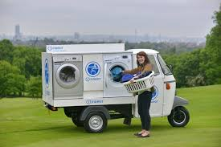
Business on Wheels
Food trucks
Laundry trucks
Entertainment (Karaoke, Movie, Games) trucks
Book store on wheel
Class on wheel (cooking class, DIY class, language, Bimbel)
Flower shop on wheels
Gift shop on wheels
Coffee shop on wheels
Store on wheel

Slide 3
Event Planning/Organizing
School reunion organizing
Party organizing
Group traveling organizing
Kampung bazaar organizing
Joing Garage Sales organizing
Arisan

Slide 4
Visiting Tutors
Foreign language (English, French, German, Manadrin)
DIY Arts and Crafts
Photography
Sports
Music (piano, guitar, drum)
Bimbingan belajar (math, science, statistics)
Cooking
Computer programming

Slide 5
Free-lancing
Photographer
Translator
Interpreter
Modeling
Writing newsletters for organizations
Ghost writers
Singer
Musician

Slide 6
Home Business
Home day-care (babies, Senior citizens)
Home cafe
Washing machine rental
Making Meal-to-go (breakfast/lunch to go)

Slide 7
Caring Business
Home care – elderly
House sitting
Baby sitting
Pet sitting

