Slide 1
GROUP 13
Georgina D. A. Penna
Gerald W. M. R. P. Koa
Harli S. Soleman
Jessica
Kazy F. Geofryantino

Slide 3
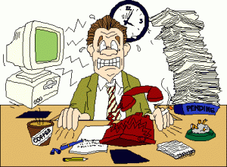

Slide 4
Good time management had good impact for us
That’s why we must know
HOW TO MANAGE OUR TIME

Slide 5
Time management’s impact
Concentration increase
Time organize will be better
Stress level decrease

Slide 6
HOW to MANAGE our TIME
Make a plan, schedule and priority
Try delegation
Say “NO” to something that you can’t do
Don’t be lazy and procrastinate
Avoid things that can distract you

Slide 7
KEYS
Plan
Consistency
Commitment

Slide 8
Manage Your Time Well !
Time is something that you can lose and never come back

Slide 9
References
http://www.webmd.com/add-adhd/features/time-management-tips#1
https://www.workitdaily.com/prioritize-decide-set-boundaries-3-keys-time-management/
https://www.mindtools.com/pages/article/newHTE_00.htm

