Slide 1
Business (Fundraising) Plan for a social project
(Group Work)

Slide 2
What is a business plan?
A business plan is a written document describing a company's core business activities, objectives, and how they plan to achieve their goals.
Startup companies use business plans to get off the ground and attract outside investors.
Good business plans should include an executive summary, products and services, marketing strategy and analysis, financial planning, and a budget.
(Source: Investopedia.com)

Slide 3
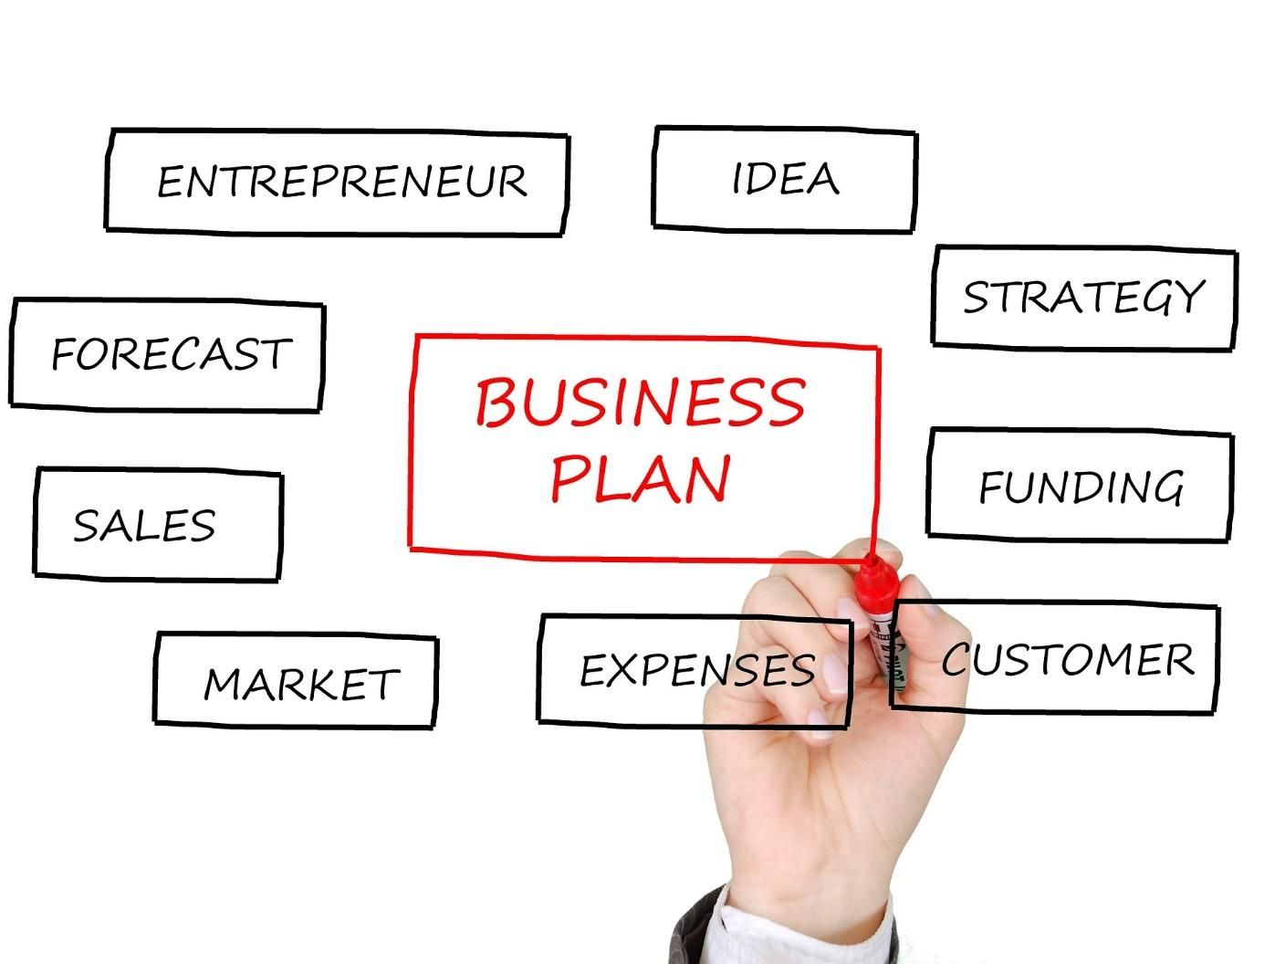
What needs to be in the business plan document?
Source: https://www.getcloudapp.com/blog/business-plans-visuals

Slide 4
Social Enterprise
Organizations that address a basic unmet need or solve a social or environmental problem through a market-driven approach. (socialenterprise.us)
Source: socialenterprise.us
A social enterprise is a business with social objectives that serve its primary purpose.
Unlike a charity, social enterprises pursue endeavors that generate revenues, which fund their social causes.
Source: Investopedia.com

Slide 5
Social enterprise ideas
ARUNA
Du’Anyam
Kerjabilitas.com
Tom’s Shoes
Walby Parker Eye glasses
Stateback: Buy one give one

Slide 6
Social projects
Education for all
Health care
Medicinal herb garden
Food hawkers
Food for homeless people
Plastic waste Recycling

Slide 7
Social project ideas
Free meals for online transportation and taxi drivers
Free wheel chairs or crutches
Scholarships for the needy
Health-protection kit for the needy
Entreprenuership training for school dropouts
Free glasses
Free school shoes and unifomrs
Supporting orphanages
Supporting senior homes
First aid box

Slide 8
Business ideas to fund your social project
Food, cakes, drinks
Surgical Masks (health care kit)
Umbrellas
Calendars
Mugs
T-shirts
Groceries Bags
Tumblers

Slide 9
YOUR ORGANIZATION
Vision: What you want your organization to be (Be .... )
Mission: How you are going to do it (To ....)
1 | Name | T-SHARE
2 | Vision | Be an inpsiring social enterprise that improves livelihood for the economically disadvantaged
3 | Mission | To empower the school dropouts to be financially independent.
4 | Motto | Good shirt by good people for good people

Slide 10
Your target of service
The people you are going to help.
1 | Who are you going to help? | School dropouts Street children
2 | Why do you choose them? | They deserve education for a better future
3 | What problems are they facing? | Education problem Family problem Financial problem
4 | How are you going to help them? (Your solution) | Training of Basic life skills and green entreprenuership Funding the startup of their green business
6 | How much does it cost? | 2 weeks @ Rp 3 million 10 participants/batch – Rp 30 million

Slide 11
Your product/service
Your business: The product or service you will produce and market
1 | What product/service do you offer? | T-shirt with inspirational quotes
2 | Who will be the target market of your product/service? | Clubs (hobby, interest) Offices Orgnizations Schools
3 | What is unique about your product/service? | Simple design Inspirational quotes/motto
4 | What benefits do you give to your target market with this product/service? | 1. Help others 2. Inspire others

Slide 12
Marketing your product/service
Your strategies to market your product/service
No | Marketing Mix | Marketing strategies
1 | Product | Template design and inspriational quotes Customized logo and inspirational quotes (In the future, the design will be made by the school dropouts)
2 | Price | Rp. 75.000/t-shirt
3 | Promotion | Advertising through social media E-WoM Volunteered Endorser/influencer (Public figure)
4 | Place | Organization plattform (IG, Facebook, youtube, blogs) Partners plattform (school, company, organizations)

Slide 13
Your team
No | Name | Role (Job Title) | Contribution (Job descriptions)
1
2
3
4
5
6

Slide 14
Funding to start the business
No | Possible sources of income | Strategies to raise income | Target revenue
1 | Members | @Rp. 1 million | Rp. 10 million
2 | Sponsors | CSR | Rp. 20 million
3 | T-shirt design competitions | Registration fee @Rp 100,000 Target: 500 | Rp. 50.000.000 – Operational cost = Rp. 20 million
4 | Pre-order sales | Promote to groups to order in advance (schools, companies) | Rp. 20 million
 |  |  | Rp. 60 million

Slide 15
Timeline of activities
No | Activities | 1 | 2 | 3 | 4 | 5 | 6 | 7 | 8
1 | T-shirt design Contest
2 | Proposal for sponsorship
3 | e-flyers
4 | Contacting schools
5 | Jurying
6 | Promoting in social media
7 | Getting pre-order
8 | Printing
9 | Delivering

Slide 16
Work in Groups
Present your ideas next week.
Group leader and deputy group leader will give the overview of the project
Every member should be given the opportunity to speak about their role and responsibilities in the project.
You can show your e-flyer, poster
You can include photos and videos too
Each group is allocated a 10-minute presentation + 5 minute of Q&A

