Slide 1
Good afternoon!

Slide 2
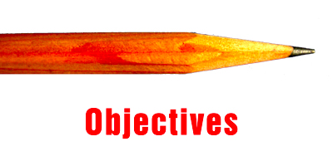
Learning objectives
5’

Slide 3
Describing People
Giving opinion about people

Slide 4
Warm up activity
5’

Slide 5
Find someone who…
Has long hair ?
Wears glasses?
Is between 150-160 cm tall?
Has curly hair?
Is as big as you?
Taller than you?
Heavier than you?
As tall as you?

Slide 6
Presentation: describing people

Slide 7
Physical Descriptions
Posture
Height
Weight
Big/small/average size
Tall/short/average height
Thin/fat/slim/average weight

Slide 8
Physical Descriptions
Hair:
straight, wavy, curly
Short, long, shoulder length
black, brown, blond
Face
Moustache, dimple, mole

Slide 9
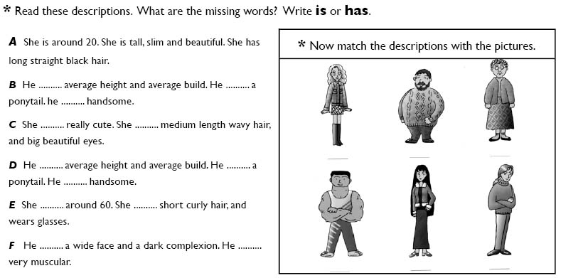

Slide 10
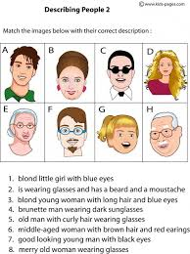

Slide 12
Personality Traits
Hardworking
mature
careful
Smart
Nice
Creative
Patient
Understanding
Organized
Lazy
Immature
Careless
Forgetful
Ignorant
Moody

Slide 13
Speaking activity
5-10’

Slide 14
Describing People: Activity 1

Slide 15
Activity 2: Guessing Game

Slide 16
Answer the following questions
1. Answer the questions:
What do you like about yourself? Why?
What do you want to improve about yourself? Why and How?
2. Then, interview a friend (ask the two questions)
3. Compare your answers

Slide 17
Group discussion
(20-25’)

Slide 18
Discussion Questions
Describe people you know: your family, your best friend, a celebrity.
Say why you choose them.
Share it with your group.

Slide 19
Writing activity

Slide 20
Writing Activity
Describe someone!

