Slide 1
DAILY ROUTINES

Slide 2
Years

Slide 3
YEARS
1985
1998
2004
2016
When were you born?
I was born in ______

Slide 4
Month of the year

Slide 5
Months of the year
What is your birth month?
What month is your birthday?
What month do we celebrate our Independence day?
January
February
March
April
May
June
July
August
September
October
November
December
My month of birth is ______
My birth month is ______
Our Independence Day is on ______

Slide 6
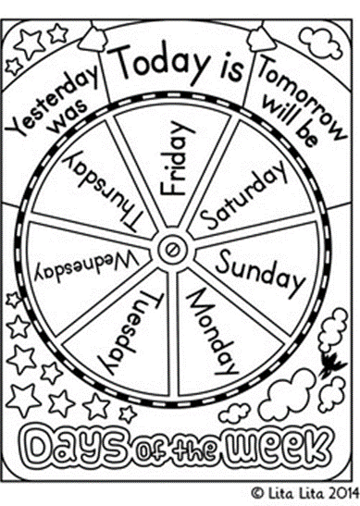
Days of the week

Slide 7
Days of the week
When do you study English?
When do you study math?
When do you have holiday?
Monday
Tuesday
Wednesday
Thursday
Friday
Saturday
Sunday
I study ____ on ____ and ____

Slide 8
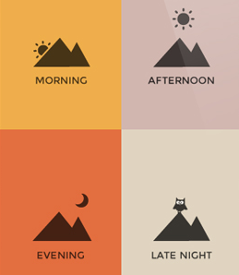
Time of the day
Dawn
Morning
Afternoon
Late afternoon
Evening
Late evening
Midnight

Slide 9
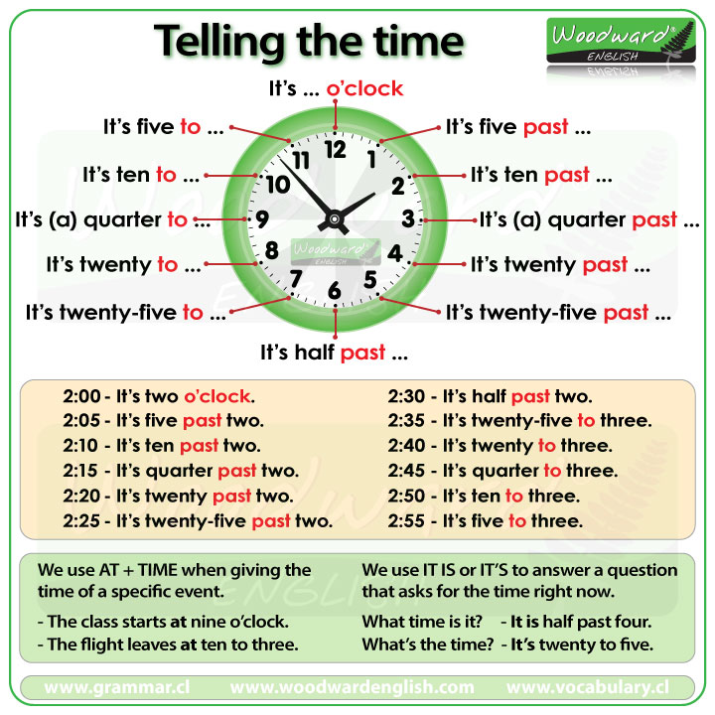
Telling time

Slide 10
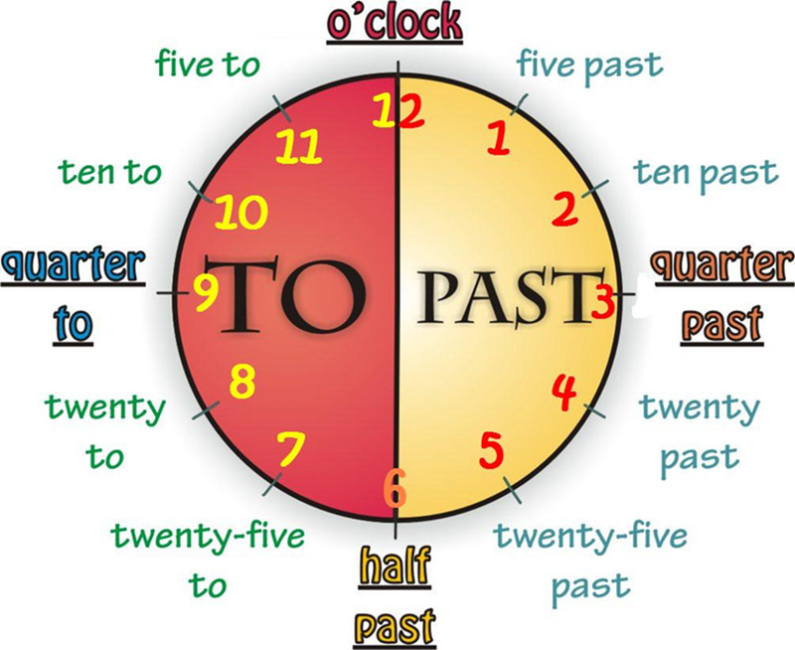

Slide 11
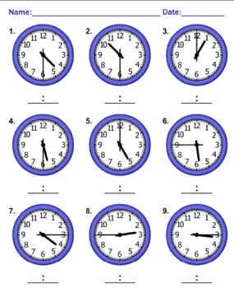
What time is it?

Slide 12
09:45
09:00
10:05
08:50
01:00
09:15
11:55
07:15
02:18
12:45
05:40
03:52
09:30
12:15
06:10
05:45

Slide 13
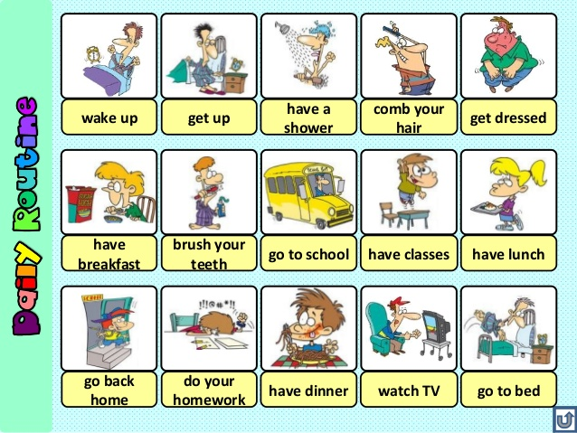
Daily routines

Slide 14
MY DAILY ACTIVITIES
My name is Dony. I usually wake up at 5.00 but I get up at 5.15 and brush my teeth. Then, I read the bible and pray. After that, I take a bath and get dressed. At around 6, I have my breakfast and then I go to classes. I study from 7.15 to 16.00. I have my lunch break from 12.00 to 13.00. During break, I eat lunch, review my lessons and just chat with friends. I go home at 4.30 pm. At home, I take a bath, and watch TV. At around 7 pm, I eat dinner. Then, I do my homework and go to bed at 10 pm.

Slide 15
MY FRIEND’S DAILY ACTIVITIES
My friend’s name is Dony. He usually wakes up at 5.00 but he gets up at 5.15 and brushes his teeth. Then, he reads the bible and prays. After that, he takes a bath and gets dressed. At around 6, he has his breakfast and then he goes to classes. he studies from 7.15 to 16.00. he has his lunch break from 12.00 to 13.00. During break, he eats lunch, reviews his lessons and just chats with friends. he goes home at 4.30 pm. At home, he takes a bath, and watches TV. At around 7 pm, he eats dinner. Then, he does his homework and goes to bed at 10 pm.

