Slide 1
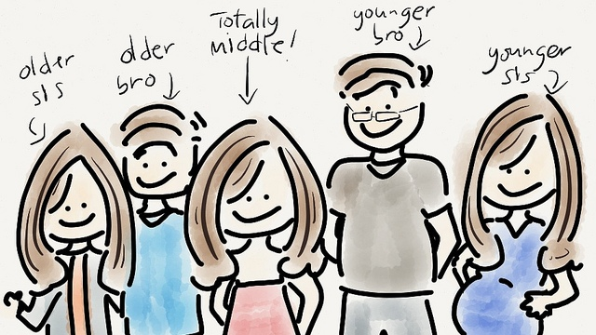
Birth Order and Personality Type
Mainly taken from an article by
By Diaz H, Chinie, Birth Order and Personality: Are you a true type?, http://www.rappler.com/move-ph/ispeak/35606-birth-order-personality, accessed November 17, 2014, 10:30

Slide 2
Birth Order and Personality Type
The theory that birth order affects personality has been around for centuries. It was first proposed by psychiatrist Alfred Adler (1870-1937), and while it has been contested by other experts over the years, I still tend to think that there’s some truth to it.
Here are the basic birth order personality types, according to Kevin Leman, PhD, author of The Birth Order Book: Why You Are the Way You Are. Are they true for you?

Slide 3
Firstborns
Firstborns are natural leaders. Taking the lead from their parents, they like taking charge and want everything to be just right. This may also mean they struggle to admit when they are wrong.
Typically reliable and conscientious, firstborns are often perfectionists who don't like surprises. Although firstborns are usually aggressive and confident, many are also people pleasers with a strong need for approval from anyone in charge.

Slide 4
Firstborns

Slide 5
Compensation and Professions
Compensation: A recent survey by CareerBuilder.com found that workers who were the firstborn child in their families were more likely to earn $100,000 or more annually compared to their siblings.
Professions: The oldest tend to pursue vocations that require higher education, like medicine, engineering or law. Firstborns from the CareerBuilder.com survey reported working in jobs in government, engineering, pharmacy and science. Ohio State University researchers found firstborn children were more likely to pursue "intellectual" jobs.

Slide 6
Job Level and Famous People
Job level: Workers who are firstborn are more likely to report holding a vice president or senior management position, according to the survey.
Famous firstborns: Oprah, Hillary Clinton, Winston Churchill, Sylvester Stallone and Bill Clinton.

Slide 7
Only Children
According to Leman, only children are "Super Firstborns" or “firstborns in triplicate.” They share many of the same traits as firstborns and frequently shoulder parents' high expectations. Thus, they tend to be even more responsible and even bigger perfectionists. They also tend to struggle more with criticism.
Only children are often confident, well spoken and tend to do well at school. They are also likely to use their imagination more than other children, and usually get along better with people older than themselves.

Slide 8
The Only Child

Slide 9
Compensation, professions, famous people
Only Children are similar in compensation and professions to Firstborns.
Famous only children: Jack Welch, Tiger Woods, Alan Greenspan and Maria Sharapova.

Slide 10
Middle Born
Middle-born kids are the most difficult to pin down, because while they are guaranteed to be opposite of their older sibling, that difference can manifest in many ways. Middle kids will usually develop skills and interests different from those shared by the family, and prioritize friends and peer groups since they often feel they do not have a special place within the family.
Middle children often feel that they receive the least attention, which can make them insecure and secretive; however, it also makes them more independent, inventive and resourceful. They can usually read people well, and often act as mediators or peacemakers since their “middle” role allows them to see all sides of a situation.

Slide 11
Middle-born

Slide 12
Compensation, profession, job level, famous people
Compensation: More middle children identified themselves as earning $35,000 or less per year than firstborn or youngest children, according to the CareerBuilder.com survey.
Professions: Middles tend to have excellent negotiating and people skills -- anything that employs these skills is a great fit. Middle children from the CareerBuilder.com survey said they work in nursing, law enforcement, firefighting and machine operation.
Job level: Middle children were more likely to identify with professional and technical staff level positions in the CareerBuilder.com survey. They also reported being the most satisfied with their current positions.
Famous middles: David Letterman, Richard Nixon, Madonna and Princess Diana.

Slide 13
Last Born
The lastborn or “baby” of the family usually benefits most from the fact that by the time they come around, parents are more comfortable and experienced when it comes to the art of parenting.
Lastborns "shoulder less responsibility, so they tend to be more carefree, easygoing, fun-loving, affectionate and sociable, and they like to make people laugh," says Leman.
He adds, however, that while lastborns may be charming, they have the potential to be manipulative, spoiled or babied to the point of helplessness. They are also the most financially irresponsible and can turn rebellious, with an “I’ll show them!” attitude, as they tend to view their elder siblings as faster, stronger, bigger and smarter.

Slide 14
Last-Born

Slide 15
Compensation, Professions, Job Level, Famous People
Compensation: Last borns were the least likely to report earning six figures, according to the CareerBuilder.com survey.
Professions: Youngest children often gravitate toward artistic and outdoor jobs, according to the OSU survey. They're also successful in journalism, advertising, sales and athletics. Those who responded to the CareerBuilder.com survey reported working in art, design, sales and information technology.
Job level: The majority of last borns in the CareerBuilder.com survey held administrative and clerical level positions. They also reported being the least satisfied in their current jobs.
Famous younglings: Jim Carrey, Billy Crystal, Steve Martin, Cameron Diaz and Rosie O'Donnell.

Slide 16
Not so fast…
University of Georgia psychologist Alan E. Stewart also recently distinguished between “actual” birth order, or ABO (the numerical rank order into which you are born in your family of origin) and “psychological” birth order, or PBO (self-perceived position in the family).

Slide 17
So, …
Predicting personality based on birth order is not as simple as one may think. There are many exceptions that can have an effect on how much birth order plays a role in determining personality. Some of these factors are listed below:
Gender
Blended families
Adoption
Multiples (for example, twins or triplets)
How many children are in the family
Spacing of children (for example, whether 1 year or 9 years separate siblings)

Slide 18
Other References
University of Maine Cooperative Extension. (2005). Birth Order Helps Make Us Unique. Retrieved February 22, 2006 from http://www.umext.maine.edu/onlinepubs/htmpubs/4359.htm
Zupek, Rachel, Can Birth order determine your career?, cnn.com, http://edition.cnn.com/2008/LIVING/worklife/10/22/cb.birth.order.career/index.html?iref=24hours, accessed November 18, 2014, 10:51

