Slide 1
Advertising

Slide 2
Famous Advertising Slogans
I’m lovin’ it | ?
Finger lickin’ good | ?
Just do it | ?
Life’s good | ?
Connecting people | ?
Let’s make things better | ?
Hello Moto | ?
The ultimate driving machine | ?
Intel inside | ?
It’s the real thing | ?
Be the first to know | ?

Slide 3
Famous Advertising Slogans
I’m lovin’ it | McD
Finger lickin’ good | KFC
Just do it | Nike
Life’s good | LG
Connecting people | Nokia
Let’s make things better | Phillips
Hello Moto | Motorolla
The ultimate driving machine | BMW
Intel inside | Intel
It’s the real thing | Coca Cola
Be the first to know | CNN

Slide 4
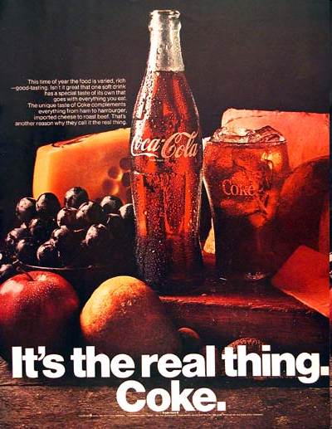

Slide 5
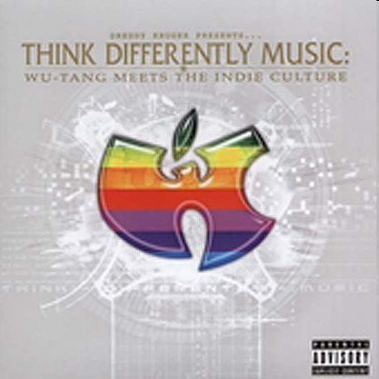

Slide 8
Talking Points
What advertisement do you find annoying?
Why do you think so?
What advertisement do you like best?
What does it advertise?
Why do you like it?
Have you ever bought something after you read the advertisement?
Can you mention different ways companies advertise their products?
Do you think it is important for a company/organization to advertise its product/service?

Slide 9
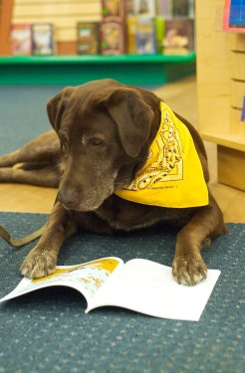
Hi! Are you ready to learn more?

Slide 10
Skimming
Changing World Markets
Can you guess what the article will be about?
One type of market
A number of markets in the world

Slide 11
Scanning
Read the article on Page 7 and 8.
The word before interruption in paragraph 2 is _____?
What is ‘non-existent’ in China (par 3)?
How many years must a company plan ahead before entering the market in China (par 4)?
What was a strange idea in Russia (par 5)?
What Russian dish was ‘pizza’ similar to (par 6)?
Which one is the concluding sentence in paragraph 7?

