Slide 2
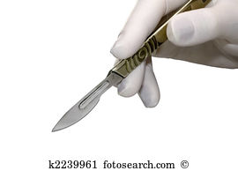
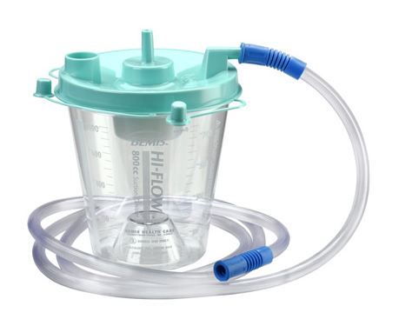
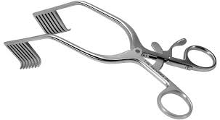
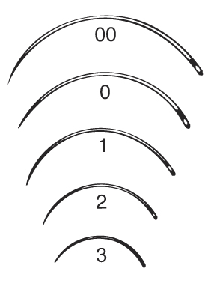
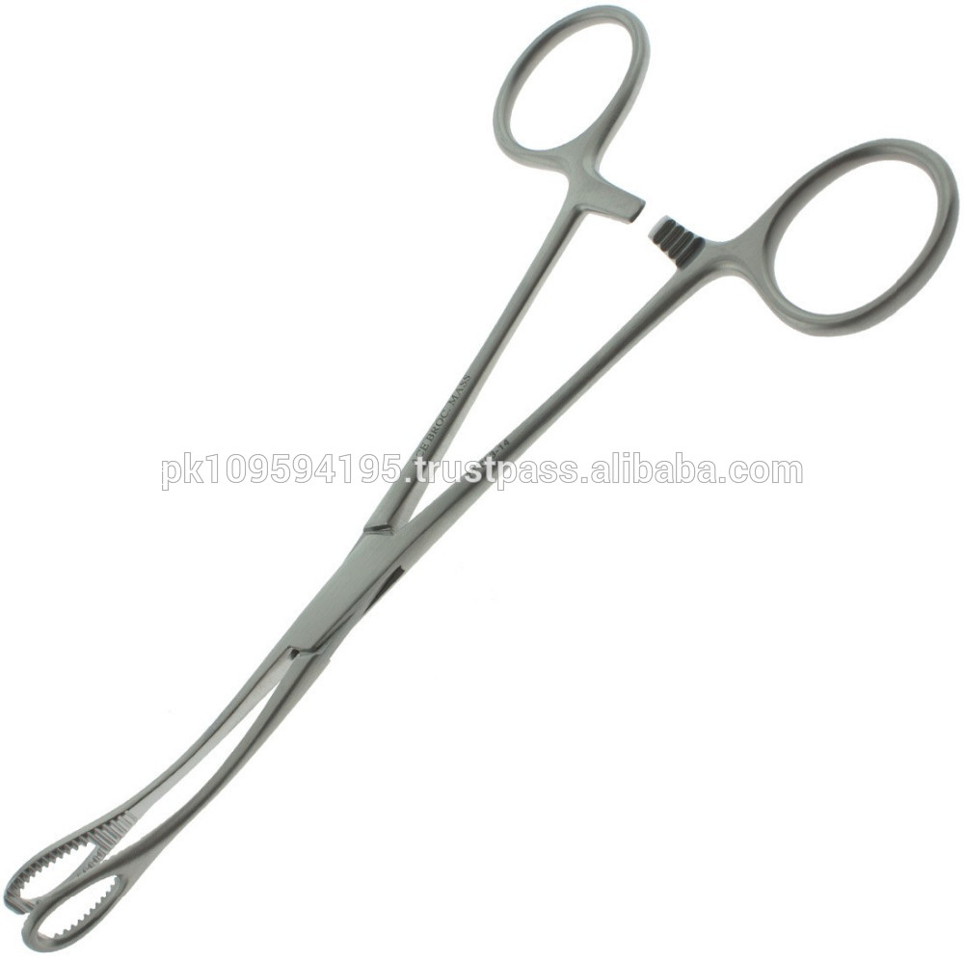
Retractor
Scalpel
Suction
SURGICAL TOOLS
Forceps
Surgical Needles

Slide 3
SURGICAL TOOLS:
Can you guess?

Slide 4
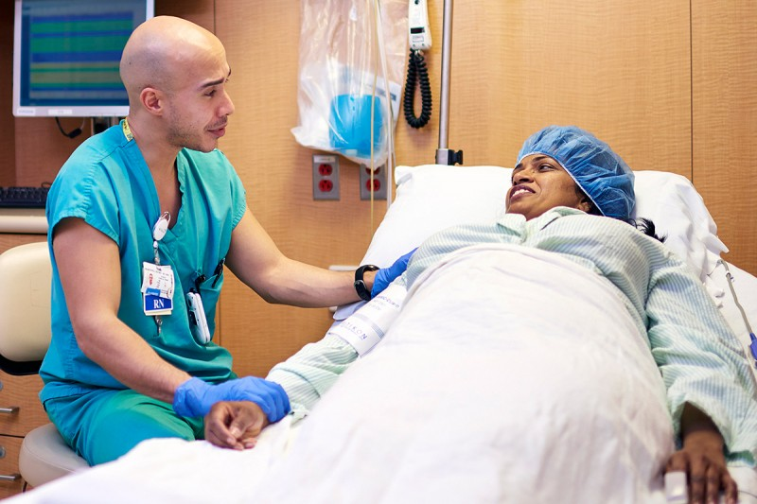
Pre-Operative Checks
(Nurse-patient communication)

Slide 5
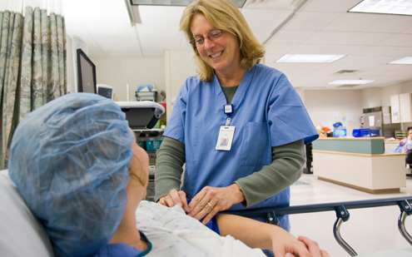
Purpose
Obtain health information
Assess patient’s readiness

Slide 6
Opening
Greetings: Good morning, Mrs. Smith. How are you feeling today?
Introduction and purpose of visit: I’m Ns. Linda. I’m going to help you get ready for your surgery.
Procedure: I will ask some questions to make sure you are ready for your surgery.

Slide 7
Opening
Greetings:
Introduction and purpose of visit:
Procedure:

Slide 8
Legal Checklist
ID Checking: Can you say your name and date of birth?
Information about surgery: Has the doctor given you the information about your surgery?
Questions: Do you still have questions about your surgery.
Informed consent: Have you signed the informed consent for the surgery?

Slide 9
Legal Checklist
ID Checking: ?
Information about surgery?
Questions: ?
Informed consent:?

Slide 10
Medical Checklist
Drug allergies: Do you have any drug allergies?
Antibiotic allergies: Do you have any antibiotic allergies?
Food and drink: Did you eat any breakfast this morning?

Slide 11
Medical Checklist
Drug allergies:?
Antibiotic allergies:?
Food and drink:?

Slide 12
Non-medical checklist
Dentures: Do you have any dentures in?
Contact lenses: Are you wearing contact lenses?
Hearing aids: Are you wearing any hearing aids?
Make up: Do you have your make up on?
Nail polish: Do you have nail polish?
Jewelry: Do you wear any jewelry, like ring, earring, necklace and bracelet?

Slide 13
Non-medical checklist
Dentures:?
Contact lenses:?
Hearing aids:?
Make up:?
Nail polish:?
Jewelry:?

Slide 14
Closing
Ending 1: It seems that you are ready for surgery.
Questions: Do you still have any other questions?
Transition: Next, the operating team will come and take care of you.
Prayers: Do you want me to call somebody to pray for you before the surgery?
Calming down: Don’t worry. You are in good hands.
Ending 2: Okay, ma’am. I will see you after the surgery.

Slide 15
Closing
Ending 1:.
Questions:?
Transition:.
Prayers:?
Calming down:.
Ending 2:.

