Slide 1
INFOGRAPHICS

Slide 2
WHAT IS INFOGRAPHIC?
LOOK AT THE FOLLOWING EXAMPLES!

Slide 3
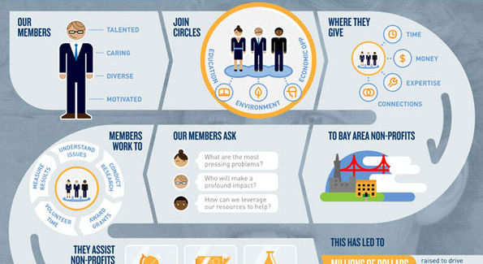

Slide 4
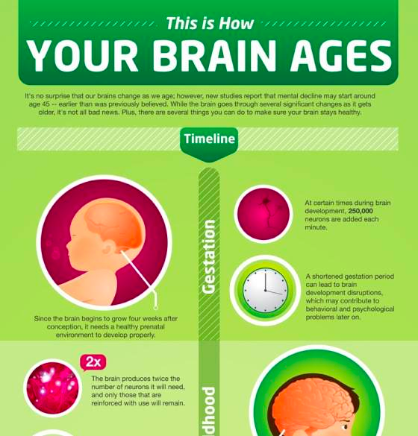

Slide 5
SOURCES
http://www.infographicszone.com/health/how-your-brain-ages-infographic

Slide 6
WHY ARE THEY IMPORTANT?

Slide 7
Why Infographics?
Reading Time
Info Overload
Attention Span
East to understand
Well Organized

Slide 8
HOW TO CREATE EFFECTIVE INFOGRAPHIC?

Slide 9
How to?
1. Goal
2. Audience
3. Core Message
4. Contents
5. Organization

Slide 10
1. What is your goal?
To persuade
To explain
To propose
To request
… others

Slide 11
2. Who is your audience?
Existing knowledge
Job title
Preferences
Education background
… others

Slide 12
3. What is your core message
1
Describe
2
Explain
3
4
Propose
Request

Slide 13
4. What is your content?
Process
Concept
Numerical Data
Classification
Text explanation
Cases
pictures

Slide 14
5. Organization
Key Points
Headings
Sub-headings
Supporting points
Supporting data
Supporting arguments
Examples

Slide 15
Let’s Try!

Slide 16
Work in groups!
Choose a topic of your interest:
How to change a tire
Travel tips to our hometown
Why breakfast is important?
… etc.

Slide 17
Information Design Document: CHANGING A CAR TIRE
NO | CONTENTS | INFOGRAPHICS | REMARKS
1 | Tools needed | Numbered pictures + names of tools | (details)
2. | Location of tools needed | Car Trunk with the tools needed
3. | Jack points | Picture of a car with jack points
4. | Steps (6) | Picture + text explanation

Slide 18
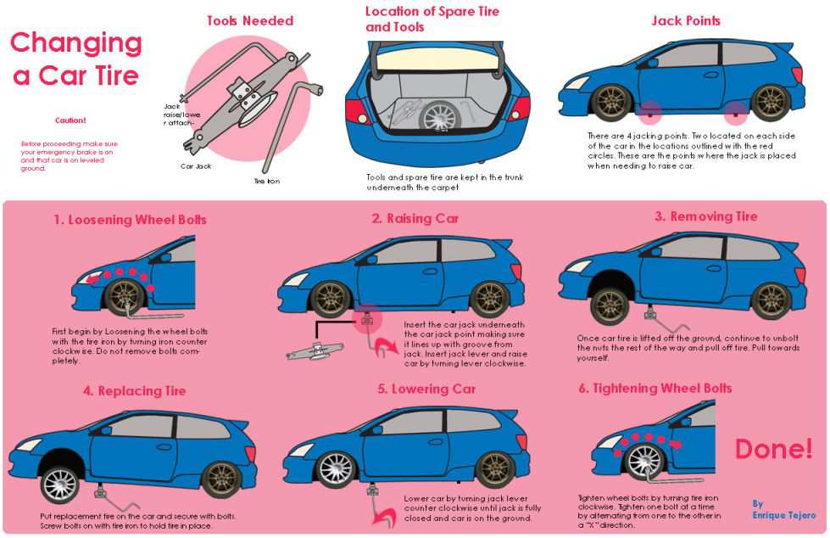

Slide 19
Report Design Document TRAINING REPORT
NO | CONTENTS | INFOGRAPHICS | REMARKS
1 | Training goals | Listing
2 | Audience | Text descriptions + 1 picture
3 | Training schedule | Timetable | Session, date, ….
4 | Attendance | Graphs
5 | Training materials | Listing + text explanation
6 | Lesson outline | Flow chart + text
7 | Issues and solutions
 | Suggestions
8 | Closing | Text

Slide 20
Visual tools
Timeline
Time table
Table
Graphs
Charts
Maps
Pictures
Comparison table

Slide 21
Thank you

