Slide 1
Topic, Main idea, Topic Sentence and SUPPORTING DETAILS
Sandra Sembel

Slide 2
Topic, Main idea, Topic Sentence
REVIEW

Slide 3
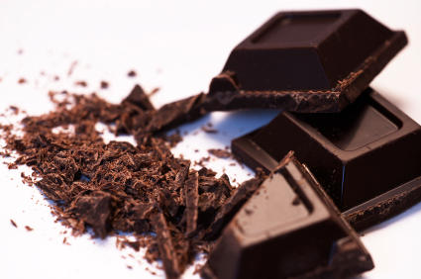
Topic, Main Idea and Topic Sentence
Topic: Chocolate
Main idea : Why I like chocolate
Topic sentence : I like chocolate for three reasons.
Main idea : My favorite chocolate drink
Topic sentence : I need four steps to make my favorite chocolate drink
Main idea : Health benefits of dark chocolate
Topic sentence : Dark Chocolate offers several health benefits

Slide 4
Supporting Details
Brief Explanation

Slide 5
Supporting Details
Topic: Chocolate
Main idea : Why I like chocolate
Topic sentence : I like chocolate for three reasons.
Supporting details:
I like chocolate because of the tastes
I like chocolate because of the packaging
I like chocolate because of various ways of enjoying it

Slide 6
Supporting sentences
What are supporting sentences?
They are sentences that explain the main idea to make the main idea clear.
They form the body of a paragraph.
What do they do?
They give details to develop and support the main idea of the paragraph.
How do I write them?
You can provide supporting facts, opinions, descriptions, examples, causes, reasons, steps, etc.

Slide 7
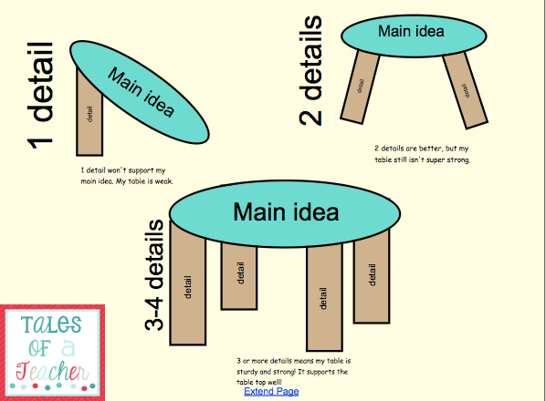

Slide 8
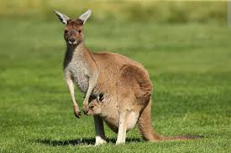
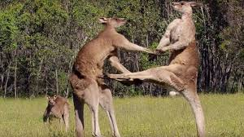

Slide 9
Main Idea 1: Kangaroos protect themselves in many ways.
Which ones are the relevant supporting details? (2)
If a kangaroo senses danger, they will bang their tail on the ground to warn the others.
A new born kangaroo or joey is cute and only the size of your thumb.
Kangaroos rely on their speed and endurance to escape from dangers.
Kangaroos grab their enemies with their front paws and kick with the back legs.
Kangaroos are typical animals that can be largely found in Australia.

Slide 10
Main idea 2: Kangaroos are strange-looking animals.
Supporting details? (2)
Some kangaroos act as guards to protect the mob.
They have small front legs and huge hind legs with great big feet.
Kangaroos are in the Macropodidae family, which also includes tree-kangaroos, wallabies, wallaroos, quokkas and pademelons.
They have a kind of pocket on their stomach.

Slide 11
Finding Relevant Supporting Details

