Slide 1
Making Inferences: Introduction

Slide 2
Picture 1: Who is he?
Do you see a man or a woman?
What is he wearing on his eyes?
What color of clothes is he wearing?
What is he carrying?
So, what do you think his job is? What is he?

Slide 3
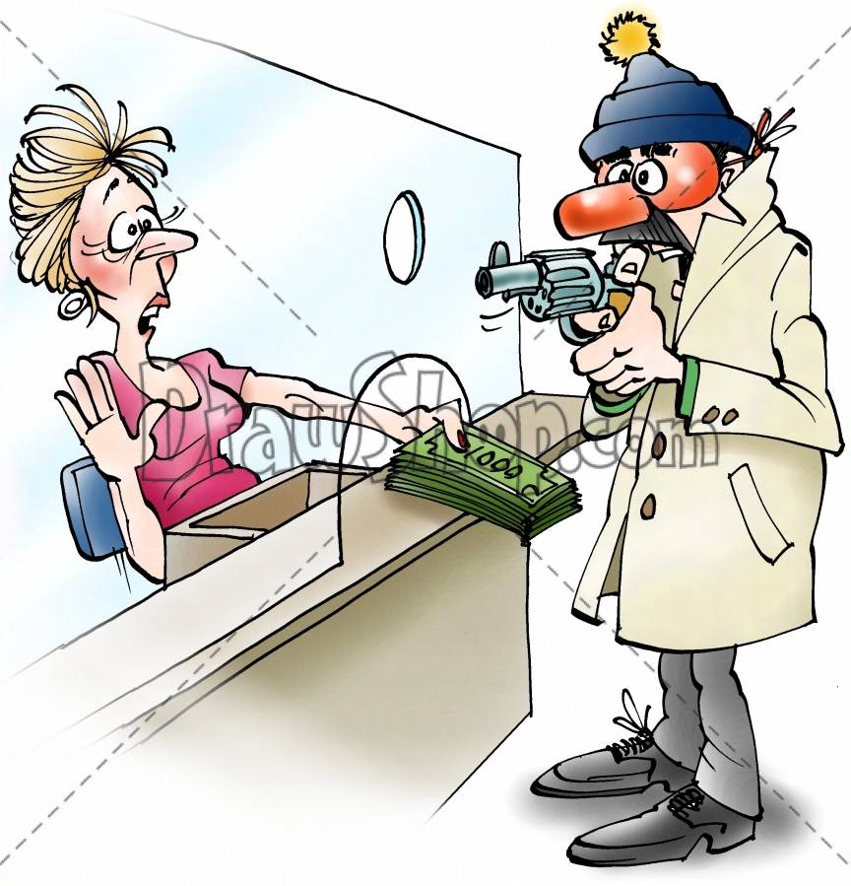
Picture 2: What is happening?
Look at the man.
What is he holding in his hands?
Who is he pointing it at?
Why is he doing it?
Look at the woman.
What is the woman holding in her left hand?
What box is opening in front of her?
Is the box full or empty?
What is the woman doing with her right hand? Is she raising or lowering down her hand?
Look at her face. Do you think she is happy or frightened?
Why is she feeling that way?
So, what’s happening here?

Slide 4
Now, look at the next picture!

Slide 5
Picture 3:
Who is the owner of this suitcase? (A man or a woman?)
Where is the person going?
In the picture, I see …. | I know that …. | So, I think …

Slide 6
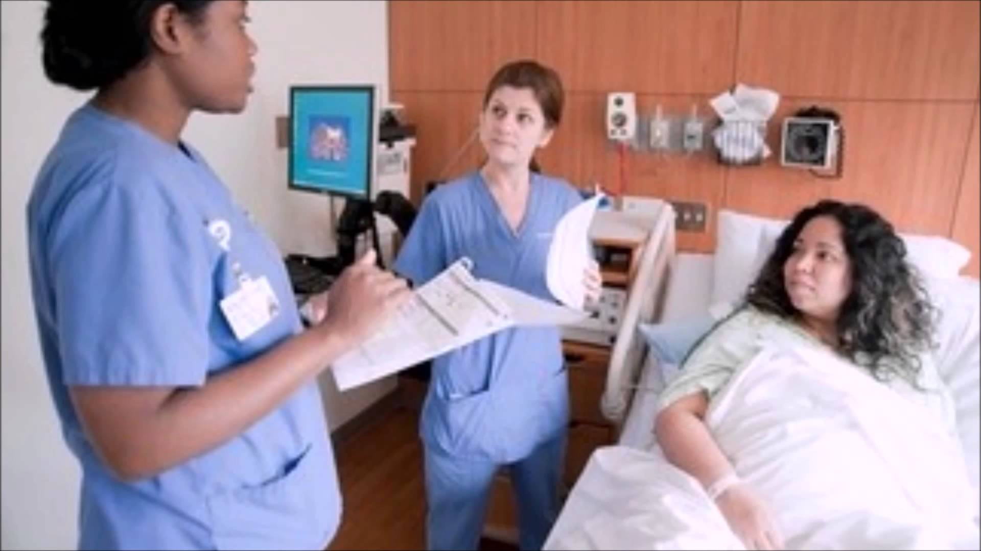
Picture 4: Who are these people? Where are they?
In the picture, I see …. | I know that …. | So, I think …

Slide 7
So, you have just made INFERENCES using the pictures

Slide 8
What is an INFERENCE?
An inference is a CONCLUSION that you make based on FACTS/EVIDENCE that you get, combined with your KNOWLEDGE and EXPERIENCE related to the facts/evidence.
KNOWLEDGE & EXPERIENCE
FACTS/CLUES/EVIDENCE
INFERENCE

Slide 9
How?
FACTS
KNOWLEDGE/
EXPERIENCE
INFERENCE
STEP 1.
Observe the facts/evidence
STEP 2.
Link it to what you know and what you have experienced
STEP 3.
Combine Step 1 and 2, to make an Inference

