Slide 1
Make inferences from pictures
(Choose 3 pictures. Make 2 inferences from each picture)

Slide 2
Picture 1

Slide 3
Picture 2

Slide 4
Picture 3

Slide 5
Picture 4

Slide 6
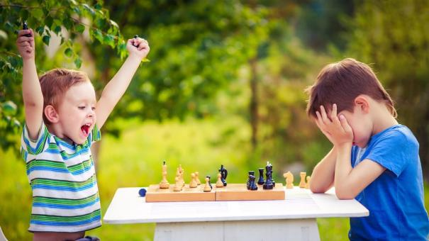
Picture 5

Slide 7
Picture 6

