Slide 1
INSTRUCTIONAL DESIGN Easy and Impactful

Slide 2
Should learning be like this?

Slide 3
Learning is easy, enjoyable and effective

Slide 4
Learning
Instructional Design
Expected Change

Slide 5
"identify the skills, knowledge and the attitude GAPS of a targeted audience and to create, select and suggest learning experiences that close this gap" (Connie Malamed)
Make learning easier and more effective

Slide 6
Instructional Design
Make learning easier and more effective

Slide 7
Learning Objectives
Learner oriented, Action, SMART

Slide 8
King
Keep it Simple and Relevant
Notes:
Language, visuals

Slide 10
Types of information
Concept
Problem-Solution
Cause-Effect
Process
Steps
Process flow
Skills
Negotiation
Telephone
Comparison-contrast

Slide 11
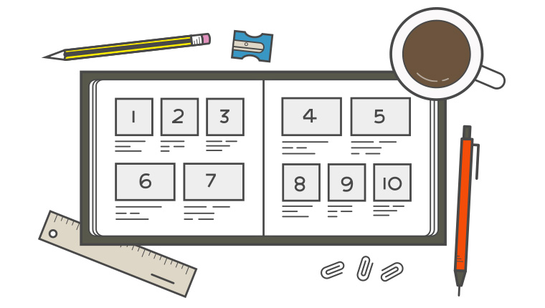
Provide Learning Guides
Questions
????
Quizzes
Audio Visuals
Activities/ interaction
Worksheets
Graphs/charts/tables

Slide 12
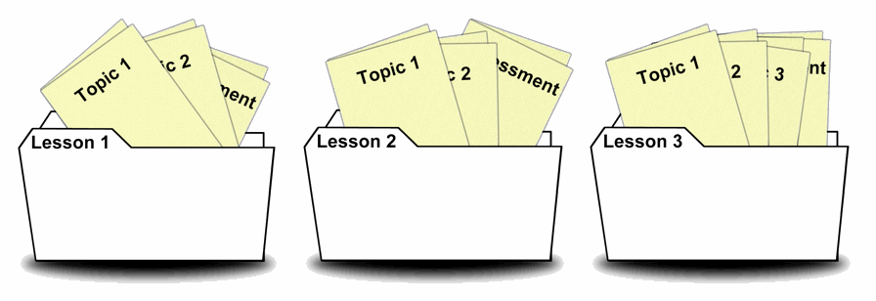
Organization

