Slide 1
Scanning
Brief Explanation

Slide 2
What is Scanning?
Scanning refers to reading a text quickly in order to locate specific pieces of information.

Slide 3
Why Scanning?
Scanning is useful to find specific piece of information quickly (e.g. date, names, numbers) without reading the entire article.

Slide 4
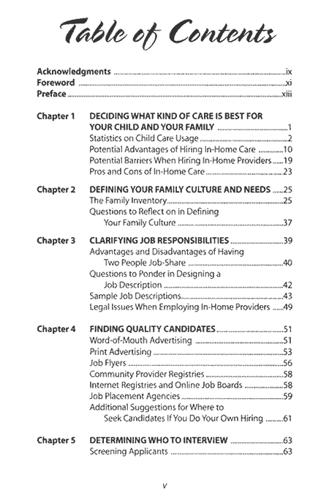
When do we scan?
Table of contents
Time Table
Glossary
TV Guide
Advertisements
Telephone directory
Others?

Slide 5
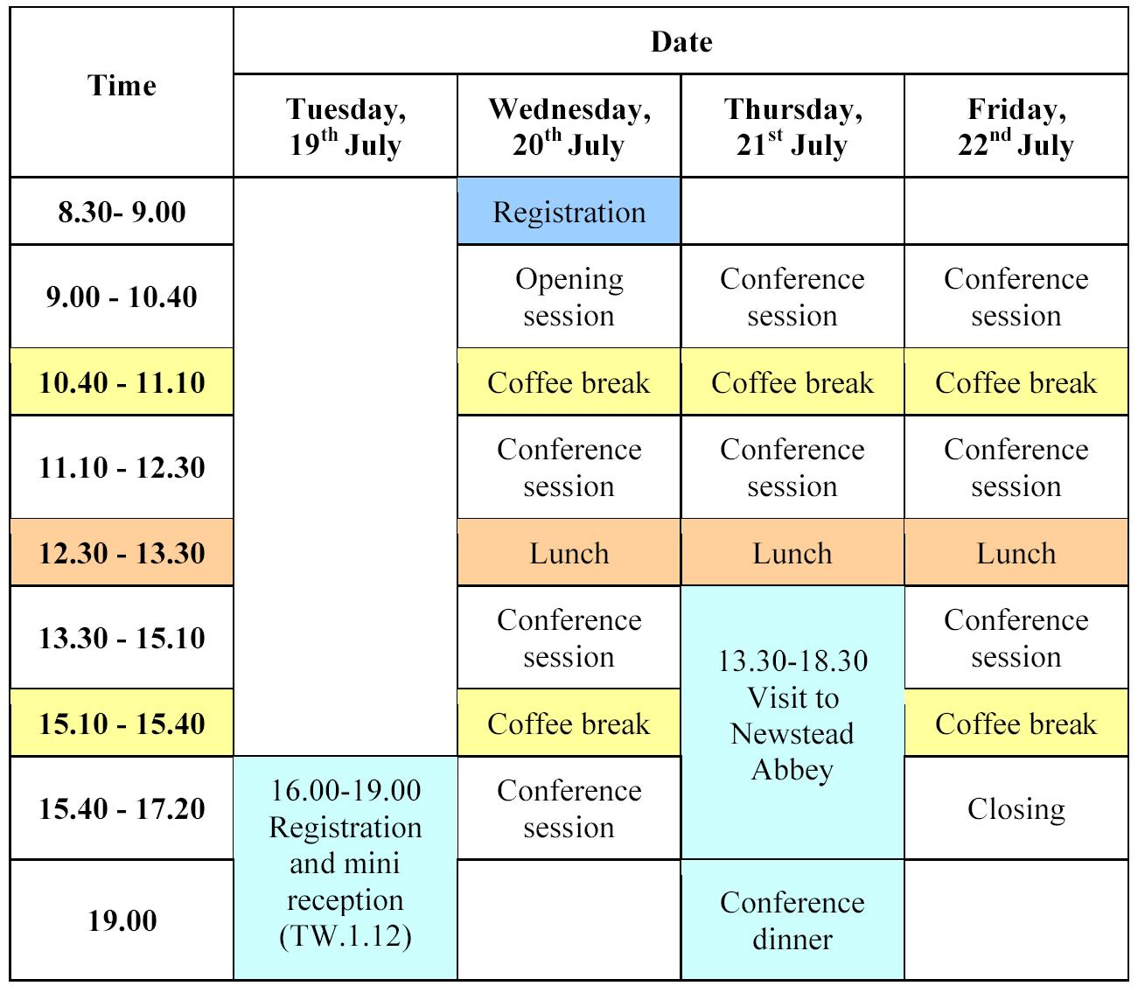
Time table

Slide 6
How to Scan specific information?
Analyze content organization (e.g. page number, alphabetical order, sequence of events)
Keep the ‘key word’ in mind all the time
Read quickly to locate the information containing the key word
Jump around in the text, skip unnecessary parts

Slide 7
Example
Go to your favorite TV station.
Find the program you want to watch.

