Slide 1
EFFECTIVE TEACHING AND LEARNING

Slide 2
Interested or bored?
Smiling or frowning?
Sleeping or active?
Successful teaching and learning
Notes:
Smiling or frowning? Sleeping or active? Interested or bored?

Slide 3
In a Successful Teaching and Learning
 | I See | I Hear
Participants
Facilitator

Slide 4
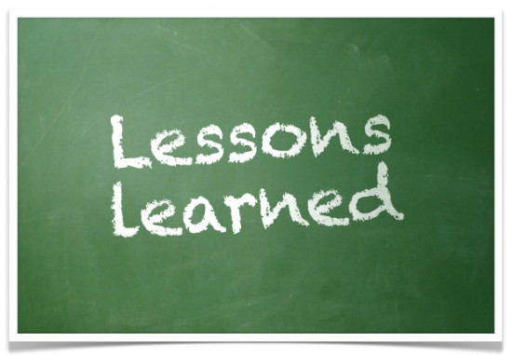
So, what’s the lessons learned?

Slide 5
Relevant to Needs and Interest (Meaningful)

Slide 7
Be Helpful!
Easy to digest ; Provide learning guides

Slide 8
Applicable
Demo
Case Study
Questions
Scenario
Notes:
Real case study, real situations

Slide 9
Be Inspiring
Moving to Action

Slide 10
Summary: Effective teaching and learning!
I |  | H | E | A | R
Inspiring |  | Helpful | Engaging | Applicable | Relevant

