Slide 1
TOEFL iBT Preparation Class

Slide 2
Course descriptions
This is a course that helps students to become familiar with a standardized English test (iBT TOEFL), by exposing them to types of questions usually found in the the test, as well as strategies that can improve the ability to use English in Academic context.
Pre-requisite: This course is recommended only for students who have finished and passed the General English course.

Slide 3
General learning objectives
Students will improve their independent and integrated academic skills in English, while building test-taking strategies and confidence.

Slide 4
Specific learning objectives
In Academic Context

Slide 5
Teaching and learning process
Lecturer
Facilitating learning
Students
Learning ACTIVELY by:
Participating in learning activities (in class and on-line)
Completing assignments (in class and on-line)

Slide 6
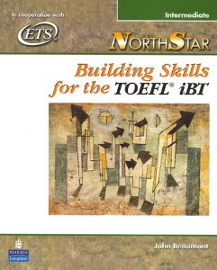
Textbook
NorthStar: Building Skills for the TOEFL(R) iBT: Intermediate, by John Beaumont, Pearson-Longman

Slide 8
Topics
Session | Topics/Tasks
1 | Course Introduction and Class Policy
2 | Skimming and Scanning + Task 1
3 | Making Inferences + Task 2
4 | Using Context Clues + Task 3
5 | Rhetorical/Text/Information Patterns + Task 4
6 | Quiz 1
7 | Simulation Test 1 (Task 5)
8 | MID-TEST

Slide 9
Topics
Session | Topics/Tasks
9 | Paraphrasing + Task 6
10 | Summarizing + Task 7
11 | Comparing and Contrasting + Task 8
12 | Using detailed examples + Task 9
13 | Cohesive devices + Task 10
14 | Quiz 2a: Speaking and Writing
15 | Quiz 2b: Listening and Reading
16 | FINAL TEST

