Slide 1
2. Teaching and Learning activities

Slide 2
2.1. Video conferences (2)
Beginning of the course: Course intro
After mid-test: Review, Feedback and course plan after mid-test

Slide 3
2.2. Diagnostic test
Multiple choice

Slide 4
2.3. Daily assignments (KAT1)
10 Assignments
Independent learning worksheets
Listening, Reading, Speaking, Writing tasks

Slide 5
2.4. Discussion forums (6 SESSIONS)
(2 postings per session)
Post a question, opinion.
Post a reply to a question or opinion (answer, comment or suggestion)

Slide 6
2.5. One-minute PRESENTATIONs
2 Speaking Tasks
Submit outline
Submit scripts
Submit audio file (speaking)
(1 Speaking task before mid-test and 1 speaking task before final test)

Slide 7
Summary 2
2. Teaching and Learning Activities
Video Conferences
2.1. Session 1 and Session 9 (after mid-test)
Diagnostic Test
2.2. Multiple choice
Daily Assignments (KAT 1)
2.3. Ten (10) Assignments
Discussion Forum (KAT 2)
2.4. Six (6) Discussion forums
Presentations (KAT 3)
2.5. Two (2) Speaking tasks

Slide 8
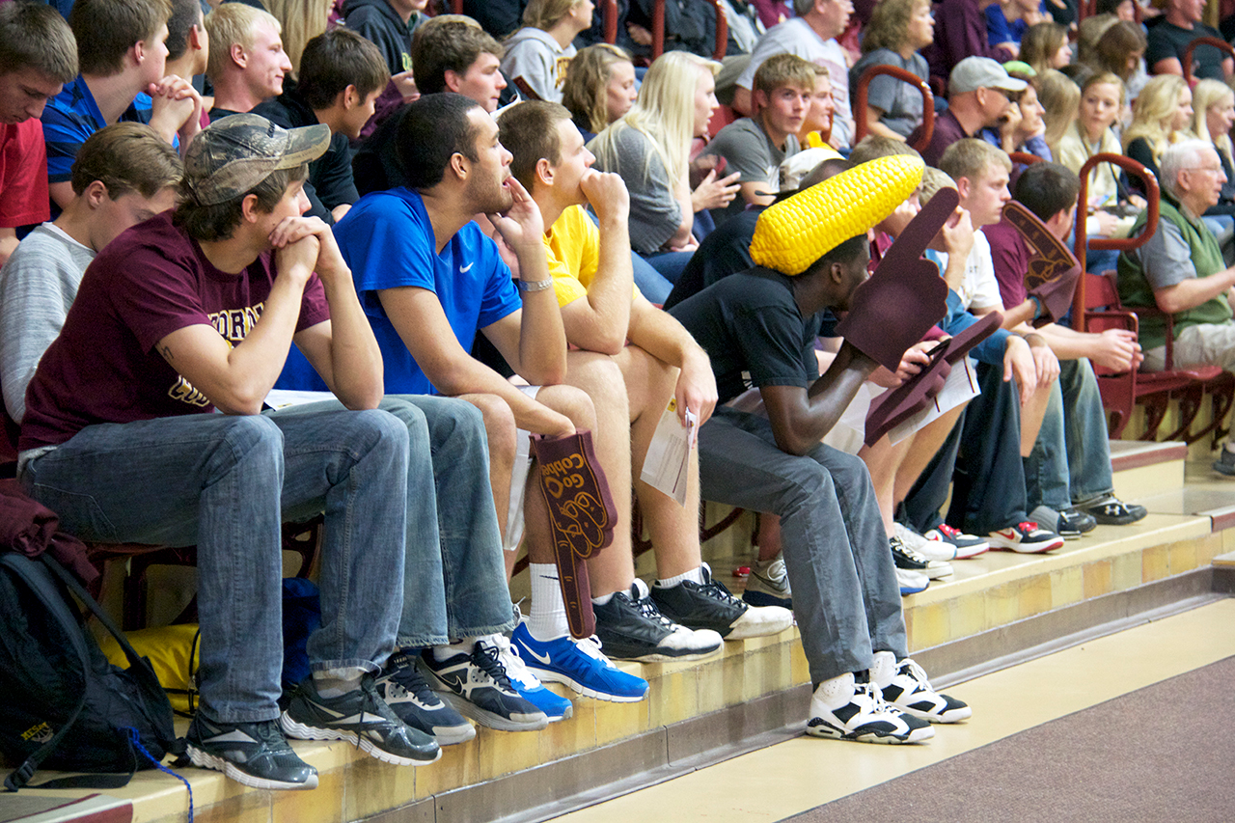
Sports Spectators

Slide 9
Learning is not a spectator sport. – D. Blocher
Message to remember!
If you want to master English, get involved and practise as much as possible.

